Slide 1
OCHA INTERNAL DOCUMENT
Version 19/05/2023
Response Monitoring
Introducing the basic concepts
+ Monitoring the HRP
IMPACT version
David Goetghebuer
(OCHA/APMB/MATS)

Slide 2
VISION:
One integrated monitoring model
REALITY:
  Situation and needs: ”how things are”
  Response capacity: ”who can do”
  Implementation: ”what is done”
  Output results: ”what was delivered”
  Outcome results: ”what has changed”
  Funding: ”who funded who”
----------- Needs Monitoring
3 W
Response
Monitoring
----------- Financial tracking
Notes:
A Vision for Monitoring: one integrated approach to all that should be monitored.
1) CLICK Situation and needs monitoring: Watching things as they are (situation), this includes:
* Situation, context monitoring: monitoring of population movements, weather, economy, politics etc. that affect both needs (directly, in positive or negative) and the delivery and achievements of the response.
* Risk monitoring: anticipate new crisis, or further degradation of a crisis, to support prevention, preparedness and response, 1) exposure to hazards and conflicts 2) vulnerability 3) lack of coping capacity
* Access monitoring: humanitarian actors’ ability to reach populations affected by crisis, as well as an affected population’s ability to access humanitarian assistance and services.
* Needs monitoring: how the needs evolve over time
* Border monitoring: observing the movements at a border
* Protection monitoring: observing the protection incidents happening to the people of concern
2) CLICK Response capacity: the possibilities of action: the actual or planned presence of actors; the intended action; the projects; human resources; material resources; financial resources; information/knowledge resources; administration and procurement systems;
3) CLICK Implementation: Who does What Where; all actions on-going now; are things being done as planned ; (Construction started, staff recruited, …); What are the gaps.
4) CLICK Output results: what was delivered, the direct effect; Examples: a health center was built; a quantity of blankets were distributed
5) CLICK Outcome results: the middle term effect, what has it changed for the people, in relation to the objectives and goals. Examples: All households in the camp have a decent shelter
6) CLICK Funding: how was it all funded, who gave money to who.
Ideally, a monitoring approach should integrate all these aspects. But CLICK we are not there yet.
CLICK - The monitoring of needs often happen as a distinct process
CLICK - The monitoring of the response capacity, Implementation and output results is often called the 3W
CLICK - Monitoring of implementation, output results, and outcome results is called Response Monitoring
CLICK - Monitoring the financial flows is called “financial tracking”
While the integrated approach remains the vision for the future, we will here further discuss the work on Response Monitoring.

Slide 3
PURPOSE OF MONITORING
The purpose of response monitoring is two-fold:
Internal: allow humanitarian actors to know whether they are on track to achieve the planned results, and provide an evidence base for making operational decisions to address shortcomings, fill gaps, bring corrective action and/or adjust the HRP, to improve the humanitarian response, in the short and long term;
External: improve accountability of the humanitarian community, towards people affected by the crisis, local governments, donors and the general public, and allow advocacy towards donors and political decision makers.
Notes:
Let us now see what the purpose of conducting response monitoring is. It has two goals:
1. Internal to humanitarian actors, monitoring should allow actors to know if they are on track to achieve goals. It should provide them with an evidence base for making operational decisions or adjust the HRP to improve the response.
2. External to humanitarian actors, monitoring allows to improve accountability of humanitarian community to those affected by the crisis, to donors, to local government, to the general public, and allow advocacy towards donors and decision makers

Slide 4
THE RESULTS CHAIN /1:
Inputs
Action
Outputs
Outcomes
Impact
EXAMPLE
$40,000
10 staff members
100 household water treatment kits
Distribute kits
100 households received water treatment kits
Increased number of people have access to safe drinking water
Reduced mortality in affected population
Notes:
Starting with the fundamental concepts that will allow monitoring, we have to consider the results chain. CLICK
The results chain, which is something used in many areas, not just humanitarian work, is the sequence that starts with the inputs into an action and ends up with the impact of that action.
CLICK We see the inputs : the means that are injected into the action …
… then the action itself …
… then the output which is the direct effect of the action …
… then the outcomes : the medium-term effects….
… and finally the impact is the long term effect.
An example is given here with the distribution of water treatment kits.
This is fundamental to our approach, because we can monitor any of these segments.

Slide 5
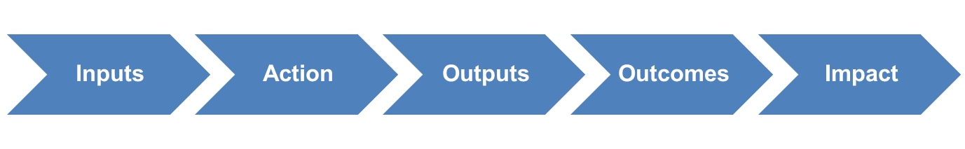
THE RESULTS CHAIN /2
INPUTS (resources) “what did we utilize?”
  the financial, human and material resources that go into the intervention.
ACTION (activities, process, interventions) “what did we do?”
  the work done with the inputs, in order to produce the results.
OUTPUTS “what has the action delivered?”
  the direct effect of the action: the goods or services delivered to the target population.
OUTCOMES “what has it changed for them?”
  the short and middle-term effects for the people targeted.
IMPACT “what has it changed over time?”
  the long-term effect on the people, and on the situation, of the intervention.
Notes:
Let us see more in detail what is the definition of each step:
CLICK The inputs can be presented as “what did we avail”, “what did we inject”
It is the financial means, the human resources, and the material resources that go into the intervention.
CLICK The action, often called activities, or projects, or interventions, is “what did we do”
It is the work done with the inputs, in order to produce the results.
In our example, it was the distribution.
CLICK The outputs can be presented as “what was delivered”, and it is the direct effect of the action.
So if it was a distribution, it is how many items were distributed. If it was a service, it could be “how many medical consultations”
It is something that you can count and which is directly the effect of the action conducted.
CLICK The outcome looks at “what did it change for the people who received it”, so it is the short or middle term effect, for the people affected.
In our example, water treatment kits were distributed, so the outcome will look whether the people have water of better quality for their daily consumption.
CLICK The impact is “what has it changed over time”, it is the longer term effect
In our example, it would be “less water related diseases among the population that benefitted the distribution”
---------------------------------------------------------------
Note on output: Output is the direct effect of an action. In there, depending on what is measured, we can see 2 types:
enablers, process: number of humanitarian staff trained on AAP, install a feed back mechanism
output delivered to beneficiaries: number of blankets distributed.
Note on outcome:
Monitoring the output is necessary, but it does not tell us the end of the story.
For example: the school was built. Fine. But does it function, with children attending classes ? The wells were digged: do people have more water ? The latrines were built: do we see a decrease in the hygiene related diseases ?
The monitoring work cannot limit itself to counting what was done, and what was delivered, without asking itself: did it achieve the intended goal ?
Note on impact:
Impact observes the long term effects of an action. For Humanitarian work, we don’t look at impact, for 2 reasons: 1) Most of the humanitarian action aims at short term effects: save lives, restore dignity, offer protection. 2) to measure things on the long term, we need stability: if the situation is essentially the same from one year to the next, then I can measure what changes my action has brought. By nature, humanitarian action happens in contexts of crisis, that change significantly in time, therefore it is impossible to measure long term effects.

Slide 6
Response monitoring:
Implementation / Output results / Outcome results
THE RESULTS CHAIN /3
Implementation
Results
Inputs
Action
Outputs
Outcomes
Impact
Projects
Clusters
Strategy
Notes:
Remember, our definition of Response Monitoring was looking at 3 parts: Implementation, output results and outcome results.
We can see this in the results chain:
1) CLICK When we follow the inputs, the action, and some outputs (the enablers), we are monitoring the implementation: what is being done
We are looking at the actions that are undertaken, in order to deliver aid.
Examples: build latrines / train community workers / set up a feed back - complain mechanisms / open a medical consultation / conduct protection monitoring / purchase and transport materials / make a focus group discussion / etc…
The 3W is a tool for monitoring implementation.
2) CLICK When we follow other output results (things delivered to beneficiaries), outcome results, and impact, we are monitoring the results (Effects, Achievements, Progress)
We are looking at our actual goal: the aid that was delivered.
Examples: medical consultations delivered / liters of water provided / blankets distributed / improved food consumptions scores / better social acceptance of refugees / etc…
Response monitoring looks at both these dimensions
Just try to not confuse one and the other.
Why monitor at the outcome level ?
Implementation up to output is necessary, but it does not tell us the end of the story. We cannot monitor only the implementation and direct effects, without looking at the actual effects, or outcome.
For example: the school was built. Fine. But does it function, with children attending classes ? The wells were digged: do people have more water ? The latrines were built: do we see a decrease in the hygiene related diseases ?
The monitoring work cannot limit itself to counting what was delivered, without asking itself: did it achieve the intended goal ?
Note: For Humanitarian work, we don’t look at impact
Impact is measured in time, across years. This can be done if we are in a rather stable context, in order to have comparable data from one year to the other. This is rarely the case in humanitarian crisis, so in general we do not use the notion of impact for the monitoring of humanitarian aid.
The results chain also allows us to illustrate the monitoring at 3 levels:
CLICK Project level measures outputs
CLICK Cluster level measures output and outcome
CLICK Strategic level measures outcome

Slide 7
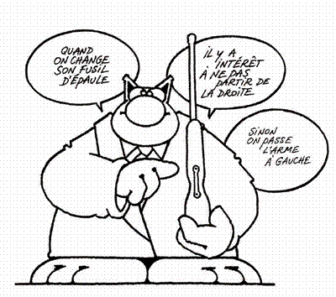
Monitoring what: implementation or results ?
I travelled 216 km to the village where the lion was last seen
I had 2 key informant interviews …
I bought 3 guns and 560 bullets
… and 3 Focus Group Discussions with the community
DID YOU KILL THAT BLOODY LION !!????
Notes:
What does this story tell us ?
That it is not enough to monitor the process, or the steps undertaken, or the efforts, we need to also measure whether the goal itself was attained.

Slide 8
Relationship between planning & monitoring
RESPONSE PLANNING
RESPONSE MONITORING
STRATEGIC PLANNING
Country Strategy
Strategic Objectives
Specific Objectives
Indicators and Targets
STRATEGIC LEVEL MONITORING
Outcome Results
CLUSTER PLANNING
Cluster Response Plans
Cluster Objectives
Cluster Activities
Indicators and Targets
CLUSTER LEVEL MONITORING
Outcome Results
Output Results
PROJECT PLANNING
Organizations’ Projects
Project Objectives
Project Activities
Indicators and Targets
PROJECT LEVEL MONITORING
Output Results
Notes:
The work of monitoring happens at 3 levels, that correspond to the 3 levels of Planning.
CLICK A Humanitarian Response Plan presents the planned action and objectives
CLICK At strategic level: the collective planning determines the strategic objectives and the specific objectives, with indicators and targets
CLICK From there, at cluster level: the cluster determines the cluster objectives and the cluster activities, with indicators and targets
CLICK Then, at project or activity level: each actor determines the project objectives and project activities, with indicators and targets
Now, the response monitoring will be conducted at the same 3 levels:
CLICK
CLICK For each project, the project owner will measure the indicators attached to the project activities and to the project itself. These indicators are mostly output: we count what was delivered.
CLICK At cluster level, the cluster will measure the indicators attached to the cluster objectives and activities. These may be output indicators, calculated by aggregating the values from various projects. Example: total number of children vaccinated, across 5 projects. The cluster may also have outcome indicators, measured directly at the level of the cluster. Example: access to school, or the decrease of a disease incidence.
CLICK At Strategic level, the humanitarian community will have to measure the indicators attached to strategic objectives and specific objectives. These indicators are outcome, qualitatives, they measure progress towards strategic objectives, as they result from the action conducted by all participating actors.

Slide 9
BASIC USE OF INDICATORS /1:
Indicator label target result
need
Number of household kits distributed
20,000
5,000
4,800
Indicator label target result
baseline
% coverage of measles vaccination
50%
90%
95%
Notes:
To monitor all parts of the results chain, we will use indicators.
In a simplified way, let us see the basic notions to handle indicators:
The indicator is described in a label, that has to tell precisely what will be quantified.
We then set out a target figure, and later we will measure an intermediate or final result
BUT: in this example, we set a target of 5.000, but what was the overal need ? Maybe it was 20.000, and this is an interesting information also. We should provide that information, and we call it the need.
For indicators measuring a quantity that is delivered, it is useful to mention the « need » figure: the ideal target if all was possible.
NOW, let us see another type of indicator:
Again, we then set out a target figure, and later we will measure an intermediate or final result
BUT: in this example, we set a target of 90%, but what was the value before we started vaccinating ? It was not zero, maybe it was 50%, and this is an interesting information also. We should provide that information, and call it « the baseline ».
For indicators measuring an evolving situation, it is useful to mention the « baseline » figure: the value before the action started.

Slide 10
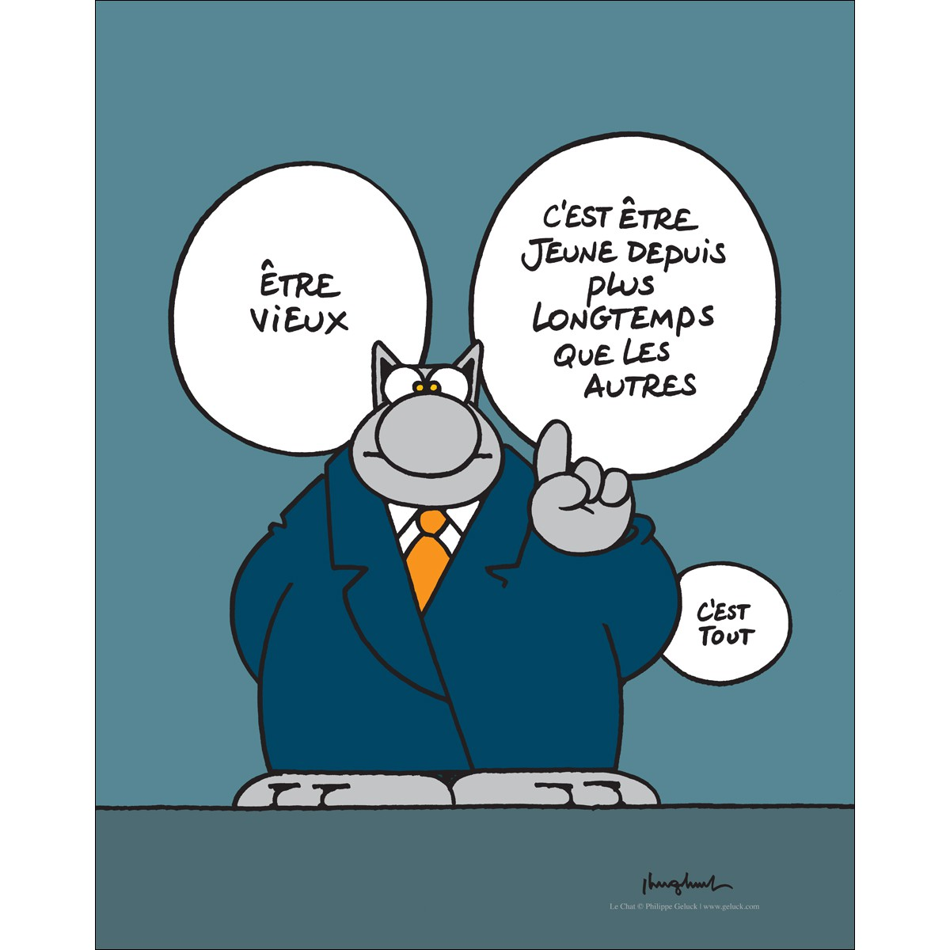
Need – Target – Result:
Performance Monitoring
I had
Last year 1,790 people asked me for help
planned to help 1, and so I did.
So my performance
is …
100%
Notes:
What does this story tell us ?
That if we give high importance to the %age result / target, it might have the perverse effect of encouraging people to set low targetsn, in order to have a high %age.

Slide 11
Different types of quantitative indicators:
More than just # and % !!
BASIC USE OF INDICATORS /2:
Type Example target result
# - items Number of household kits distributed 5,000 4,500
# - people People receiving food 50,000 48,000
# - Likert scale Degree of satisfaction …… >3 4
# - rate Number of inhabitants / health center 10,000 12,000
% - percentage Coverage of measles vaccination 90% 85%
% composite Degree of compliance to … 100% 85%
Yes-No New law on refugees is passed yes yes
Welcome to the Kiosk on indicators!
Notes:
Often, we play with 2 types of indicators: the hard count, and the %
But in fact, there are more than 2 types of indicators:
- There are several types of #
- and several types of %
- and other types of indicators.
For each type, treatment may differ: how to measure, how to analyse, how to aggregate, or average
Let us see here the main indicators types that you might work with:
CLICK # - items Number of household kits distributed
We like that one. One figure to count, easy to use, it works well for outputs, no need for a baseline
CLICK # - count People Number of people receiving food
It is not the same. The aggregation methods will be different
CLICK # - Likert scale degree of satisfaction ……
It is a number, but it is not a count, it comes against a graduated scale (for example 1 to 5)
The value recorded has gradual meaning. Examples : food consumption scores (scale to 5) / balanced score cards on CRI / IPC phases / degree of coverage of the essential needs
CLICK # - rate Number of inhabitants / health center
It is a number, but it requires to count 2 things …. A numerator and denominator. These 2 are of a different nature: inhabitants and health centers
CLICK % - percentage coverage of measles vaccination
Again one number, requiring a numerator and a denominator, and this time they are of the SAME nature. In this example, children and children
CLICK % - composite Degree of compliance to …
It presents like a percentage, but it is not calculated with a numerator and denominator. It is based on several parameters, each one having a certain weight, the total weight being 100. You score against each parameter, and sum the values to make the indicator measure.
CLICK Yes-No New law on refugees is passed
Simple to use indicator, where we measure of a certain thing is done or not.

Slide 12
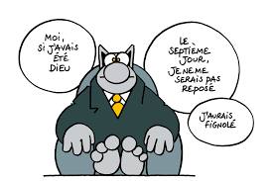
Composite indicator
Get dressed : 100%
Eat : 100%
Brush my teeth : 100%
Save the planet : 0%
All in all, my achievement today is 75%
Not bad !
Notes:
What does this story tell us ?
That it is easy to cheat with a composite indicator, by giving important weight to the easy bits

Slide 13
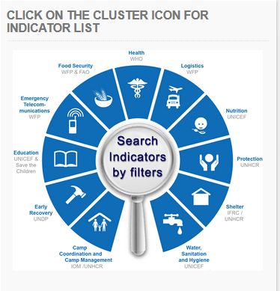
Indicators + targets should be SMART
BASIC USE OF INDICATORS /3:
Specific
Measurable
Achievable
Relevant
Humanitarian Indicators Registry
ir.hpc.tools
Time bound
Notes:
SMART
You often hear that an indicator has to be smart. Actually, the indicator alone cannot be considered smart or not. It is the indicator + target that we will observe:
CLICK Specific
Tells precisely what will be measured. While the objective/outcome/result itself can be broad, the indicator should be narrow.
Example: An indicator “are people happy” would not be specific enough.
CLICK Measurable
Can be counted, observed. An indicator may be measurable in an ideal world – e.g. with enough time and resources. But not in humanitarian contexts.
Example: “How many Covid infection over last week in Germany” cannot be measured. But we can count “how many positive testing”
CLICK Achievable
The target attached to the indicator should be realistically achievable, with the resources and time allocated for the action.
Example: “% of HIV positive in the population”, target zero is not achievable.
CLICK Relevant
The indicator measured must actually inform about the action / outcome / objective it is attached to.
Example: We distribute water in the camp, and we measure how many children go to school, would not be relevant.
CLICK Time-bound
Must be attached to a time frame. The indicator should state what is the time period that corresponds to the target.
Example: “number of blankets distributed”: over last month ? Since the start of the project ? Since first of January ? Since the start of the crisis ?
CLICK The Humanitarian Indicator Registry should help

Slide 14
Aggregation
BASIC USE OF INDICATORS /4:
Aggregation / Disaggregation
Several values
One value
Disaggregation
Values per…
  - location
  - project
  - time period
  - population group
  - household
  - etc.
Several methods:
MAX
SUM
LAST
AVG
%SUM
Notes:
In many different cases, we will face the following situation:
we have an indicator, and a series of measure for that indicator, and we need to get one value out of the many values.
CLICK For example, I might have several values…
- from different locations
- or from different projects
- or for different time periods
- or for different population groups
- or per households
But for the report, I have space to only report on one value.
CLICK Going from the many values to determine the one value is called “aggregation”
CLICK Going from the one value to look at the many values is called “disaggregation”
The many values can be called “granular values”, or disaggregated values.
The one value may be called “display value”, or “aggregated value”
CLICK: There are several methods to aggregate several values into one value. The main methods you will have to use are:
MAX / SUM / LAST / AVERAGE / SUM%
Which method should be used for which indicator ?
There is no simple rule like “for these indicators, use this method”.
Depending on the indicator, and the data that was collected, there are MANY different scenarios for data aggregation.
So, in the Kiosk on Indicators, we will see a series of situation, where we need to aggregate several values into one value. We will see when to use which method.
And once you understand the logic, when you will have to aggregate data, you will think by yourself, and determine what is the appropriate aggregation method.

Slide 15
Disaggregation of population indicators
BASIC USE OF INDICATORS /5:
<18 18–60 >60
35
51
46
132
=
72
18 | 26 | 28
17 | 25 | 18
Male
Fem.
60
Population indicators can be disaggregated by:
2
Sex: M / F
X 3
Age: children / adults / elderly
X 4
Status: Refugees / IDPs / Hosts / Returnees / …
X 2
Disability: yes / no
= 48 values !!!!
Notes:
Let us see what disaggregation apply to population indicators:
One measure may be disaggregated by
CLICK Sex : male / female
CLICK Age : 2 or 3 categories
CLICK if we combine bith, we need 6 values for one value
CLICK Population status: Refugees, IDP’s, hosts communities, returnees, migrants, etc.
CLICK Disability
But we have a problem here: this makes 2 (sex) X 3 (Age) X 4 (status) X 2 (disability) = 48 values to collect for one measure !!!

Slide 16
Disaggregation: too much is too much
BASIC USE OF INDICATORS /6:
Jan
Feb
Mar
Apr
May
Jun
Jul
…
288
values
12
6
48
X 2
Sex: M / F
X 3
Age: children / adults / elderly
X 2
Disability: yes / no
X 4
4 status
3456 values collected for one indicator !!!
X 6
6 locations
X 12
months
Notes:
Let us now see the limits of data disaggregation.
Imagine we have one population indicator measured every month, with disaggregation along all parameters. It would look like this:
CLICK: when I measure the indicator, I want to have a breakdown per sex and age. This means I need to collect 6 values
CLICK: but I also want to disaggregate along disability. This doubles the number of values, which is now 12
CLICK: and I want to disaggregate along 4 different people status: this means I will collect 48 values
CLICK: the action happens in 6 locations, so I now need to collect 288 values
CLICK: and this was for the first month, so I have to do the same every month
So, for one indicator, I would nee to collect 3.456 values.
And we can count 2 indicators per activity, 3 activities per objective, and 30 objectives per plan.
This is of course impossible.
Conclusion: we have to be realistic when committing to disaggregate indicators. If we want to disaggregate all population indicators along all criteria, it rapidly becomes impossible.
We should commit to disaggregate the data only if:
1) It is relevant: are we really going to use these data ? Not just for a good looking report ?
2) It is feasible: we actually have the capacity to measure the granular data. It is pointless to measure only the total value, and from that one, invent some fake disaggregation

Slide 17
Steps of the monitoring work
Monitoring
Based on Monitoring
Design
Collect
Analyse
Act
Report
Evaluate
Define the monitoring work /
write a monitoring plan
Collect the data, curate, aggregate, store
Get the findings out of the data
Turn findings into action: decisions and recommend-ations
Share findings and decisions to various audiences, through various channels
Answer specific questions
Notes:
Reminder: as explained in the recorded ppt presentation, the response monitoring work is made of 3 steps, and feeds into 3 other steps.
CLICK: Design : preparing the monitoring work that will be done along the year.
Thinking of what needs to be monitored, what resources we have, setting the indicators and targets, defining the different information sharing channels that will be used, and presenting it all in the monitoring plan. At planning stage, before the work starts.
CLICK: Collect: Data collection and management. Data collection, validation, treatment, aggregation, and storage. Continuous process, along the implementation.
CLICK: Analysis: bring together all data, and analyse it to get the story behind the data, the findings. At given times
CLICK These are the 3 steps that actually make monitoring.
CLICK The following 3 are “actions that come after Monitoring, that require the monitoring work, but are not exactly part of the monitoring work”.
CLICK: Act: what we make out of the findings: decisions and recommendations, to improve the response. At given moments.
CLICK: Reporting and information sharing. different channels, online and pdf, to feed the data and findings to different audiences. At given moments (some parts are real-time).
CLICK: Evaluation. Monitoring feeds into Evaluation, which is a different things. At given moments

Slide 18
Designing the monitoring work
Design
Collect
Analyse
Act
Report
Evaluate
The design includes:
  1) Identify one HAO and one IMO, working together on Monitoring
  2) Analyze the ask (or demand) for monitoring and the capacity
  3) Make a Monitoring Framework: Objectives, indicators and targets; How they will be measured
  4) Define how and when analysis will be conducted;
  5) Define the information sharing channels, with a timeline
  → Present all that in a monitoring plan.
Bite off as much as you can chew!
Notes:
To prepare the monitoring work, at the beginning of the year, you should:
CLICK name the 2 OCHA staff who will coordinate this work
CLICK identify the ask (or demand, or need, or expectation) for monitoring, and the capacity for it. Determine what you need to know and why you need to know it. The monitoring plan has to be demand-driven. Considering our two-fold purpose, we will have internal demands, things we need to know to do better, and external demands, things we need to report on to be accountable.
CLICK make the monitoring framework: gathering all indicators that were set at the strategic, specific, and cluster level, and defining how and when data will be collected
CLICK Define how and when analysis will be conducted
CLICK Define the information sharing channels, with a timeline announcing when will each report be available
CLICK Present all that in a monitoring plan. (explained next slide)
CLICK-Bite off as much as you can chew
It is not useful to list monitoring intentions that will not be achieved.
The monitoring plan should present what will be monitored with the available resources. It may also indicate that more can be done with additional resources.

Slide 19
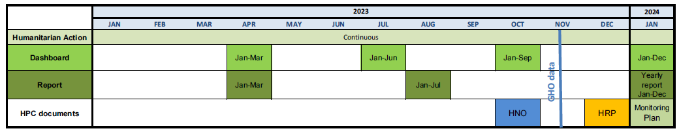
Design
Collect
Analyse
Act
Report
Evaluate
The monitoring plan is the description of how the monitoring work will be organized along the year. It is made of:
the monitoring framework: all objectives and indicators
at strategic level
and cluster level
2) a narrative presentation of the monitoring work; and
3) the timeline of the monitoring and reporting work
Notes:
As a result of the design work, a country will produce a monitoring plan: a document that presents how the monitoring work will be organised along the year.
It is essential to have a plan agreed at ICCG and if possible at HCT level, in order to then implement it during the year.
The Monitoring Plan is made of 3 elements:
CLICK 1) the monitoring framework, that gathers all objectives, indicators and targets, at strategic and cluster level, with all parameters telling when and how they will be measured,
CLICK 2) a narrative that explains how things are organised, the responsibilities, the methods used, and the possible challenges, and
CLICK 3) a timeline showing what reporting document will be released at what moment.
In fact, you may consider that this information is for a part in the HRP. However, it is useful to conduct the discussions at Intercluster level, and produce this more detailed document, in order to ensure that everyone knows and agrees on the commitments, and everyone knows its own expected contributions.
------------------------------------------
In the live presentation:
1) You may want to present the Monitoring Plan to the HCT, in order to manage expectations, and possibly underline that more could be done if more resources were available.
2) The Monitoring Plan will be as heavy as the Country Coordination mechanisms will decide.
Nothing is imposed from HQ except one thing: people reached yearly figure
All the rest is decided in the country:
- The content: objectives, indicators and targets
- the reports that will be produced
Therefore, there is no point in saying “the monitoring obligations are too heavy”.

Slide 20
The monitoring framework tells for each indicator:
Label
  Definition of the indicator, including its unit
Need
  For quantified deliveries
Baseline
  For outcome indicators
Target
  Intended value after action
Disaggregation
  Sex, Age, Status, Location, …
Source
  Hum. Actor, Government, report, …
Methodology
  How data will be collected
Frequency
  How often the indicator will be measured
Responsibilities
  Who will collect the data/ Who will validate the data
Data storage
  Where the data is stored for analysis and use
Notes:
The monitoring framework, the first part of our monitoring plan, is the gathering of all indicators, and for each indicator, it tells all the parameters that determine how the indicator will be used.
CLICK * The label of the indicator, telling what is measured
CLICK * The need figure, for those indicators that require it
CLICK * The baseline, for those indicators that require a baseline
CLICK * The target that is set, that is the intended final value of the indicator
CLICK * The disaggregation that will be applied on the indicator
CLICK * The data source: the person, entity, report, or device that will provide the data
CLICK * The methodology used for collecting the indicator measure
CLICK * The frequency of data collection: each indicator may have its own frequency of measuring: monthly, quarterly, yearly, …
CLICK * The responsibilities: who will do what in the process of data collection, validation and storage
CLICK * The data storage: where the collected data will be stored for analysis, and for use under different forms of information sharing
All of this, for all indicators make the monitoring framework

Slide 21
Data collection
Collect
Design
Analyse
Act
Report
Evaluate
Data has many forms…
Quantitative indicators (how many, to what extent), qualitative measures (how good), narrative reports (what happened), maps, graphs, photographs, videos, …
… and comes from many sources via many methods:
Implementer self-report, Third Party Monitoring, Direct Observation, Secondary Data Review, Remote Sensing, Internet of things, Household Surveys, Focus Group Discussions, Key Informant Interviews, Feed Back mechanisms, …
Notes:
We come to the second step of our little sequence: data collection.
CLICK Data collection is not just measuring quantitative indicators.
There are all sorts of data collected in different ways: indicators quantitative measures (of course) but also qualitative narrative reports, maps, graphs, photographs, and videos
All these make monitoring data.
CLICK They may also come from all kinds of sources:
typically the implementer of an action self-reports, but we can also use third -party monitoring, direct observation, secondary data review, remote sensing (e.g. satellite images), internet of things (an interconnected system that provides data without human intervention), household surveys, focus group discussions, key informant interviews, feedback mechanisms, etc.
Welcome to the wonderful world of Information Management
Monitoring is always a collaboration between Humanitarian Affaires Officers, and Information Management Officers.
-----------------------------------------------------
For the live session with IMOs:
Data collection for monitoring is not different than data collection for situation and needs. It relies on the same sources and methods.

Slide 22

Data treatment
How to count all the stars … easy actually …
Just count half of them …
and multiply by 2
Notes:
No question on this slide, it is just a joke about data treatment

Slide 23
Data validation
Every year, 2.500.000
Either we place barriers along the river
(two million five hundred
thousand) people drowned in the Seine river.
So, two things:
Or...
I check my information.
Notes:
What does this story tell us ?
A data may be reported or in the system, and still it can be wrong !
It is necessary to check / curate / validate the data.

Slide 24
Analysis
Analyse
Design
Collect
Act
Report
Evaluate
?
Indicator target result
Number of blankets distributed
100,000
50,000
Figures alone don’t tell the story.
Raw data + Analysis = Information
Notes:
Moving now to the step “Analysis”
Monitoring is sometimes wrongly perceived as just “measuring”: I count the number of something, I place it against the original target, and I am done with my monitoring work.
Well, not really: if monitoring stopped at reporting quantitative figures, we would still be unable to understand what exactly is going on.
Let us take an example:
CLICK 50,000 blankets were distributed against a target of 100,000.
CLICK Is this a failure or a great achievement ? We cannot tell, without knowing the circumstances. Has the need decreased, did another organization make a distribution; maybe half the blankets were spoiled by water; or the road was blocked because of the rain, …
There is no way that the simple output figure tells us about the success of our intervention.
We can summarize that with a slogan:
CLICK Figures alone don’t make a story
Therefore it requires analysis. Let us have another slogan:
CLICK Raw data + Analysis = Information, the evidence that supports decision making.
Analysis is not an option, it is an integral part of the monitoring work.
How do we conduct analysis
There are many different ways, but all can be summarized like this: “Gather all available monitoring data and other relevant data and information (needs, weather, capacity, politics, …) and inject it in some human brains (an expert, or a group of people like the Intercluster Coordination Group), to get the story, the findings out of the available data.”
-----------------------------------------------------------------------------------
Monitoring without subsequent analysis serves little purpose and wastes resources: without contextualisation or sense-making, data on its own is of little use to decision-makers and may in fact lead to the wrong conclusions being drawn.
Analysis without monitoring (and thus based purely on data and information that happens to be available), means we focus on the questions that we can answer, and not the questions that we should answer, reducing the scope and usefulness of that analysis.

Slide 25
The attribution problem
Action
Output
Direct effect
Outcome
Mid-term effect
Impact
Long-term effect
Notes:
As we analyse the monitoring data, we will encounter a typical problem:
Let us remember the results chain, that was suggesting that action brings results at 3 levels: output, outcome, impact.
It is actually not that simple in real life:
CLICK CLICK… whatever change we measure at the outcome level, it might be the effect of our action, but also of other facts of life
And the same happens at impact level: there are many other causes that may have influenced the change at the Impact level.
Therefore, when we see a situation improving, we have to ask ourselves « how much is this improvement actually due to our action ? »
This question is typically called CLICK « the attribution problem ».
The analysis has to look at that, and try to determine how much the improvement of the situation can be attributed to the actions that we have conducted.
This question is also often part of an evaluation

Slide 26
Act: decisions and recommendations
Act
Design
Collect
Analyse
Report
Evaluate
A) Decide and act
Example: the camp management committee decides to prioritise the water distribution over all activities.
B) Make a recommendation
Example: The Inter-Cluster Coordination Group makes a recommendation to the HCT: to ask the government to improve humanitarian access to the population in a certain region.
Notes:
We come to the 4th step of our sequence: Acting based on the Monitoring findings
We are not anymore in the monitoring work, but we look at “those things that are made possible thanks to monitoring”
Thanks to the data collection and analysis, we have information, findings. These should be used to make evidence-based decision-making meant to improve the response.
Decisions can be about strategic orientations, priorities, resource allocation, advocacy efforts, …
This can take 2 forms:
CLICK If those people that conducted the analysis have the authority to make a decision on how to improve things.
They can decide and implement the corrective action.
Example: the camp management committee decides to prioritise the water distribution over all activities.
CLICK If the people who have conducted the analysis do not have the authority to make a decision.
→ They will make a recommendation for corrective action and present it to the decision makers.
Example: The Intercluster Coordination Group makes a recommendation to the HCT, to ask the government to improve humanitarian access to the population in a certain region.
These are the 2 ways where action may be determined based on the findings of the monitoring work.
--------------------------------------------------------------------
For the live sessions:
Monitoring and Analysis without subsequent decision-making would serve little purpose;
Conversely, decision-making without monitoring and analysis might lead to wrong decisions, possibly reducing the efficiency of response;

Slide 27
Reporting / Information sharing
Report
Design
Collect
Analyse
Act
Evaluate
Information sharing can take many forms:
  - Reports, narrative documents, at given moments, like the PMR;
  - Infographic overviews, like the Humanitarian Dashboard;
  - Websites, ‘real-time’ information, like Humanitarian Action;
  - Public posters informing PoC in a camp;
  - Radio and TV broadcasts, etc.
It targets different audiences:
  - The Humanitarian Community;
  - The People of Concern;
  - The Government;
  - Donors;
  - General public, the media, etc.
Collect once, report many times
Notes:
Coming to step 5: Reporting
Reporting is about making the monitoring data, information, and decisions made on them, available to people interested. Actually, this may happen through reports, but also under other forms, so we should rather speak of Information Sharing
CLICK Information sharing can take many forms…
- Reports, narrative documents, at given moments, like the PMR;
- Infographic overviews, like the Humanitarian Dashboard;
- Websites, ‘real-time’ information, like Humanitarian Action;
- Public posters informing PoC in a camp;
- Radio and TV broadcasts, etc.
CLICK It will target different audiences …
- The Humanitarian Community;
- The People of Concern;
- The Government;
- Donors;
- General public, the media, etc.
As part of the monitoring preparation, you need to define what will be reported when, to whom, under what form. Remember, this was the 3rd part of the Monitoring Plan.
The Humanitarian Affairs Officer and the Information Management Officer will work together to organise this reporting, or information sharing, scheme through many channels.
As you prepare that, here is another slogan for you:
CLICK “Collect Once, report many times”

Slide 28
Information sharing in documents
Notes:
The first form of information sharing: reports, static documents
We see here the variety of templates that OCHA has produced.
CLICK Humanitarian Update
CLICK Humanitarian Snapshot
CLICK Situation Report
CLICK Periodic Monitoring Report
CLICK Humanitarian Bulletin
CLICK 3W
CLICK Humanitarian Dashboard
CLICK Mid-Year Review
CLICK End of Year Report
For all these reports, support materials, templates and guidances, are available on the IM toolbox
For external reporting on the collective response, there is not mandatory template nor frequency. So it is up to each country to agree, at HCT level, on what products should be produced, for what audience, at what frequency.

Slide 29
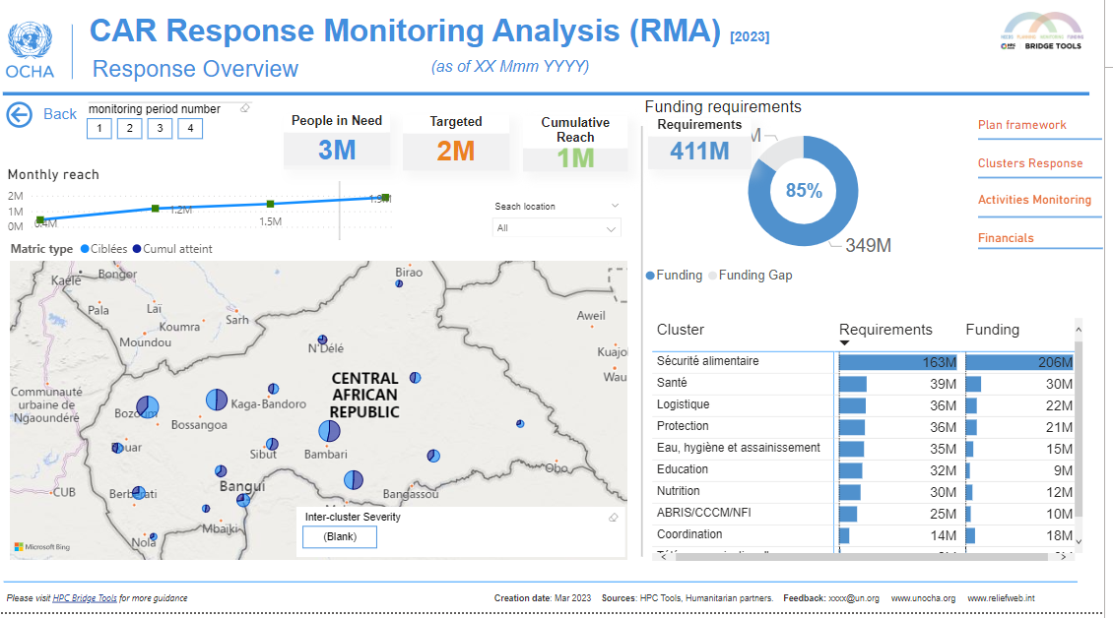
Information sharing online:
WWW.HUMANITARIANACTION.INFO
Notes:
More and more countries go for dynamic information sharing online:
The main channel for this is Humanitarian Action
This site presents all the collective response plans, coordinated by OCHA (HRP, FA) or by UNHCR or IOM (Regional Response Plans)
It is meant for all audiences
It gives an overview for each country, of the situation, the response plan, financial requirements and funding updates, and the results along the year.
What are the advantages of online reporting ?
- I can share this monitoring data without waiting for the other bits
- We are closer to real time.

Slide 30
Real Time Data
YOU ARE HERE
news travels fast…
Notes:
No question on this slide, it is just a joke about real-time data

Slide 31
Report
Design
Collect
Analyse
Act
Evaluate
Timeline with report products
Collect
Analyse
Notes:
As we will report through different channels at different moments for different audiences, it is good to make a timeline that shows how this will happen along the year.
As we have seen, such a timeline is one of the components of the Monitoring Plan.
In this example, we see that the country will share information online in a continuous manner on Humanitarian Action, plus produce a dashboard every quarter, 2 progress reports during the year, and one end of year report.
Nothing is mandatory here, it is the country who decides what information sharing channels will be used, and prepares its own timeline.
CLICK- And this allows to tell the steps ahead of the report: collection and analysis
It is essential to make it clear to all what product is expected when.
it is the promess to the audiences, all those who will need these reports
And it is a commitment from all those who will have to participate to making these reports. Once the intention is agreed by all, OCHA can turn to the cluster and say “hey, remember to provide me with the data for the report by this date”

Slide 32
Good and bad news
X
All perfect. Well done. Success. Just fine. 100%. No issues. We are the champions. All targets met.
Not bad / excellent here / Some problems there / one serious failure / 67% / identified issues are … / corrective action implemented / …
Notes:
Suppose the monitoring work detects a number of problematic issues: delays, target not achieved, complaints, …
What should we do with it ?
CLICK We may think “Let us not show that”.
The monitoring information should not reveal problems and errors to any external audience, as it would damage the image of the humanitarian community, possibly diminishing future financial contributions.. Let us present only good news, and hide the negative aspects. Or even let us collect only good news, and make them good when they are not.
CLICK: this is not a good option
CLICK We should take it differently: ”Let us not close our eyes”
- Response monitoring is not a public relations exercise. Its first purpose is internal, in to permit corrective action. If we don’t recognize the problems, how could we solve them ? Let us build a monitoring system that provides the most objective information, as good or bad as it is. Monitoring is like taking a picture.
- We will then see what parts of it should be presented externally and how. And doing so, we should have no fear to recognize areas that require improvement. Being transparent increases credibility for all reports produced by the humanitarian community.

Slide 33
HOW MANY ARE THEY?
Total Population
Situation and Needs Assessment,
HNO, MIRA
Affected
In need
(in need) HNO / MIRA / SitAn
People in need
Targeted
Planning, HRP, Flash Appeal
People targeted
Reached
Monitoring, Reports, HumanitarianAction.info
Covered
People reached
Notes:
The whole humanitarian action is about delivering assistance to people.
In order to prepare, implement and monitor this work, we often need to categorize and to count groups of people.
Counting population groups is a difficult thing, so we should rather talk about estimating population figures.
To categorize population groups in relation to a humanitarian intervention, we use the following graph:
Within a certain geographical area, we may consider:
CLICK * Total population of the area
CLICK * Affected population: all those affected by the crisis
CLICK * People In Need of humanitarian assistance
CLICK * People Targeted by the planned assistance
CLICK * People Reached / Covered by the assistance actually delivered
This beautiful graph is called « the ONION MODEL »
It allows to use a well defined terminology at the stages of CLICK 1) Situation and needs assessment, CLICK 2) planning, and CLICK 3) monitoring and information sharing.
When we use indicators that count people, we often use the term « caseload », and we mainly use the concepts of People in Need (PIN) / People Targeted / and People Reached.
We can use such a population indicator at all levels: activity / project / cluster / or for the whole Collective Response Plan.
In every country having a collective response plan, one measure is mandatory: estimating the people in need, people targeted, and people reached by the plan over one calendar year. These values are presented every year, in the Global Humanitarian Overview.

Slide 34
RESOURCES ON RESPONSE MONITORING
Where to go, what to read
https://kmp.hpc.tools/content/hpc-monitoring
HRP Monitoring Plan annotated template: EN / FR
Humanitarian Response Monitoring Guidance (2016): EN / FR
Response Monitoring: Introducing the basic concepts (ppt): EN / FR
Humanitarian Indicators Registry: EN
Humanitarian Population Figures guidance: EN
Estimating the people reached at country level: EN / FR
Periodic Monitoring Report (PMR) guidance and template (2016): EN / FR
Humanitarian Dashboard guidance and template : EN
Monitoring in an emergency: EN / FR
Your feed back on this presentation, and possibly demands for more recorded presentations on monitoring may be sent to : Goetghebuer@un.org
Notes:
To go further on the fascinating topics around response monitoring, here is a list of various pieces of guidance that may help for different issues. However, a complete guidance on response monitoring and its application to HRPs does not exist. It should exist one and we will be working on that. Thank you very much for your attention.

Slide 35
Welcome to the Kiosk on using indicators
The purpose of the kiosk is to make participants familiar with the main parameters used for indicators: label / unit / need / baseline / target / result / performance, metadata, disaggregation, aggregation,…
…as applied to the different types of indicators: #, %, composite %, yes-no, Likert, etc.
The session is made of a series of practical examples: a concrete situation is presented, with questions, participants are invited to discuss, then the animator provides clarifications as required.

Slide 36
THANK YOU

