Slide 1
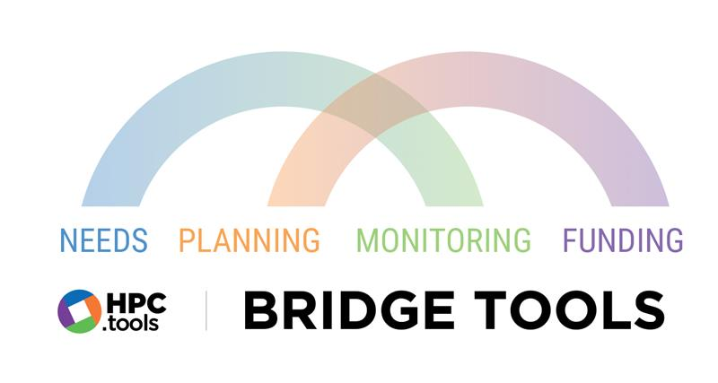
Monitoring and Tools Section (MATS)
Assessment, Planning and Monitoring Branch (APMB)
Coordination Division. July 2022
Notes:
This presentation will last for 90 minutes and it will cover the latest update about the main two bridge tools, that is the bridge tool for planning which we will also present live demonstration, and the monitoring bridge tool that is called now Response Monitoring Analysis or RMA.
If you have questions, there will be a space of time to raise them after introducing each tool so please drop them in the chat or raise your hand during this time and we will try to capture and respond to them. If no one has a problem we will start recording this session for future use by you or if you think want to share with others who couldn’t participate today, please feel free to share.

Slide 2
Developed in collaboration between APMB and field offices in Nigeria, CAR & Afghanistan
Use Microsoft Power tools (and apps) to link data from HPC tools, creating intuitive visual dashboards tailored to operational needs
Real time response analysis
Notes:
The planning bridge tool was developed as a collaboration between APMB and field office in Nigeria, and the response monitoring analysis tool was done developed based on use cases from Afghanistan and CAR, we then facilitated making it available for interested other country offices. These bridge tools basically uses Microsoft Power tools and apps to link data from HPC tools, creating an intuitive visual dashboards that are tailored to operational needs and enable real time response analysis.

Slide 3
Planning Bridge Tool

Slide 4
Complement to Response Planning and Monitoring (RPM) and Project Module (PM) platforms.
Presents the information from partner projects entered into PM next to the priorities outlined at cluster level entered into RPM.
Partners can better align projects according to needs and targets defined in the HNO/HRP
HCT, ICCG, IMWG have more oversight into the activities of project partners
Cluster level planning
Partner level planning
RPM
Project Module
Notes:
The Planning Bridge Tool provides a complement to the existing RPM and project module, by visually presenting the activities and targets outlined in a response plan that are uploaded into RPM against the activities and targets proposed by partners and uploaded into project module. This allows partners to better align their projects according to the needs and targets defined by the clusters and it provides them (the clusters) more oversight into the activities of partners projects, giving them the chance to step in sooner and address potential gaps and duplications, steering partners towards priority activities, populations, and geographical areas.

Slide 5
HNO
Cluster Target
# cash assistance delivered
1,000,000
Cluster Plan
300
# schools rehabilitated
RPM
Cluster Coordinators
# children provided with learning materials
1,000,000
Notes:
The tool was developed to solve a challenge repeatedly highlighted by colleagues in the field. Typically, cluster coordinators draw on the needs defined in the HNO (as well as their estimate of cluster capacity) and then decide on their priority activities and targets. As an example, the Education Cluster might set targets for three indicators, the amount of 1 million cash assistance delivered (where the unit is cash in US dollars), for the number of schools rehabilitated (where the unit is schools), and for the number of children provided with learning materials (where the unit is children or people). These targets are frequently disaggregated geographically, for the first two indicators, and by gender such as boys and girls for the third indicator. These activities and targets are then uploaded as part of the cluster logframe on RPM where they form the Cluster Plan.

Slide 6
Cluster Plan
RPM
Partner Target
# cash assistance delivered
75,000
Partner Plan
# schools rehabilitated
280
Project Module
Organizations / Partners
# children provided with learning materials
1,250,000
Notes:
This logframe is then visible to organizations in the PM, who draw on the activities and targets outlined in RPM to guide the development of their own projects. Typically, when registering a project, partners will select a cluster-registered activity, see that activity’s overall target, and note their own project target, with the option of geographical and target population breakdown. This information then forms the projects plan that organizations register in project module, which is made visible to cluster coordinators for informed approval decision.

Slide 7
Education Cluster Target: 1,000,000 children
?
27,527
50,487
25,458
87,659
35,265
185,694
50,487
54,782
27,527
50,487
27,527
Project Partner
54,782
159,498
50,487
124,447
83,568
Project Partner
Project Partner
Project Partner
Notes:
However, a problem arose from the fact that cluster coordinators could not easily see what the individual draft projects were adding up to. For example, the Education cluster coordinator sets a target for the distribution of learning materials to 1 million child (X in this district, Y in that district, etc.). Project partners in the Education cluster then get busy drafting their projects that include these activities. But during this drafting, or even after project finalization, the cluster coordinator could not see how many children the draft projects collectively proposed to reach – whether it was way under 1 million, way over, or about right. Neither could they see which districts had a surplus of planned outputs (according to the draft projects) vis-à-vis the original cluster target, and which districts had a deficiency. The cluster coordinators were thus ‘flying blind’ when trying to fulfil their obligation to keep the projects aligned with the priority needs.

Slide 8
Cluster Target
Partner Target
# cash assistance delivered
100,000
75,000
# cash assistance delivered
300
# schools rehabilitated
# schools rehabilitated
280
# children provided with learning materials
1000,000
1,250,000
# children provided with learning materials
RPM
Plan and cluster level priorities
Bridge Tool
Real time comparison & analysis
Project Module
Partners’ proposed activities
Notes:
The planning bridge tool now allows partners and clusters to see each other’s figures in easy dashboard views. It allows for the simplified comparison of priorities established in a cluster plan with activities proposed by partners. Users can easily see which activities, populations, and regions are under-targeted, which ones are on track, and which ones may be over-targeted. This should be particularly useful to cluster coordinators, and partners as ongoing planning process.

Slide 9
Practical Demonstration Dashboard Developed in Nigeria
Notes:
We will now run through a brief demonstration to show you how the tool looks like from Nigeria context using a dashboard that was developed by Nigeria Team over the course of two planning seasons. This tool can be easily configured to fit the specific needs of a wide variety of plans.

Slide 10
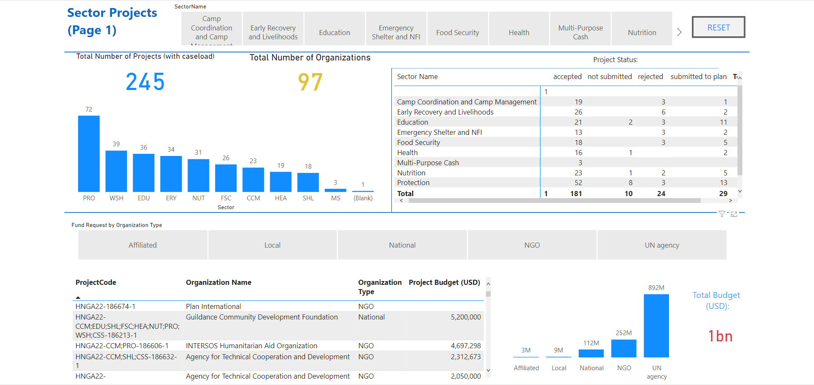
Notes:
Nigeria Bridge tool is split into four main pages. The first page provides an overview of all the projects registered. This information can be filtered by sector, project, project status, organization type, organization name, and budget.

Slide 11
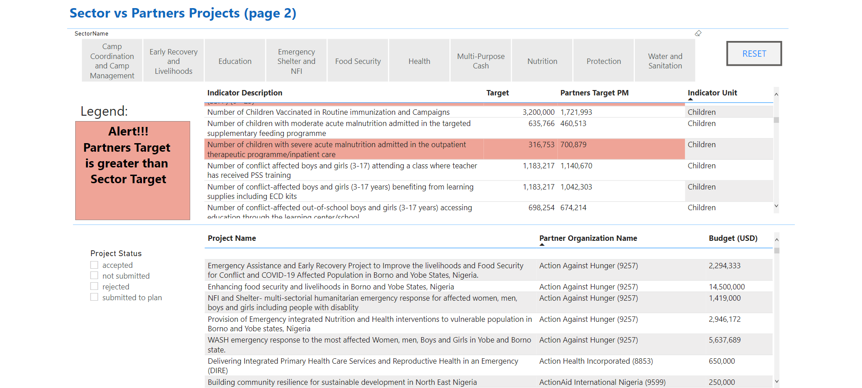
Notes:
In the second page you can see a table with the indicators and corresponding targets established by each sector, alongside the total, cumulative targets of all the projects that have registered a target figure against that indicator. The Bridge tool continuously pulls new projects data from the Project Module as partners upload their projects as well as any changes to cluster targets as clusters update their framework on RPM. This ensures that both parties are working with the latest, most up to date data. To see how this tool can facilitate planning, take a look at the example on this page.
Under Education cluster, when we look at the indicator, “Number of conflict affected boys and girls (3-17) attending a class where teacher has received PSS training,” that has sector target is approximately 1.18M children, while the project target is approximately 1.14M children. This tells the sector coordinator that activities in this field are roughly on track and they can focus their attention on other priorities. Likewise, partners looking at this page and have not yet drafted their projects or proposed any quantities for this particular output, they can see that other partners are already planning to deliver almost all of this target output and focus on other activities.
Now under Health cluster, look at the indicator, “Number of children vaccinated in routine immunization and campaigns.” Here, although the sector target is set at 3.2M, there are only 1.7M people targeted by registered projects. This signals to partners that there is an unmet need on this priority and that this may a beneficial place to direct their planning. It also clearly shows sector coordinators where gaps exist in the response, giving them a chance to step in early to encourage more partners to include this activity to their plan.
When the cumulative target of partner’s projects is above the target established by sector leads, indicators will be highlighted in red to alert sector leads that action may need to be taken. For instance, Lt’s take from Nutrition cluster plan, the indicator, “Number of children with severe acute malnutrition admitted in the outpatient therapeutic programme.” Here we can see that the total people targeted by partners is double the figure established by the sector. This isn’t automatically a bad thing. It could be that the actual need for this activity is higher than the initial sectoral target. Sectors set their targets with an estimate of partner capacity in mind, but maybe in a case like this, they were underestimating that capacity or it could simply be that partners cannot see what other partners are planning and are therefore proposing essentially duplicative activities. Either way, it is an indication that sector leads may want to have a conversations with partners to clarify this in the planning process.

Slide 12
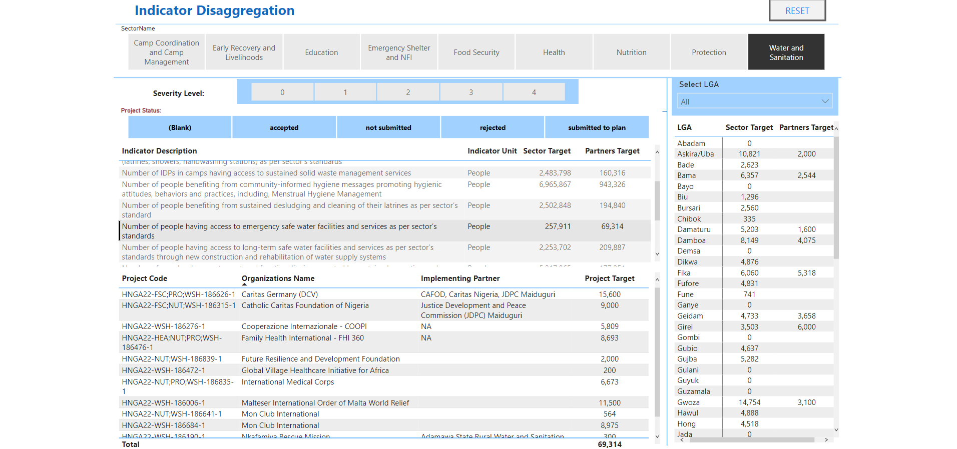
Notes:
The third page of the tool is only counting those targets that are planned in a particular Location for a given indicator. You’ll find a geographical breakdown by administrative area (called LGA in the Nigerian context), with the option to filter for the severity level of each Location (Severity referring to the index of intersectoral need). Let’s apply filter for WASH sector and click on one of its indicators, “Number of people having access to emergency safe water facilities and services as per sector’s standards”. The sector target is 260,000 and the partners target is 70,000. However, if we go back to page 2, we can see that the partners’ target is 350,000. Why is that? It is because the figures depend on partners entering their targets in the geographical disaggregation tables on the Project Module. As we see, only a minority projects have done so.
Nonetheless, even with this incomplete information, we still get some useful information. By clicking on an output indicator, you will see that the locations table on the right has updated itself and is now showing only what the projects have planned for this indicator in the various Locations. Already we see some interesting things:
Abadam is one of the inaccessible locations, so there are no targets there.
For Askira/Uba LGA, the sector set a target of over 10,000 people, for this very high priority action, emergency safe water and yet partners have only specifically proposed targeting 2,000 people in that location.
Geidam, by contrast, has a target of about 4,700, and partners have proposed about 3,700, which is not bad.
Girei: its sectoral target was initially 3,500 people. Partners are already proposing 6000. That is actually a big excess, which might need to be reduced or reallocated. If the partner really has the capacity to do that kind of emergency safe water supply, they could shift their planning to target Locations (LGAs) that are currently underserved.
For partners wondering where to place their outputs, if they know they can provide emergency water supply but aren’t sure where the highest priority areas are or where the biggest gaps are for example, this view helps them find the areas most in need.

Slide 13
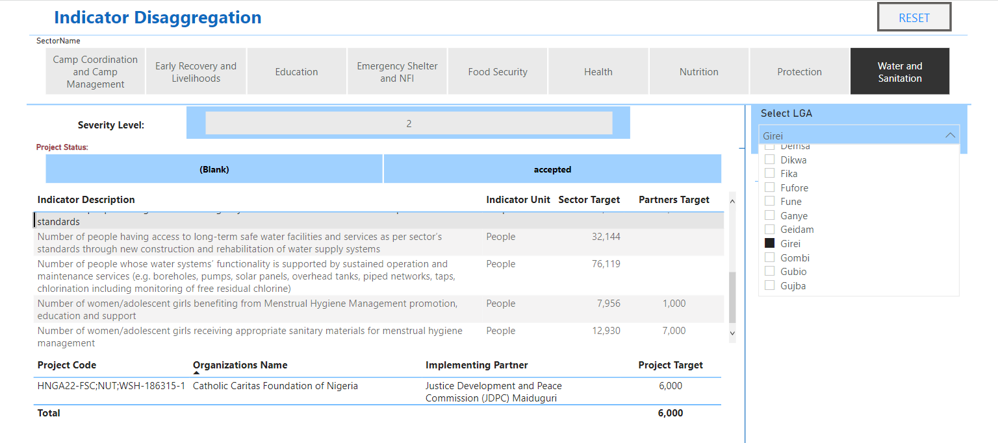
Notes:
From the same page view, sector leads may want to know which partners are proposing providing emergency safe water in Girei (for example). You can do that, by selecting Girei from the Locations table. Now on the little table that has appeared, we see which partners and projects exactly are proposing the output in the selected location. In this example, we see that it is just one, “Catholic Caritas foundation of Nigeria”. For this, or for any other locations on this table, we can see which partners are proposing particular outputs in this area. If we see a great excess vis-à-vis the sectoral target, we then know whom to follow up with.

Slide 14
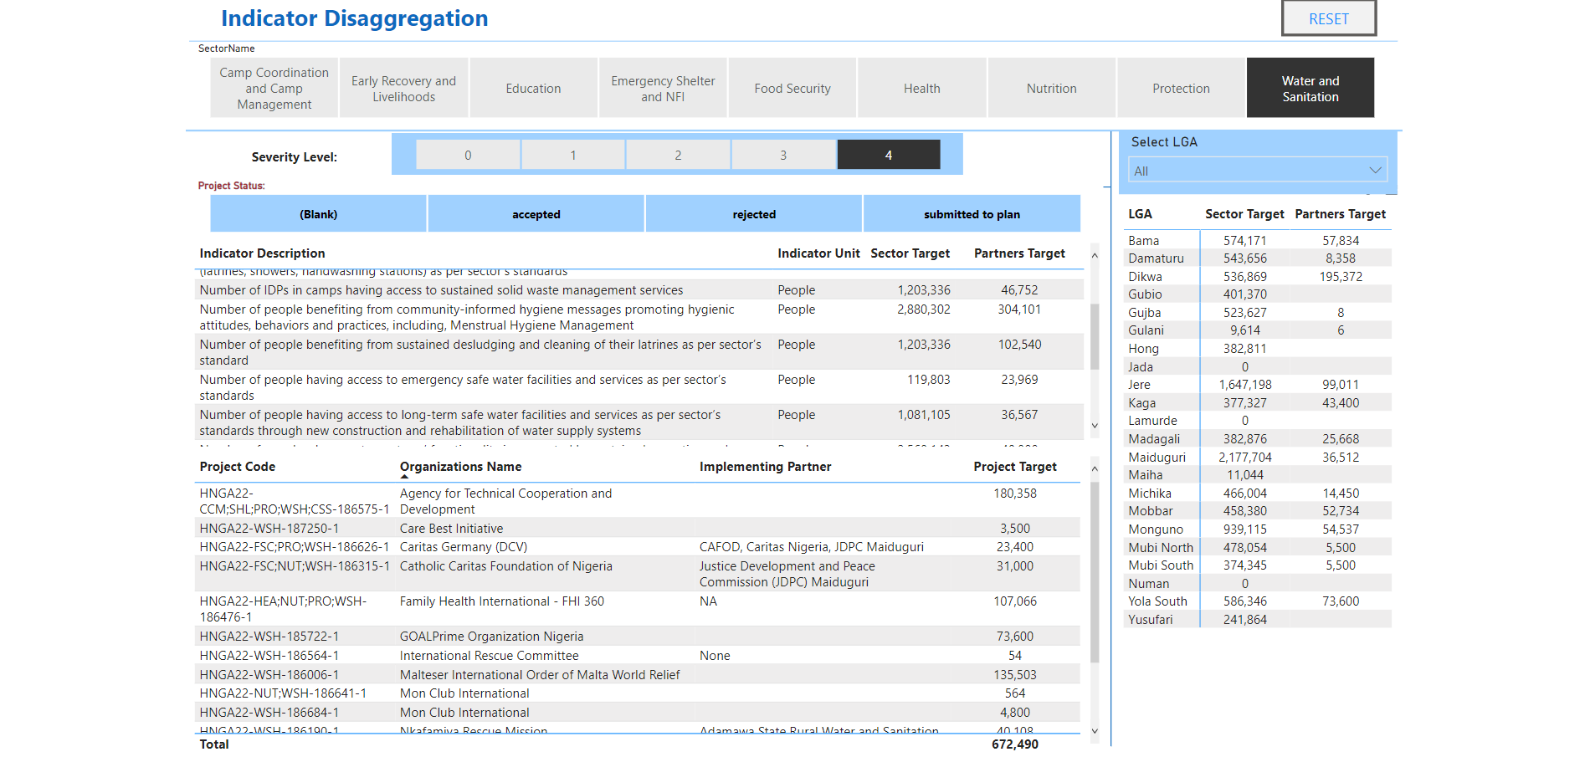
Notes:
On top of the page, you have the option to filter by severity level, the Locations severity ratings based on the intersectoral bundle of indicators. We want to focus on the most severe Locations for the most part, in most cases. So, by clicking on severity level number 4 [for the output indicator], it will be filtering to only Locations that have that severity rating.
Now it shows the targets for the same output in those Locations.
Let’s take another output indicator for this example: one about people having access to long-term safe water facilities, less time bound than the emergency water supply. We see the sectoral targets and the projects target in the Locations only with that severity 4 rating, which is the worst of any locations at this point. We see quite a few gaps: some pretty large sectoral targets in a lot of these Locations and not that many partners proposing any long-term safe water installation at all.

Slide 15
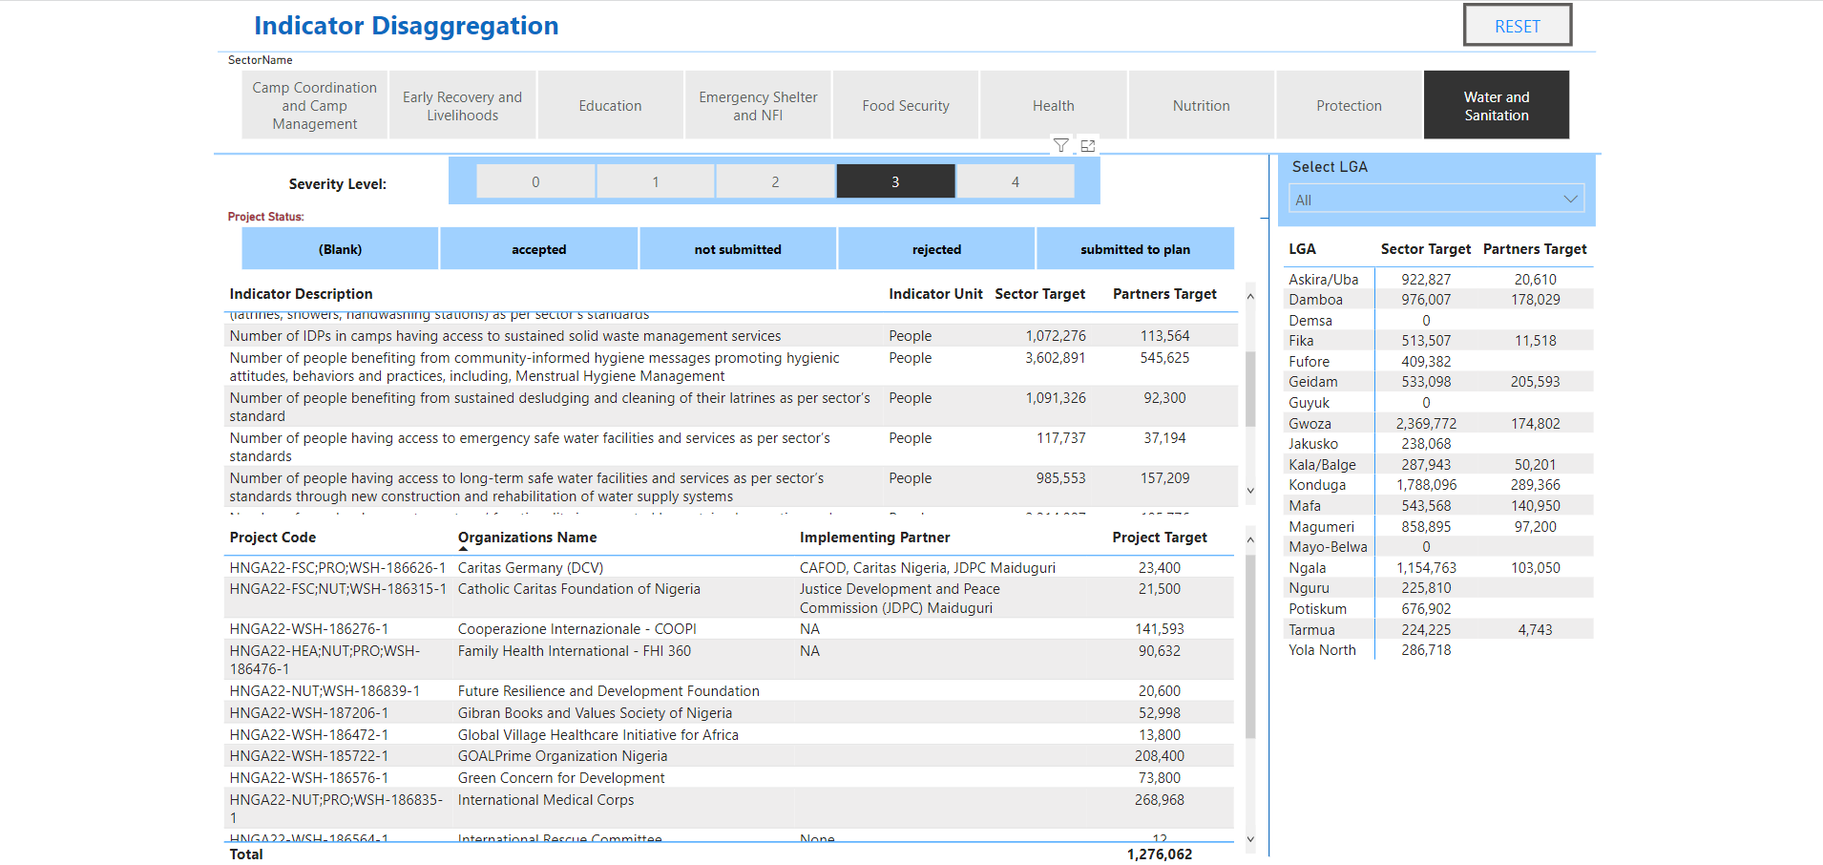
Notes:
Now if we change the severity filter and click number 3 instead, there is also some pretty big sectoral targets in the severity level 3 Locations (LGAs) but look how many more partners are provided to target at this level.
This is something for partners to discuss among themselves and the sector coordinator to discuss with partners. We really should be targeting as much as possible the higher severity Locations (LGAs) for most kinds of activities or at least priority activities, and perhaps only as a secondary matter, target the severity level 3 Locations (LGAs).
This is now very possible with this bridge tool where you can see this kind of information, where the gaps are, and whether the plan of action, so far on the Project Module, are too much weighted towards a more severity level.

Slide 16
Response Monitoring Analysis (RMA) Tool

Slide 17
What is the RMA?
Planning
Monitoring
Needs
Funding
Notes:
What is the Response Monitoring Analysis Tool or RMA? The RMA is a customizable solution that pulls information on Needs, Planning, Monitoring, and Funding from HPC tools and links it together in a way that allows country teams to easily visualize response progress at both the cluster and intersectoral level. This enhanced oversight gives cluster coordinators the ability to better track progress by severity level, target population, and geographical locations.

Slide 18
Why is this important?
Needs
Planning
Monitoring
Funding
Notes:
Why is this important?
Linking the three components of needs, established during needs assessment, planning, and funding to monitoring helps answer key question, have we reached the priority areas, by priority humanitarian activities including access to basic services an infrastructures ? Answering these type of questions should ultimately contribute to effective coordination and more people-centered approach.

Slide 19
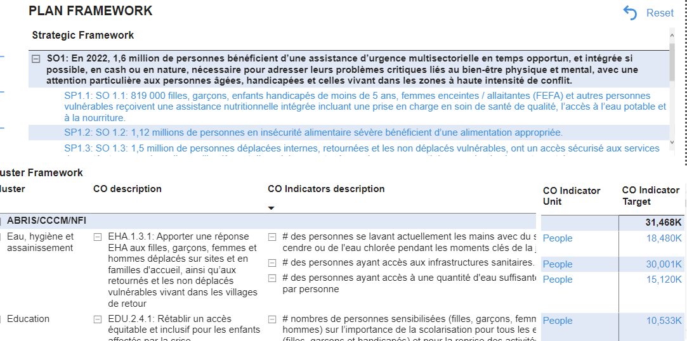
Monitor the progress toward achieving goals!
Notes:
RMA allows for dynamic navigation through the plan framework to give planners more visibility over which planned activities have been implemented. We can also see the progress toward achieving the cluster objectives and ultimately the progress toward achieving the strategic objectives.

Slide 20
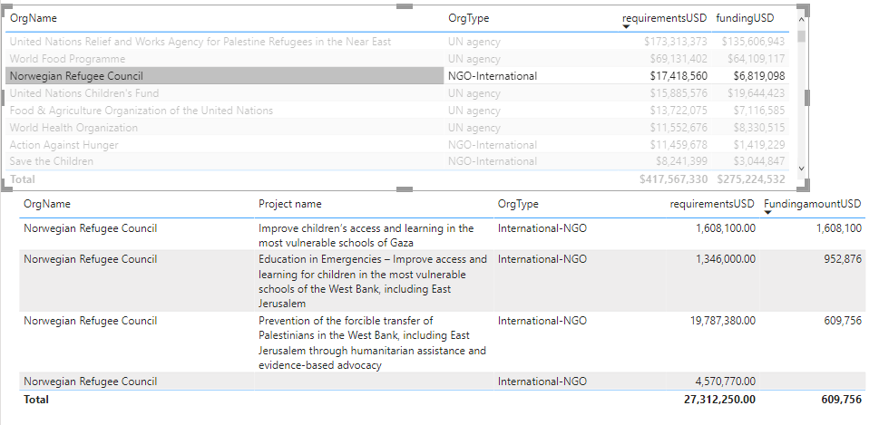
Fund monitoring!
Notes:
Connecting monitoring to funding shows us whether we are on track financially and facilitates communication with donors regarding impact of shortfalls in funding in priority areas/activities. Which raises the question? What is the impact on the affected population of the missing projects which planned to deliver key activities but didn’t receive funding or were under funded? The tool can alert us to this impact and trigger action to convey a message to donors.

Slide 21
Direct and Indirect Assistance
Direct Assistance
e.g., Educational Materials
Have we reached high priority locations with both essential direct assistance and key basic infrastructure and services?
Until now, infrastructure and services have been poorly represented in monitoring.
Ensures a more comprehensive and holistic understanding of the response and people reached.
Indirect Assistance
e.g., School Rehabilitations
Total Assistance
Notes:
The tool also incorporates both direct humanitarian assistance such as food distribution or the provision of education materials, and indirect assistance through service provision such as installation of water treatment systems, restoration of schools. Until now, the latter has been poorly represented in response monitoring, as it is common practice to count only number of people reached and overlook service provision. This tool ensures monitoring becomes more comprehensive, looking at progress in all aspects of the response.

Slide 22
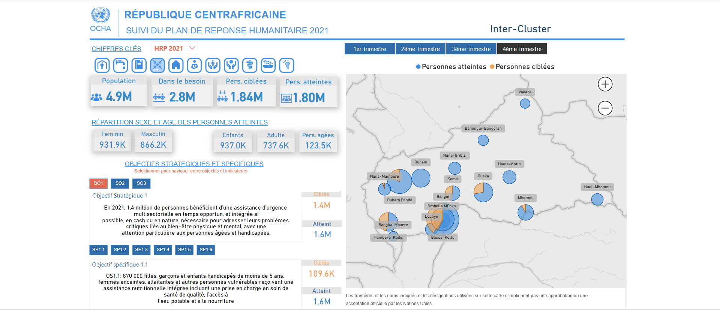
Notes:
Using Microsoft Power Tools, the RMA lets you create a customizable dashboard that includes exactly the information that you need in exactly the format that you like. All of the data connections and data processing are pre-set (as RMA draws on the latest data managed in RPM, PM and FTS). So there are no further data collection needed.
Here, you can see that the CAR field team has created a dashboard that shows key figures such as population, people in need, people targeted, and people reached,
and the indicators measurements maintaining reference to strategic framework.
Where disaggregated data is available, this can be easily visualized and configured to show progress towards targets by the priority demographic groups in each priority administrative area.
The information in RMA is presented in real time and can be configured to filter by monitoring period, letting you track the evolution of the response over time.

Slide 23
Complement to Humanitarian Insight
Notes:
Some of you may have noticed that this tool shares similar features with Humanitarian Insight. That is because the RMA is intended to be complementary to Insight. Like Hum-Insight, it is a way of visualizing information pulled from HPC tools. However, unlike Insight, the RMA doesn’t have to follow global standards on how data is presented. Because it is based on Microsoft Power tools, users can configure it in a way that is more meaningful for their country context. This can be particularly useful in cases where you need to analyze information that, for political reasons, cannot be published on a platform like Hum-Insight such as access information i.e. Areas of control. This flexibility has the added benefit of turning RMA into a testing ground for future Hum-Insight enhancements. This means if a country office develops a feature that is particularly useful, this can be adapted for other country contexts or for global reporting dashboards.

Slide 24
Conclusion
VISIBILITY
FLEXIBILITY
ADVOCACY
Notes:
As we have seen, having access to the information and analysis provided by the Bridge Tools should prove highly beneficial from different perspectives. We can summarize these benefits in three broad categories – visibility, flexibility, advocacy.
Visibility
These tools give the humanitarian community more visibility over response plans, both as they are being developed and as they are being executed. This visibility allows actors to identify potential issues earlier and change course accordingly. For organizations planning projects, the Planning tool lets them see where needs are highest and coverage is lowest, so that they can implement their activities where they will have the greatest impact. For cluster coordinators, the Planning tool flags where potential gaps and duplication might arise in the response, giving them time to steer partners towards underserved locations and populations. During the response, the RMA helps them track progress and highlights activities, regions, and population groups that may require additional support.
Flexibility
Because these tools are developed using Microsoft Power Tools, countries have flexibility in tailoring them to suit the needs of their local context. You can configure dashboards to match the operational and political reality on the ground, using the terminology, disaggregation, and coordination structures that are most meaningful for you and your clusters. It also streamlines reporting by enabling you to produce a wide variety of reports in different formats for different audiences, but all using the same underlying dataset – the data that are consistent with what audiences will see on humanitarian insight, fts, or other HPC Tools.
Advocacy
In addition to making project planning more efficient and effective for both clusters and partners, it can also help us in advocating with donors. We often hear from donors that HRPs are over budgeted, that there is too much duplication, that proposed projects don’t target the areas and populations with the greatest needs, and so on. Bridge tools provides a method to respond to those criticisms and enables powerful advocacy for resource mobilization. The detailed information on the Project Module and the visualization and analysis on the response bridge tool allows us to demonstrate that our projects are well coordinated, that we have identified and minimized gaps in programming, we have minimized duplication among partners, and that we are focusing on the regions and populations with the highest severity of needs – thereby making the most efficient use of donor resources. The RMA further allows us to highlight priority areas that are underfunded during the response and make a convincing case for the impact on affected people if these areas are not properly funded.

Slide 25
Next Steps
Reach out over your Field Support Teams channel to get a copy of the tools (in xls and PBI format)
Configure the bridge tools for your operations
Put the data in use by running the analysis and sharing the results
Reach out to Field Support if you have any questions or comments
Additional information can be found on the Knowledge Management Platform (KMP): HPC Bridge Tools

Slide 26
Questions

