Slide 1
Response Planning & Monitoring (RPM) A step-by-step guide Version 1.0 Last Updated: September 2023

Slide 2
This step-by-step guide covers:
Log in to Humanitarian ID
Navigating RPM
Setting Up: Confirming the Plan Details
Plan details, monitoring periods
Clusters structure
Creating disaggregation models
Data Management (for Plan Leads)
Adding inter-cluster caseload (and disaggregation)
Adding Strategic framework including Strategic Objectives and Specific Objectives (and indicators if available).
Data Management (for Cluster Leads)
Adding clusters Caseloads (and disaggregation),
Adding clusters framework including Objectives, Activities and their indicators (including disaggregations)
Manage monitoring data:
Adding Inter-cluster caseloads (for Plan Leads)
Adding cluster caseloads, clusters objectives/activities indicators (for Cluster Leads)
Additional resources

Slide 3
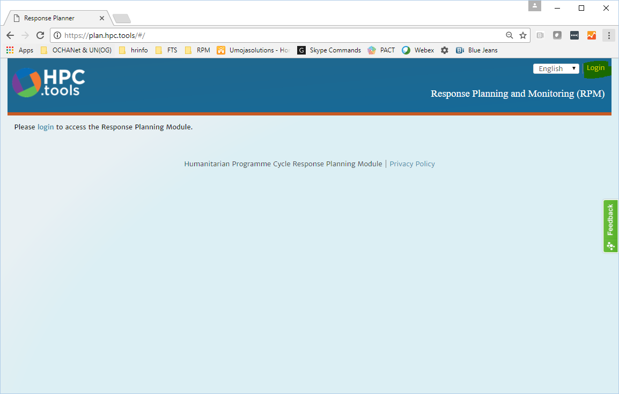
1. Log in to Humanitarian ID
Navigate to http://plan.hpc.tools and click Login in the top-right corner.
We recommend using the latest version of Chrome or Firefox.

Slide 4
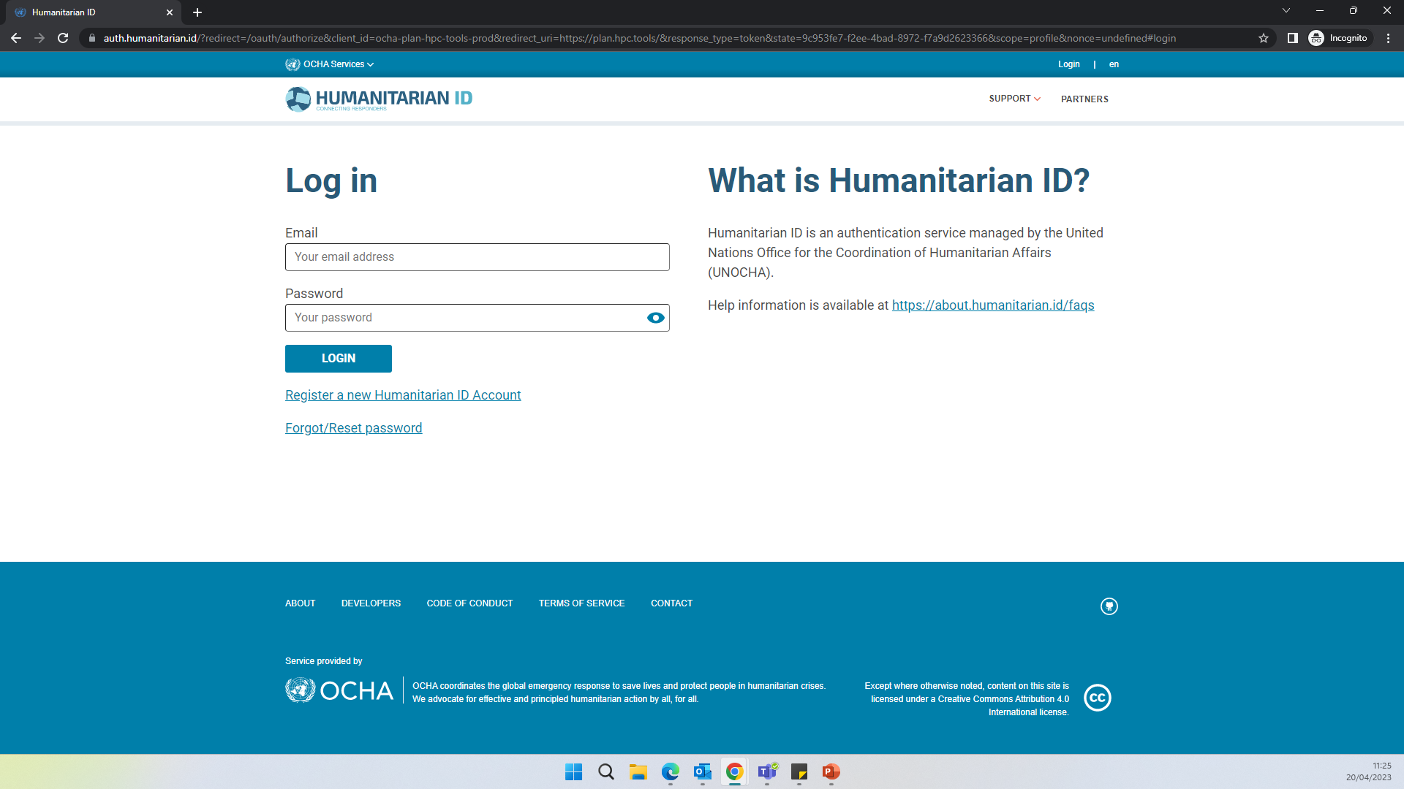
Log in to Humanitarian ID
Enter your H.ID credentials:
If you do not have an H.ID, please create a profile at humanitarian.id
If you are logging in for the first time, H.ID will ask you to authorize RPM. Please do so.

Slide 5
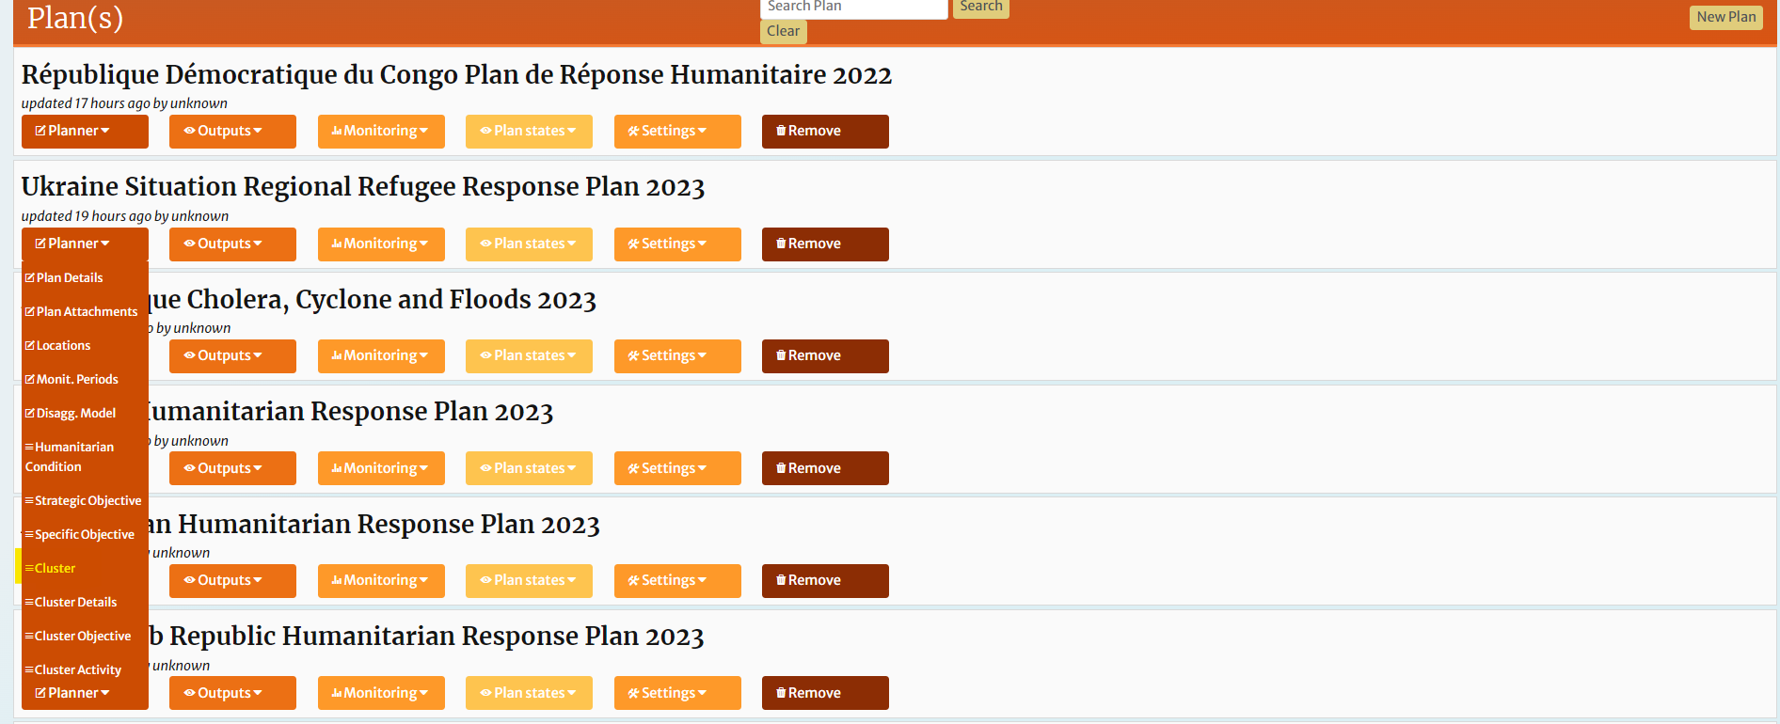
2. Navigating RPM
Plan, clusters, and some other objects used in RPM are shared by other applications such as Project Module (PM) and services such as FTS. For this reason, you will not be required to create a plan from scratch. Upon logging in, your plan(s) will be displayed.
Identify the relevant plan. Cluster leads can click on Clusters in the Planning pull-down for your plan, or from within the wizard by clicking the Cluster workflow tab.

Slide 6
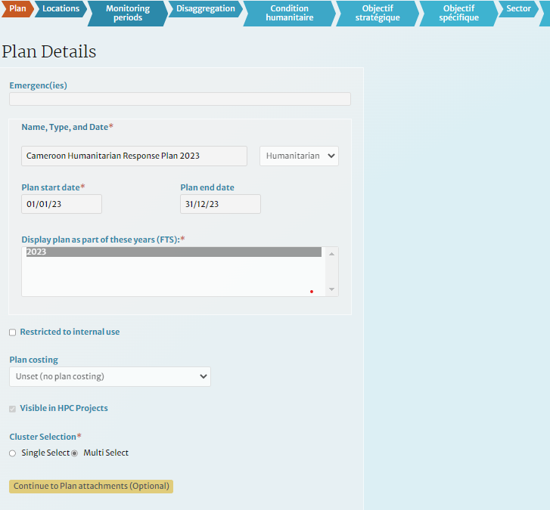
3. Confirming the Plan Details
Identify the relevant plan, hover over the planning drop-down menu, and choose Plan Details or simply click on Plan workflow tab within the wizard.
The Plan Details show the initial information collected from the field to set up the plan. Confirm that this information is correct.

Slide 7
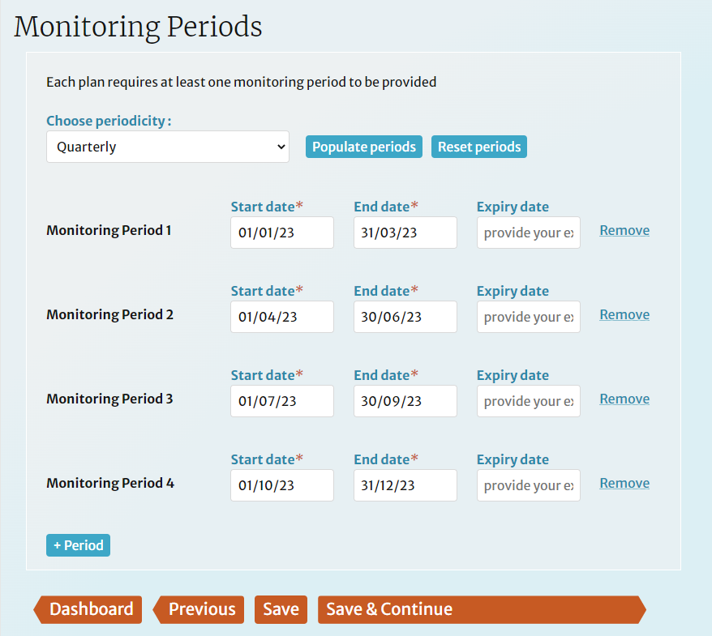
Confirming Monitoring Periods
The default monitoring periodicity for HRPs is quarterly. Choose a periodicity from the list, then click [Populate periods]. Make any changes to the start and end dates, as necessary. For cumulative results, start each period on the same day. Custom periods and expiry dates for monitoring data entry can be added; these are no covered in this guide.

Slide 8
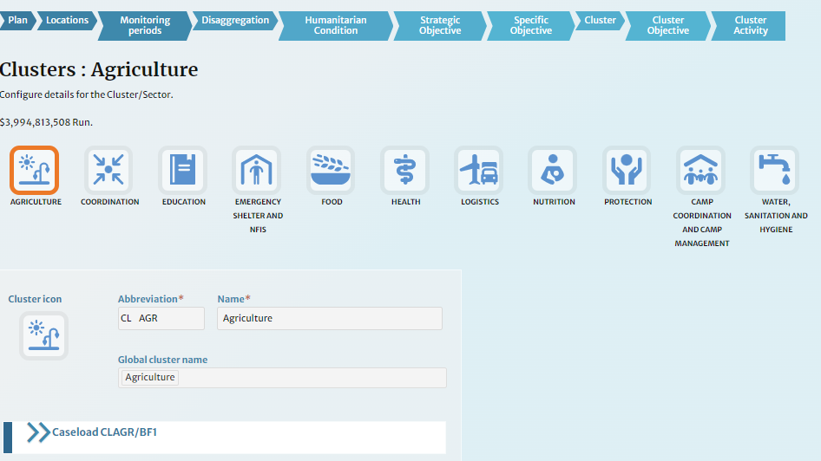
Confirming Clusters Structure
The Cluster Details page is displayed. It can be modified by adding clusters, removing clusters or changing its name. And it is done only centrally by the administrators.

Slide 9
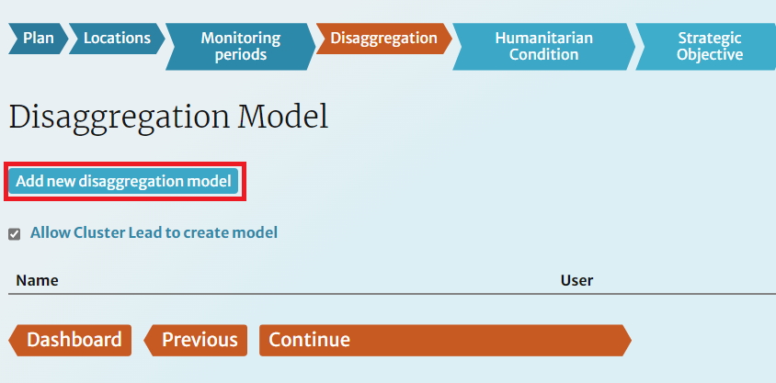
4. Creating disaggregation model(s)
Navigate to the Disaggregation Model page from the Dashboard by clicking Disagg. Model in the Planning pull-down for your plan, or from within the wizard by clicking the Disaggregation workflow tab.
RPM allows multiple disaggregation models to be managed. To start, click [Add new disaggregation model].

Slide 10
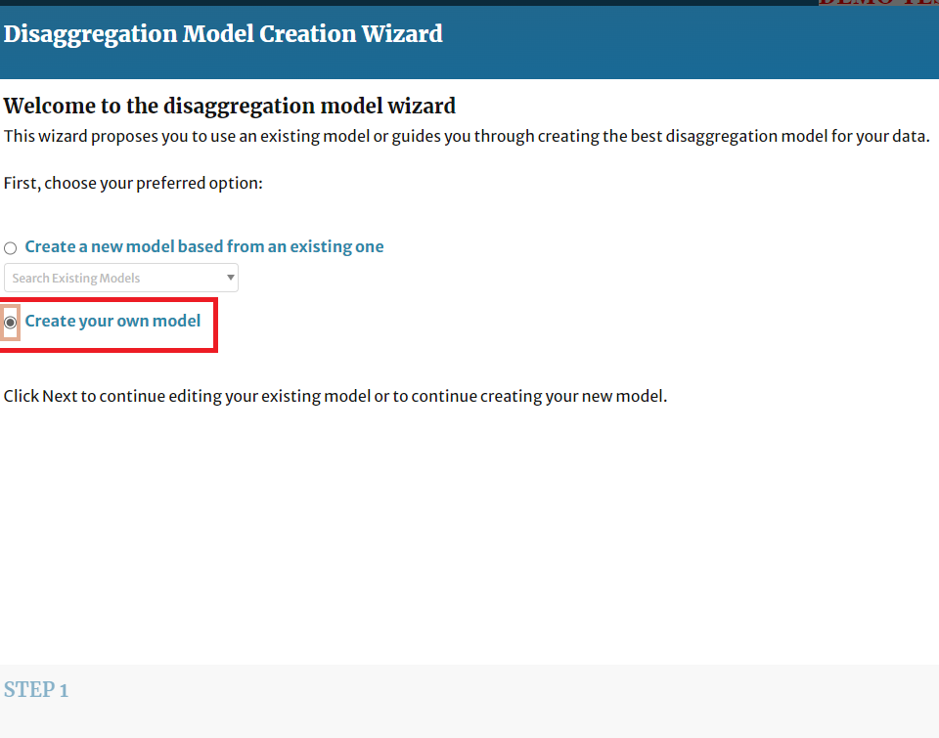
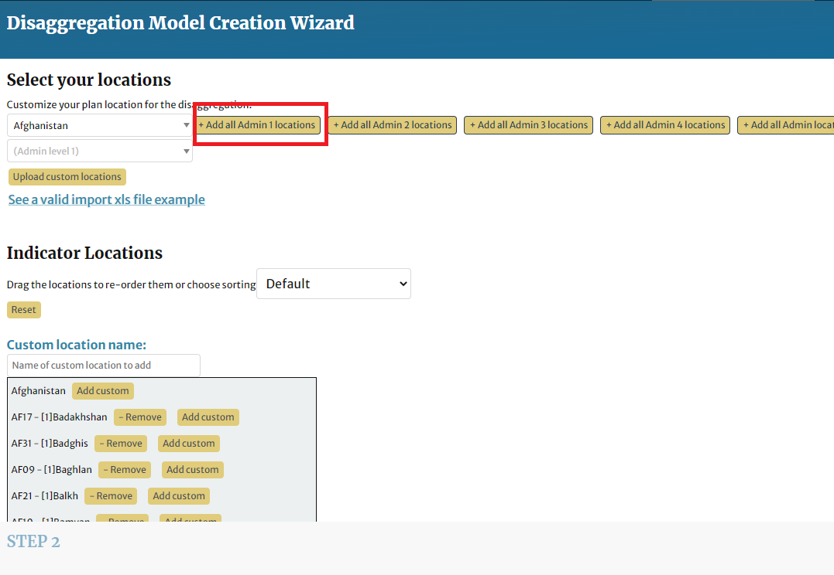
Creating disaggregation model(s)
You can create a model from scratch or use an existing model as a template. For this example, we will create a model which disaggregates beneficiaries by admin 1 locations, sex and age. First, choose the Create your own model button and click Next.
Locations and categories are handled separately. Add the locations by clicking the [+ Add all Admin 1 locations] button, click Next. You can also add custom locations; these are not covered in this guide.

Slide 11
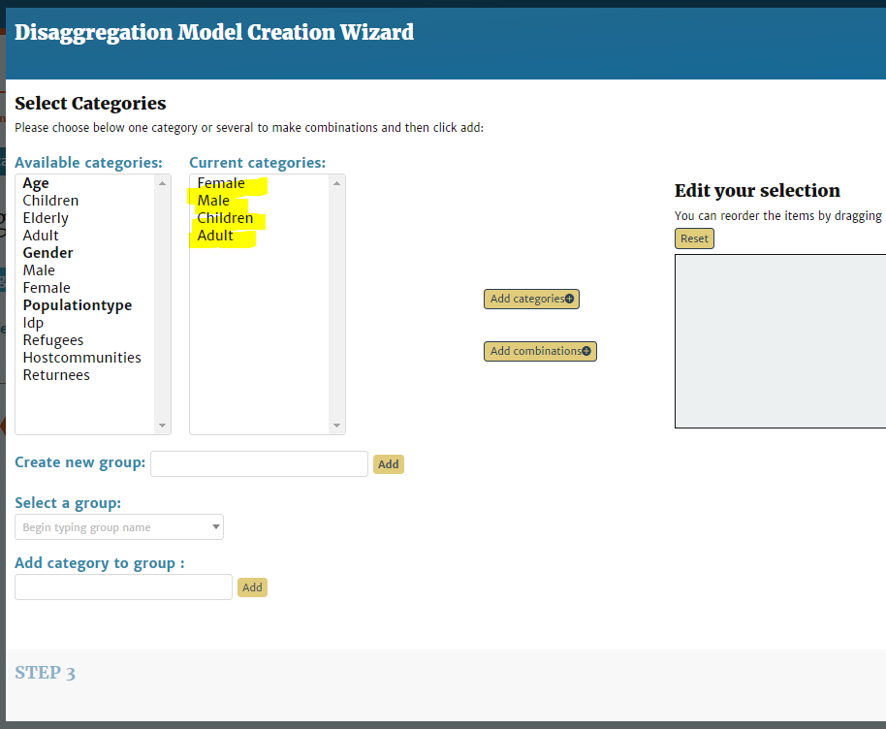
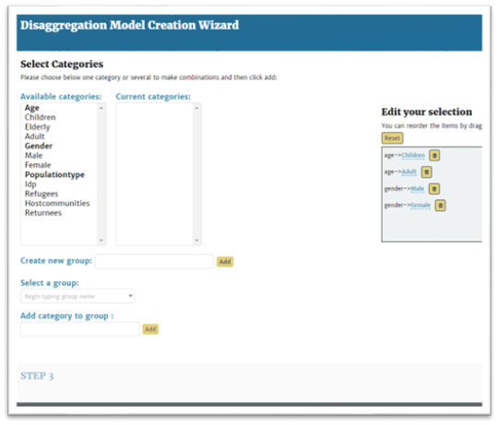
Creating disaggregation model(s)
Choose the categories in the list on the left. They are added to an intermediate list in the middle.
To use the selected categories as-is, as separate categories, click [Add categories], then click next.

Slide 12
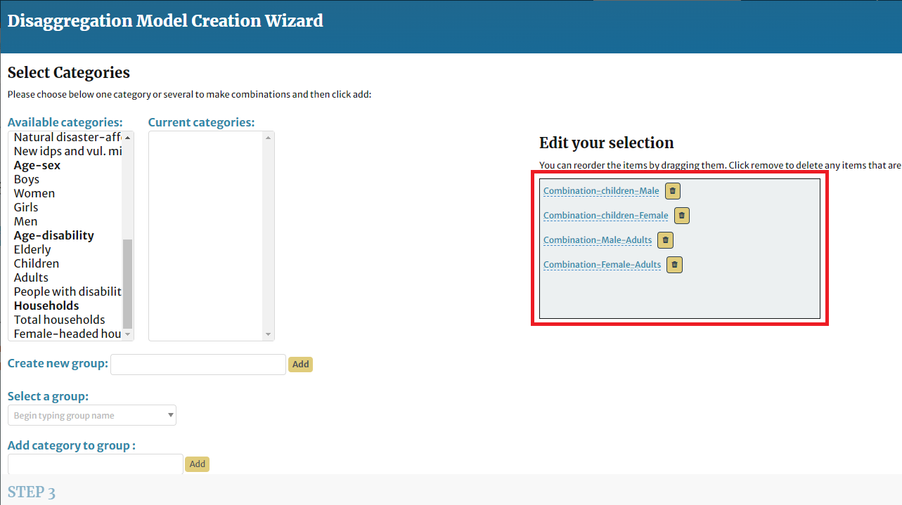
Creating disaggregation model(s)
To create combination categories, (i.e female-adults, female-children, male-adults etc.) click [Add combinations] followed by Next.

Slide 13
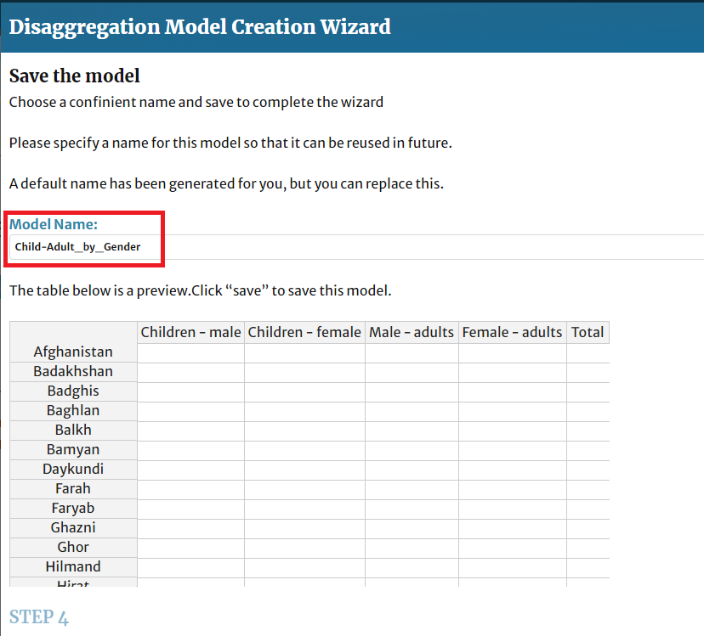
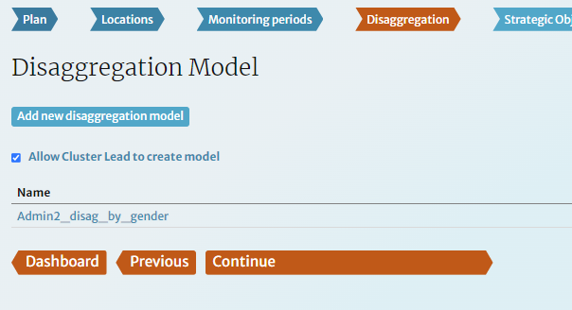
Creating disaggregation model(s)
Name the model. It is strongly recommended you specify the categories in the name as shown in the screenshots bellow. Then click Save.
Create as many disaggregation models as needed. Then Continue when done.

Slide 14
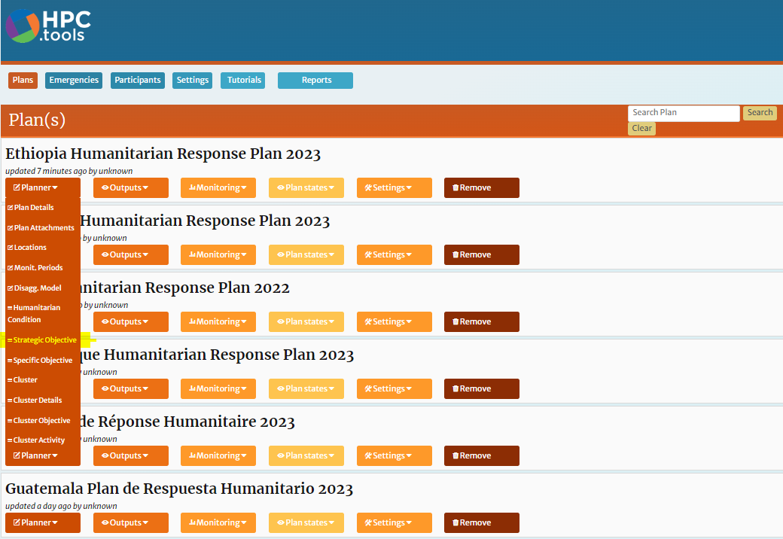
5– Data Management (for Plan Leads)
Identify the relevant plan, hover over the Planning drop-down and choose Strategic Objective.

Slide 15
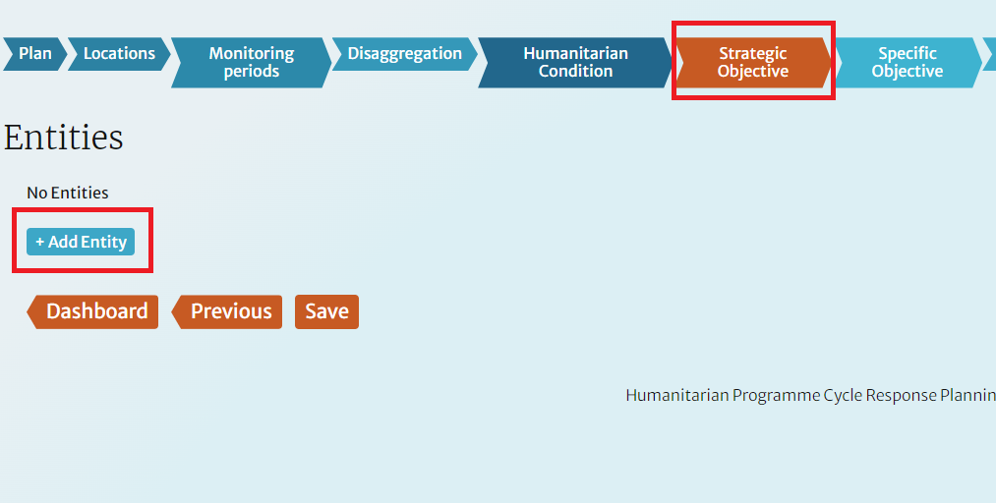
Adding Strategic Objectives
To add your first strategic objective, click the [+ Add Strategic Objective] button. The Strategic objectives data can be added and edited by the plan lead and viewed by cluster leads.

Slide 16
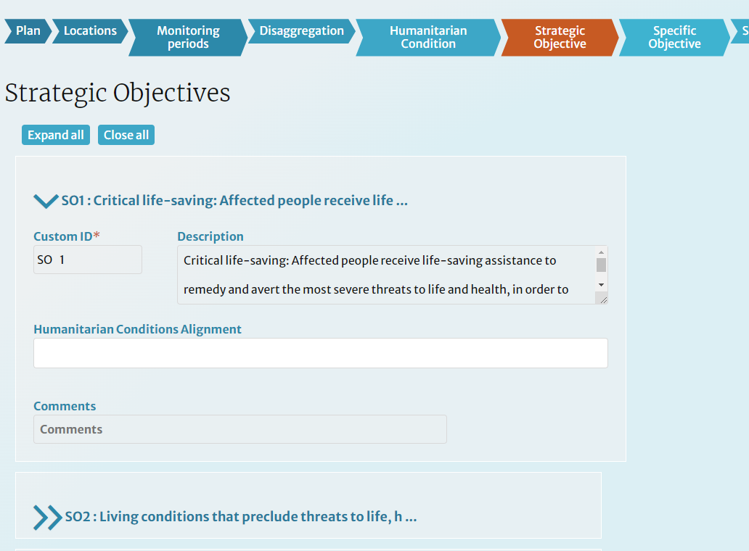
Adding Strategic Objectives
Type the objective description in the Description field. Type a new Custom ID if your IMWG has agreed to a particular naming scheme or keep the default value.

Slide 17
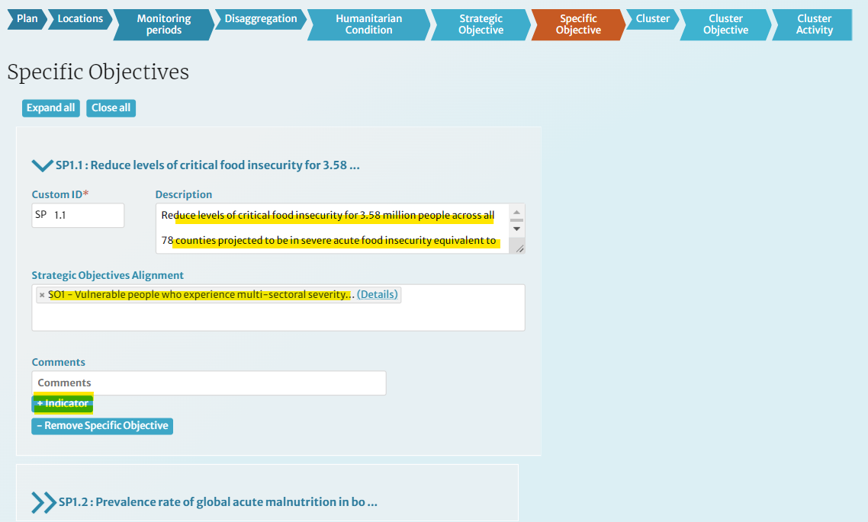
Adding Specific Objectives
Add all Specific Objectives using the same procedure outlined under Strategic Objectives and add Indicators for each of them, as explained in the next slides.
Make sure to align the Specific Objectives with the Strategic Objectives added in the previous step. This alignment shapes the framework pyramid by connecting all entities together.

Slide 18
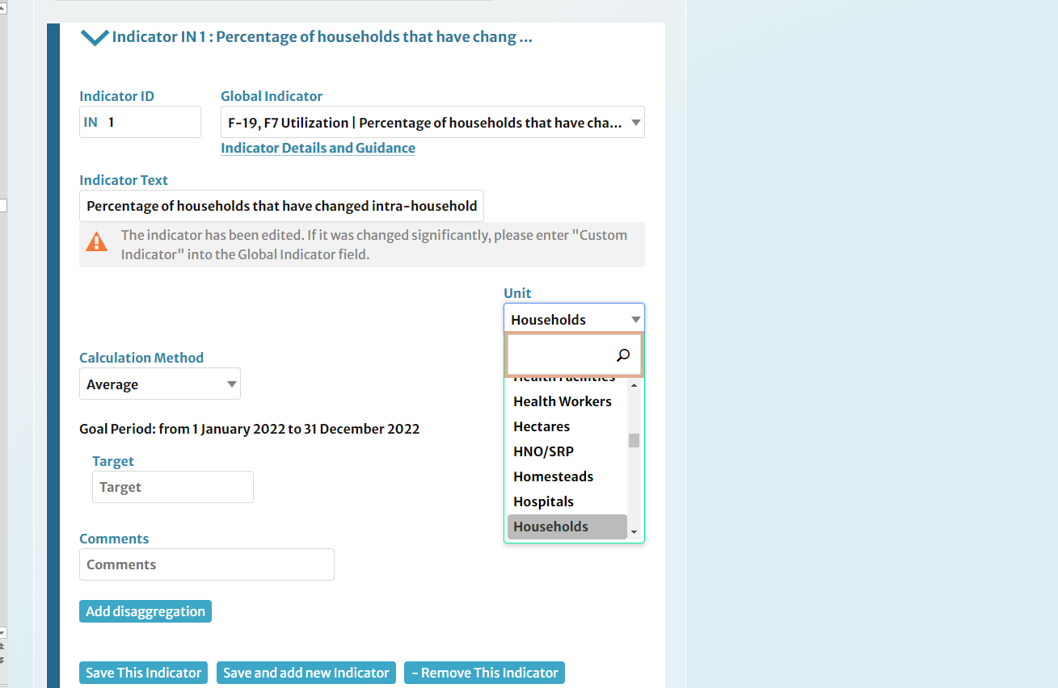
Adding Indicators for Specific Objectives
There are three ways to add an indicator: (1) by selecting from the Indicator Registry (IR) and using it as-is, (2) by using an indicator from the IR as a template to make revisions on, (3) by typing one from scratch.

Slide 19
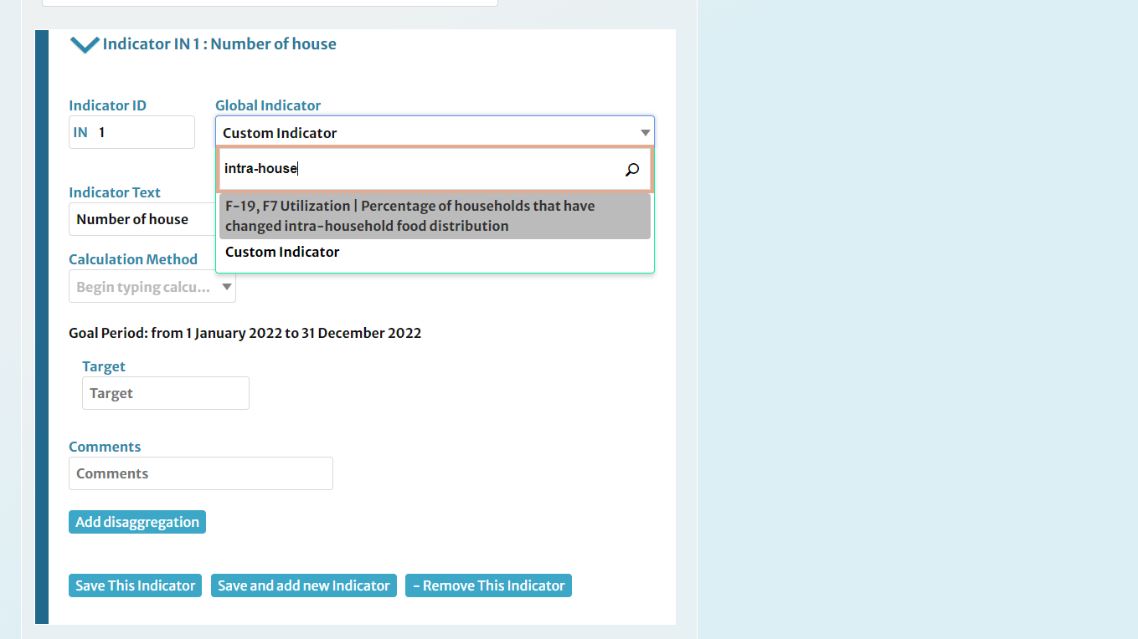
Adding Indicators for Specific Objectives
Fill out the indicator's details, including description, target and unit.

Slide 20
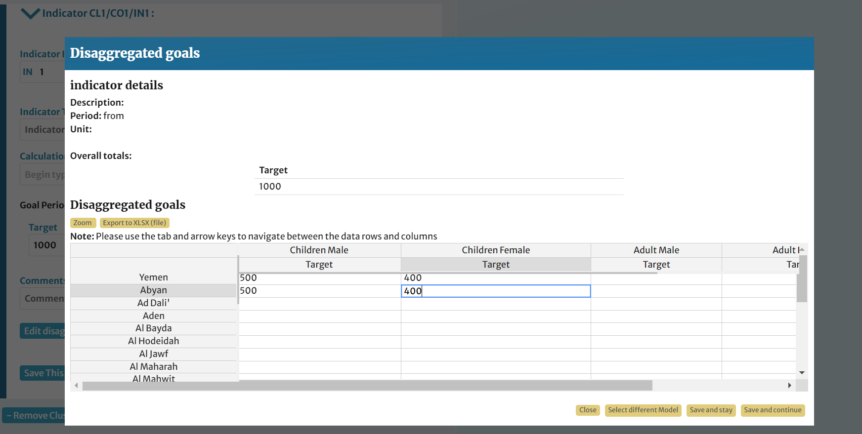
Adding disaggregated targets to: intercluster caseloads
A table is displayed when you click on Add Disaggregation. You can enter the disaggregated values directly on this page. Note than you can paste multiple rows and columns of data at once. Click Zoom to maximize and Save and continue when done. Repeat the procedure in previous steps for each indicator which needs disaggregation and click Save and Continue when done

Slide 21
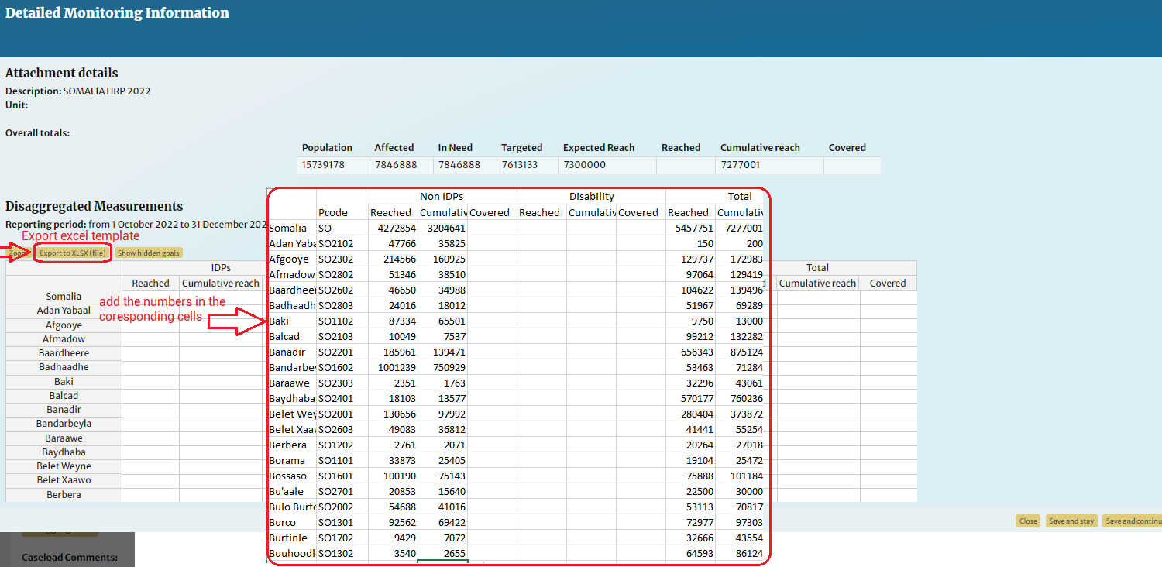
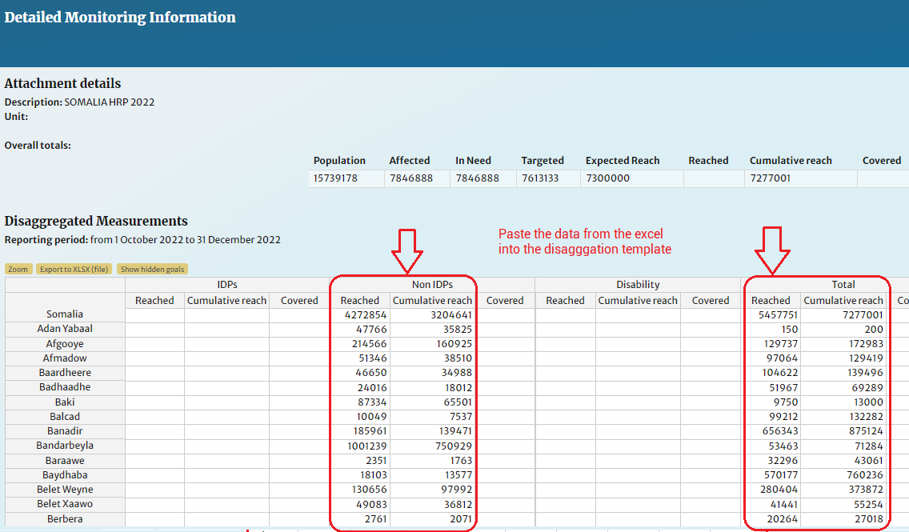
Adding disaggregated data using excel

Slide 22
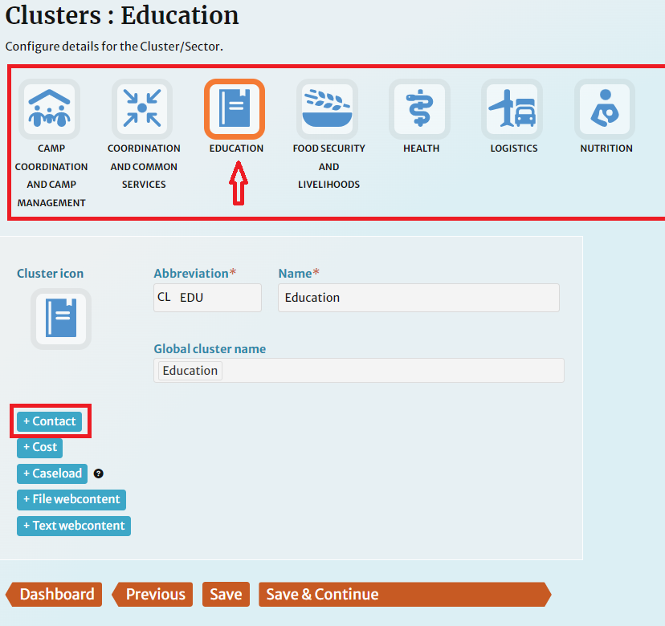
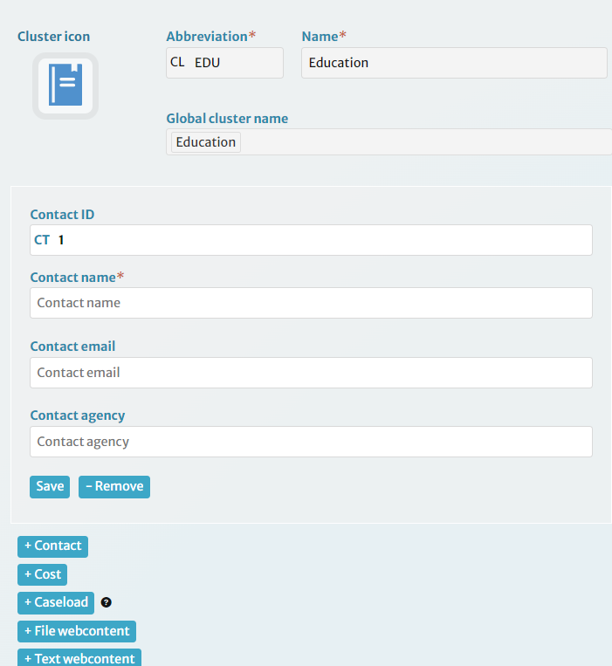
6. Data Management (for Cluster Leads)
Navigate between the clusters by clicking their icons. For each cluster, add the coordinator, co-lead and/or cluster IMO by clicking [+ Contact].

Slide 23
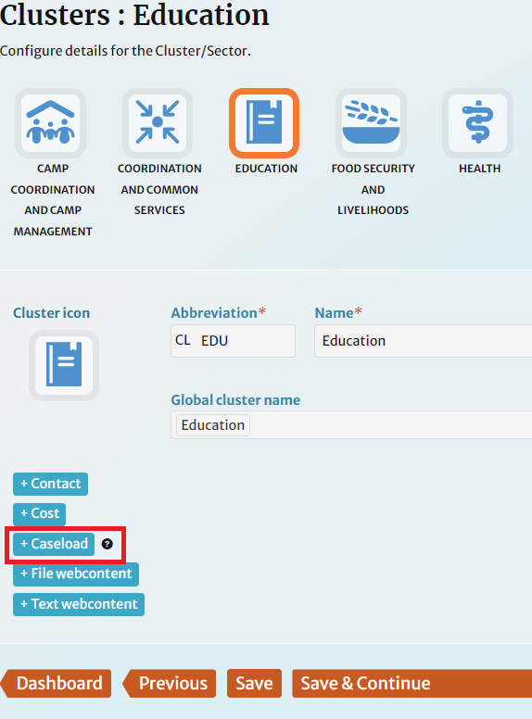
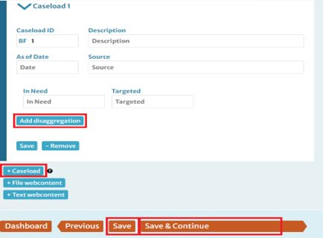
Adding Cluster Caseloads
For each cluster, add a caseload using the [+ Caseload] button.
You can use the default ID or overwrite it. Complete the form fields displayed. Adding disaggregation is covered in the next slide. Click the blue [Save] button after each caseload is complete and [Save and Continue] after the last one.

Slide 24
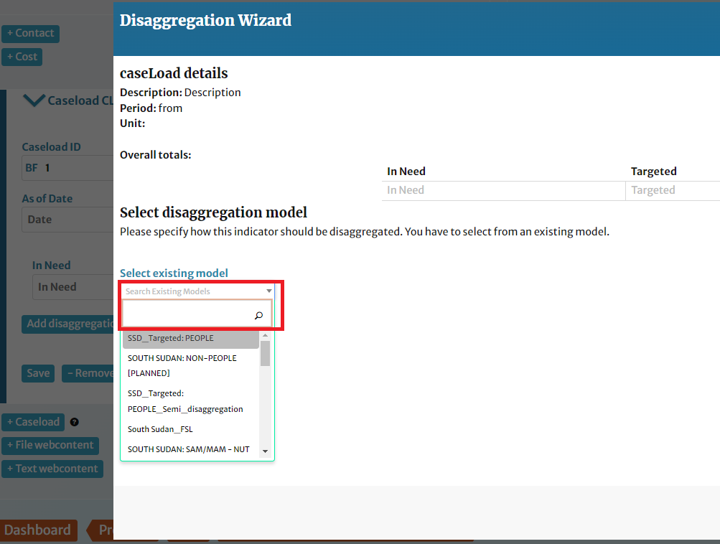
Adding Disaggregation Model to Cluster Caseloads
Select a disaggregation model from the list and click Select existing model.

Slide 25
Adding disaggregated data using excel

Slide 26
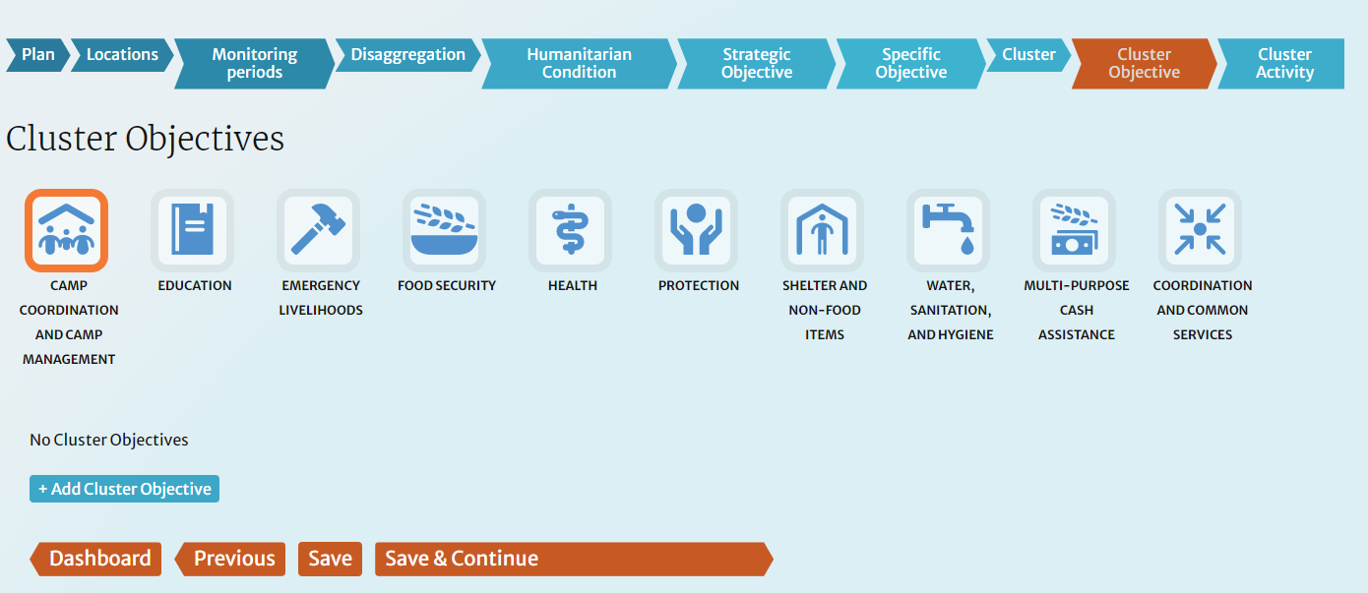
Adding Cluster Objectives and Cluster Activities
To add Cluster Objectives, Cluster Activities, and their Indicators follow the same steps developed in “Adding specific objectives”.
When adding Cluster Objectives and Cluster Activities to the Protection cluster, make sure to prefix each activity with the relevant AoR. This is important to apply the protection AoR categorization in the system.

Slide 27
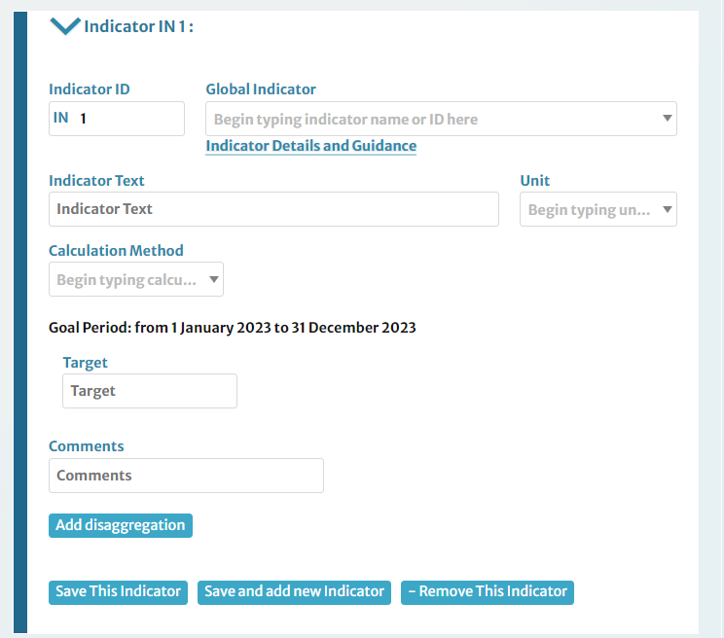
Adding Indicators for Cluster Objectives and Activities
Follow the same procedure with adding indicators for Specific Objectives. Again, there are three ways to add an indicator: (1) by selecting from the Indicator Registry (IR) and using it as-is, (2) by using an indicator from the IR as a template to make revisions on, (3) by typing one from scratch.
Populate the indicator by filling the required fields and entering Target figures. You can add a comment for reference. Comments are displayed within the app and are not included in the viewer or API feed.

Slide 28
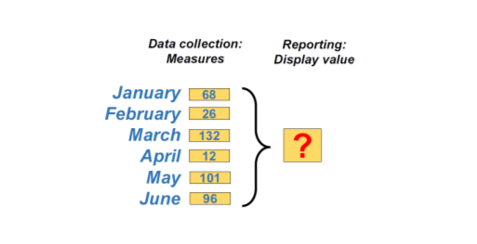
Selecting the Calculation Method for Indicators
Before entering results for the indicator in the field called measure, please select a calculation method for the Measure. The calculation method determines how the display value should be calculated out of the periodic measures of the indicator.
Sum: The displayed value is calculated as the sum of all the periodic values.
Average: The displayed value is calculated as the average of all the periodic values.
Maximum: The displayed value is the maximal value found across all periodic values
Latest: The displayed value is the last periodic value.
*For a more detailed guide on the calculation method, see more details here.

Slide 29
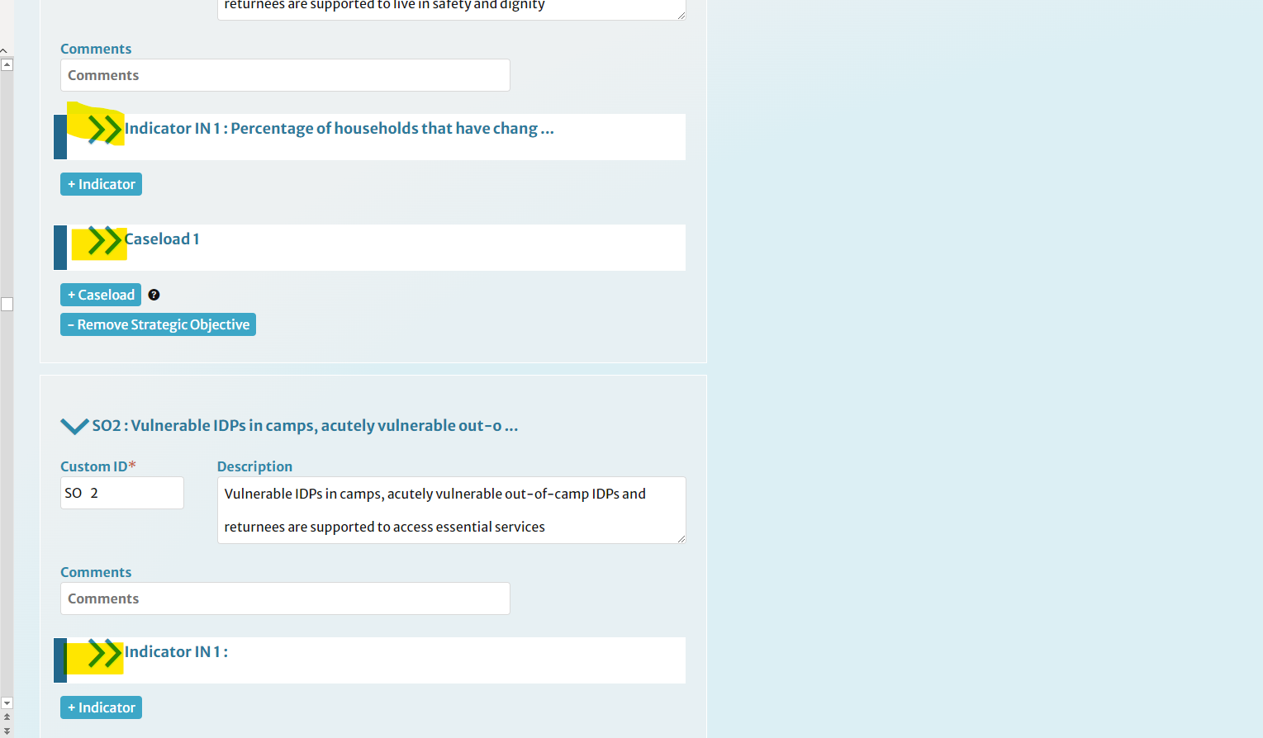
Adding Indicators for Cluster Objectives and Activities
Repeat the previous steps for each indicator under this objective/activity as well as all other objectives/activities, adding indicators as you go. Use the chevrons to the left of the descriptions to expand or minimize indicator panels.

Slide 30
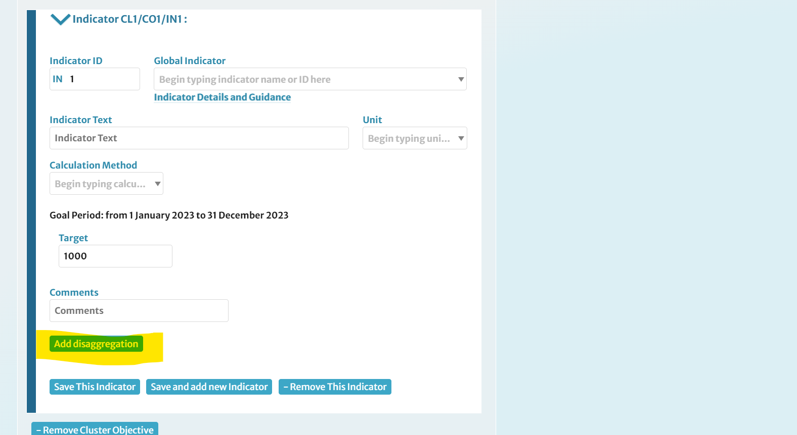
Using Disaggregation Models: cluster framework indicators
Since you already have disaggregation models created, you can apply them to the indicators in your plan. Navigate to an indicator which needs disaggregation, then click [Add disaggregation].

Slide 31
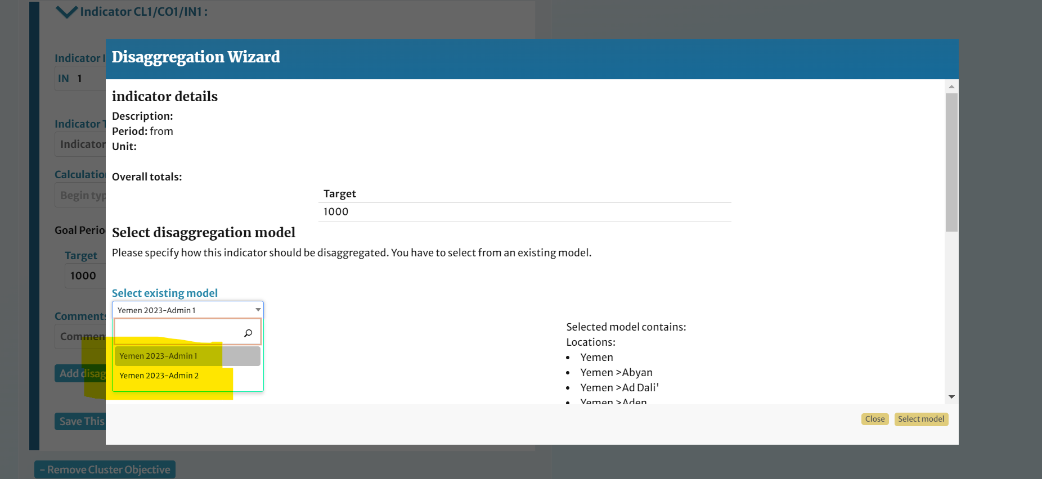
Using Disaggregation Models: cluster indicators
Select a disaggregation model from the list and click Select model.

Slide 32
Adding Indicators disaggregation using excel

Slide 33
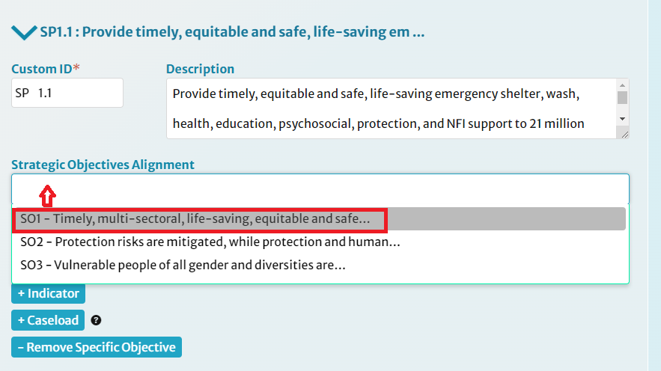
Making Alignments
Each Specific Objective needs to be aligned with ONE Strategic Objective.
Each Cluster Objective needs to be aligned with one or more Specific Objective.
Each Cluster Activity needs to be aligned with one or more Cluster Objective.
To make these alignments, click on the Alignment and choose the appropriate alignment.

Slide 34
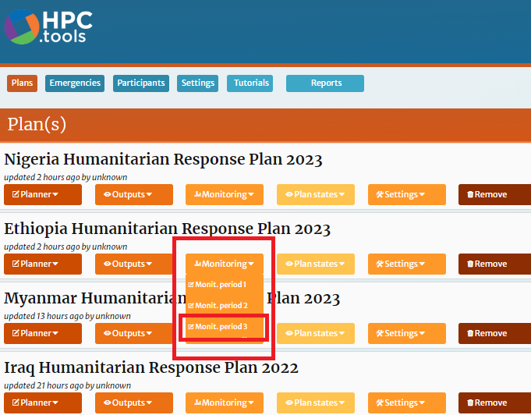
7. Uploading monitoring data
Start your monitoring reporting by clicking on the latest open MP.

Slide 35
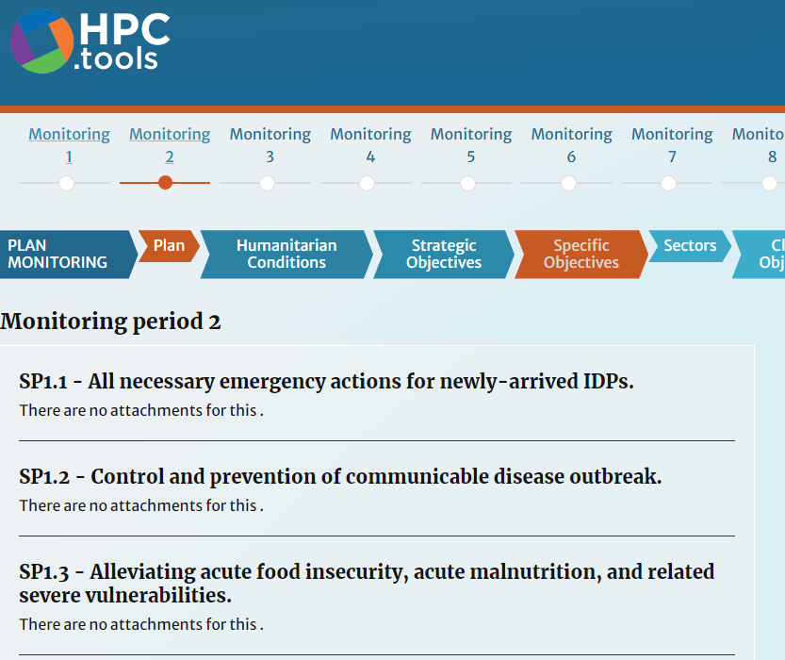
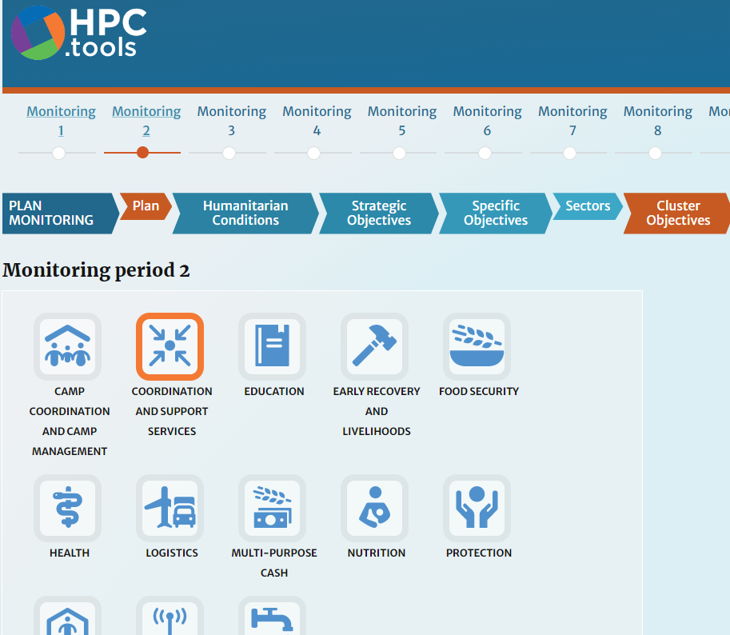
Navigating monitoring data
Under the Monitoring Section, the plan hierarchy levels are displayed. Choose the level you wish to view, e.g. Cluster Objectives or Cluster Activities. To enter data for clusters, select your cluster using the icons provided.

Slide 36
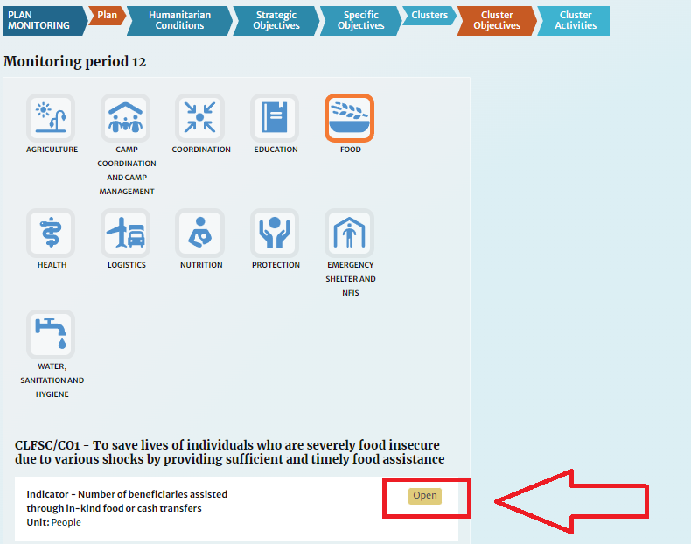
Navigating monitoring data
The elements for the selected hierarchy level and cluster are listed, e.g. all Food Cluster Activities, with indicators for each. Click Open on an indicator to view its data.

Slide 37
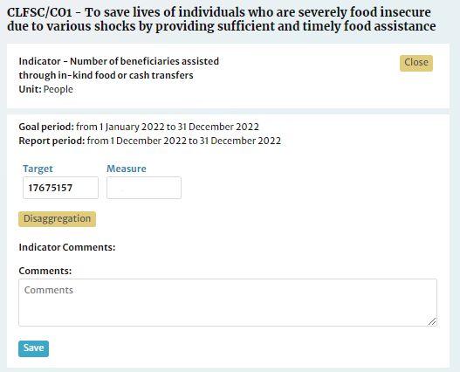
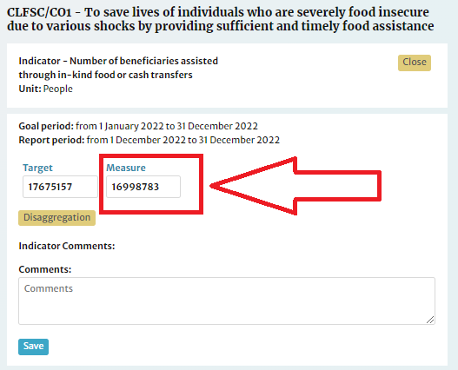
Adding monitoring data
The tool displays the target figures defined during planning. Select the indicator for which you wish to add data.
After selecting the calculation method, enter a single result for the indicator by simply adding it to the Measure field displayed alongside the planning figures.

Slide 38
Adding disaggregated monitoring data (Entering disaggregated results)
Make sure to enter any relevant subtotals and totals along with granular data.
You can enter multiple values at once by selecting the range of destination cells and simply pasting the range to it. Ensure that the arrangement of rows in the source matches that in the form on-screen.
You can also import the data using excel as follow (see screenshot in the next slide):
Export the disaggregation excel template from the disaggregated goal window.
Fill in the data into the exported excel.
Paste the data again into the disaggregated goal window
To maximize the form view, click Zoom.
Save your data and close Disaggregation by clicking Save and continue.

Slide 39
Adding Disaggregated monitoring data

Slide 40
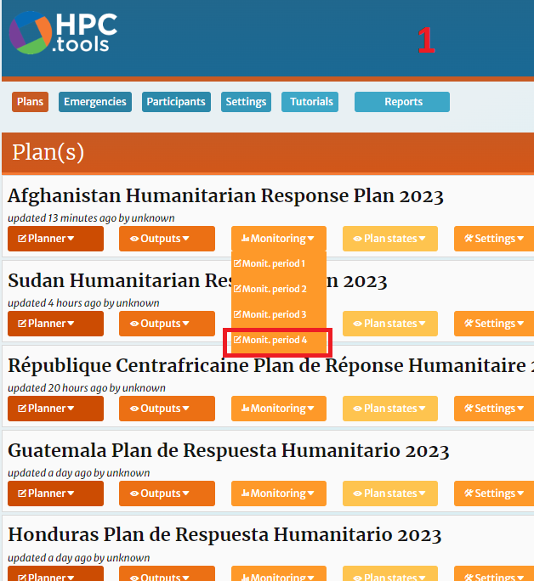
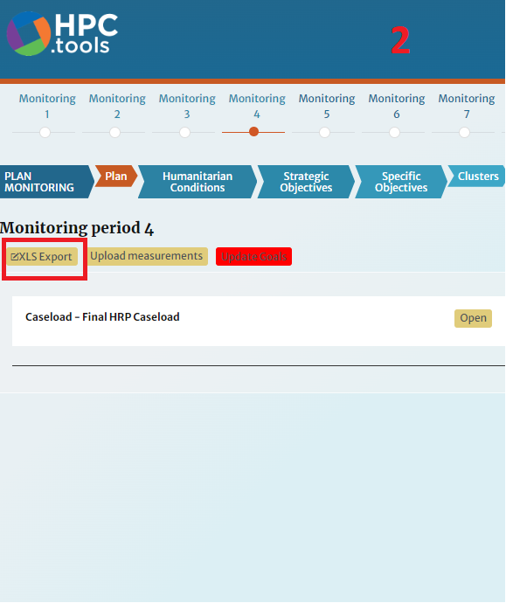
Adding monitoring data in bulk
From the Monitoring menu, select the period you wish to add data for.
Click XLS Export to download the reporting template.

Slide 41
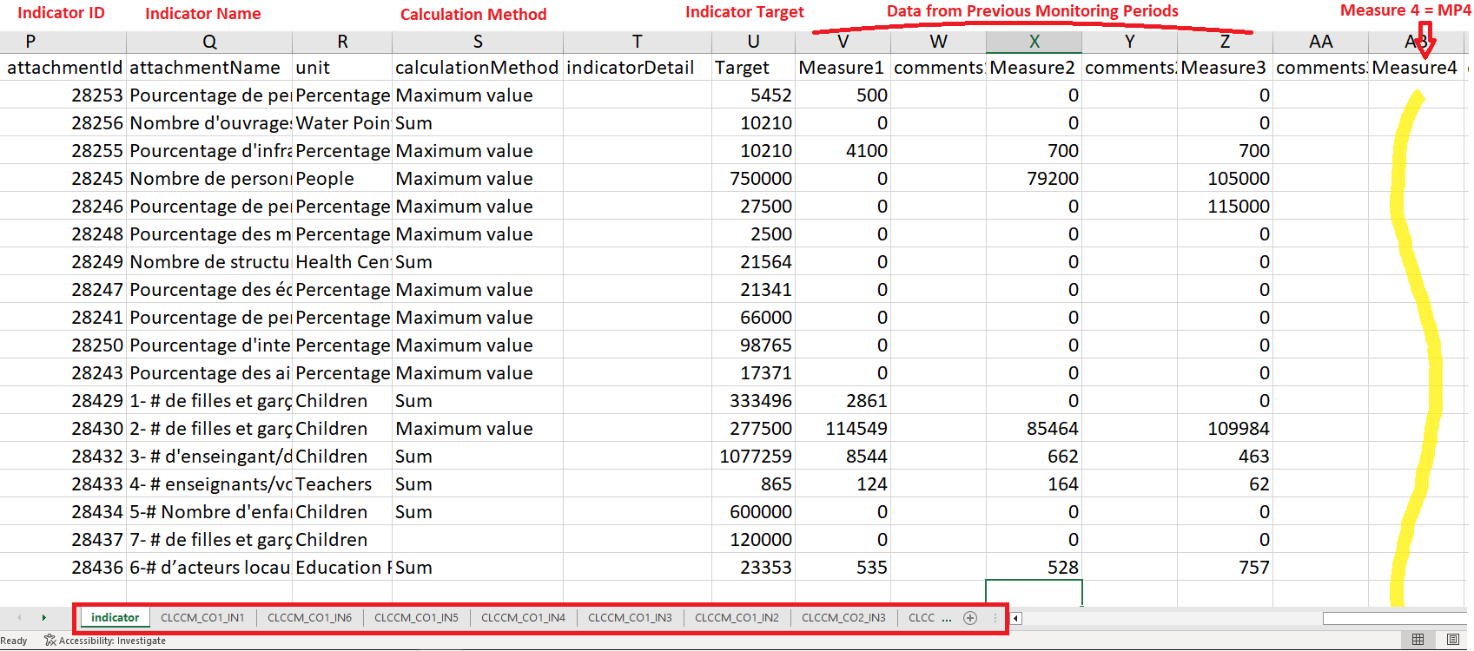
Adding monitoring data in bulk
For your indicators, complete the measurements column in the (Excel) .xls file. Results per indicator can be added in the single column in the tab labelled indicator.
For disaggregated data, the file has one tab for each indicator. To find your indicator, scroll right through the tabs and find the Custom IDs for your indicator. The tabs have rows per location and columns per category.
Add your data and save.

Slide 42
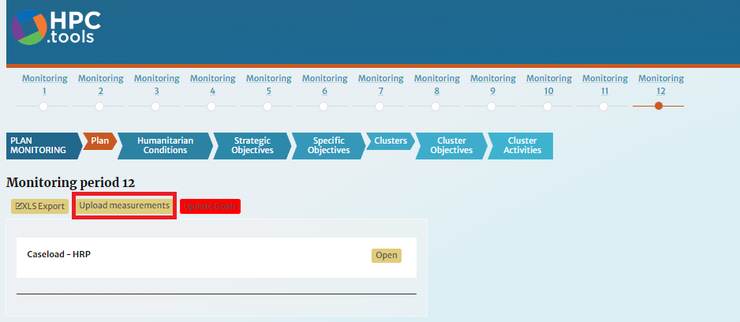
Adding monitoring data in bulk
You have written access to your cluster and read access to all others. Any data added against indicators outside the cluster(s) for which you have write-access will be rejected.
Return back to RPM and click Upload measurements.
*Visit the RPM User guide or the relevant videos available in the additional resources for more details on uploading Monitoring data in bulk.

Slide 43
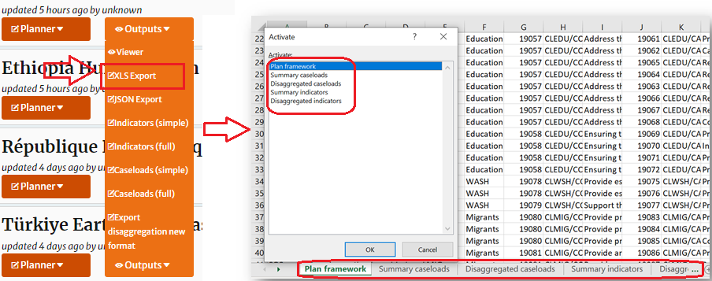
Download your data in Excel format
In the Outputs menu, select XLS Export and browse the file.
The downloaded excel has five sheets:
Plan Framework: consolidated strategic framework (Strategic Objectives, Specific Objectives) and the cluster framework (Cluster Objectives and Cluster Activities).
Summary Caseloads: overall caseloads figures at plan and cluster level, with figures for In Need and Targeted.
Disaggregated Caseloads: disaggregated caseload with figures for In Need and Targeted.
Summary Indicators: Indicators details and overall target data.
Disaggregated Indicators: disaggregated indicators with figures for Targets.

Slide 44
8. Additional Resources
Response Planning and Monitoring (RPM) User Guides
Response Planning and Monitoring (RPM) Brochure
Guide for Indicators calculation methodology
Explanatory videos : thematic here ; tutorial here

