Slide 1
Projects Module (PM) A step-by-step guide Version 1.1 Last Updated: September 2023

Slide 2
This step-by-step guide covers:
Log in to Project Module
Register New Organization
Create a New Project
Edit a Project
Clone/Copy Existing Project
Add New Project Editors/Owners
View Project Activity Log
Add or Review Comments
Approve Projects: For Both Single & Multi-Cluster Projects
Delete Projects
Edit and Change Project Status
Revise Published Projects
Download projects data
Resources

Slide 3
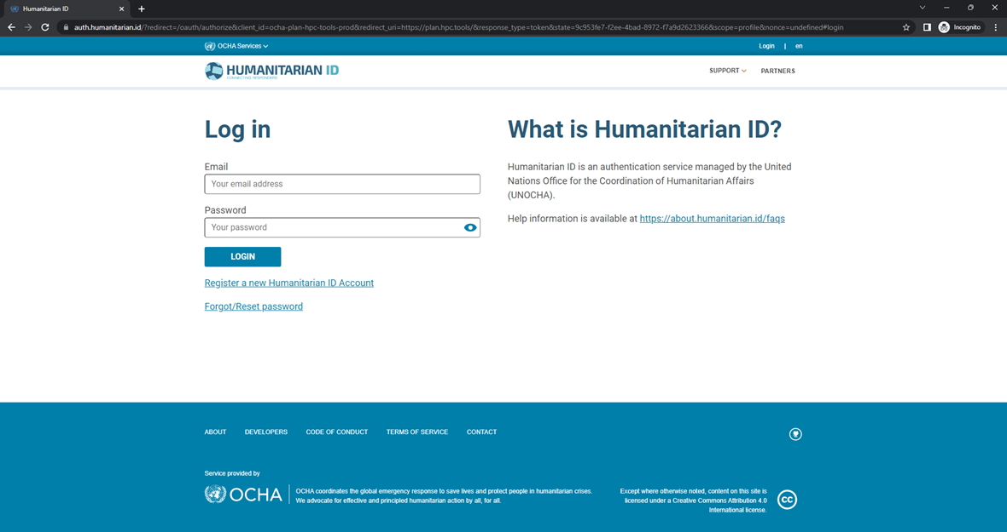
Log in to Project Module
Enter your H.ID credentials:
If you do not have an H.ID, please create a profile at humanitarian.id.
If you are logging in for the first time:
H.ID will ask you to authorize PM. Please do so.
PM will request to add organization and the country. Please add these details.

Slide 4
Log in to Project Module
Now that you have registered, go to https://projects.hpc.tools and log in!
IMPORTANT REMARKS
Only appealing partners upload projects in HPC, and NOT the implementing partners.
You don’t have to upload your project in the Online Project Form in one go. If you Save the pages you worked on, you can continue at a later time. On the landing page of the HPC Project Module, you will see the Project that you started. Click on “Edit” to continue working.

Slide 5
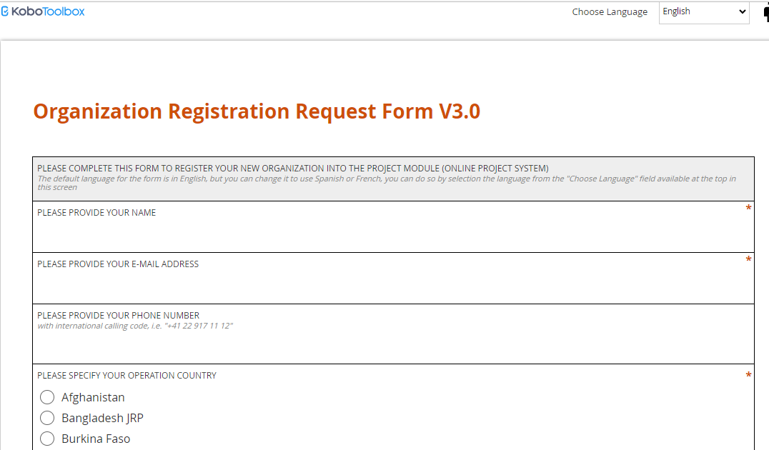
Register New Organization – Send request to register (For Partners)
The HPC Projects Module database has over 12,000 organizations already registered that partners MUST reuse. Once an organization is registered, it can then register projects.
Partners (submitting a REQUEST to be registered) and Plan Leads from OCHA or the leading appeal agency should VERIFY a do an extensive search for the organization if it exists in the database or not, to avoid duplicates or incorrect registrations. If the organization is not found in the database, partners will have to fill out a short KoBo form requesting to be registered: Link

Slide 6
Register New Organization – Verify and Register (For Plan Leads)
After a request has been filled out, a Plan Lead should VERIFY the request, confirm whether the requesting organizations can be registered in the system or not, if not then REGISTER the organization. Steps are:
Open the Organization Registration Kobo Data Excel file in desktop mode. Refresh the data by right clicking, and filtering by Submission Date and Operation to see which organization(s) have recently submitted a REQUEST to register.
Go to Project Module → Admin → Manage Organization and do search for the organization to see whether the organization already exists. Type the name or the abbreviation and click the [Search] button. If the organization exists, then please inform the partner (by email provided in the request form) and provide them with the exact name that you found, and they need to use.
Alternatively use the Master organizations excel to find the organization (right click and refresh to get the updated list)

Slide 7
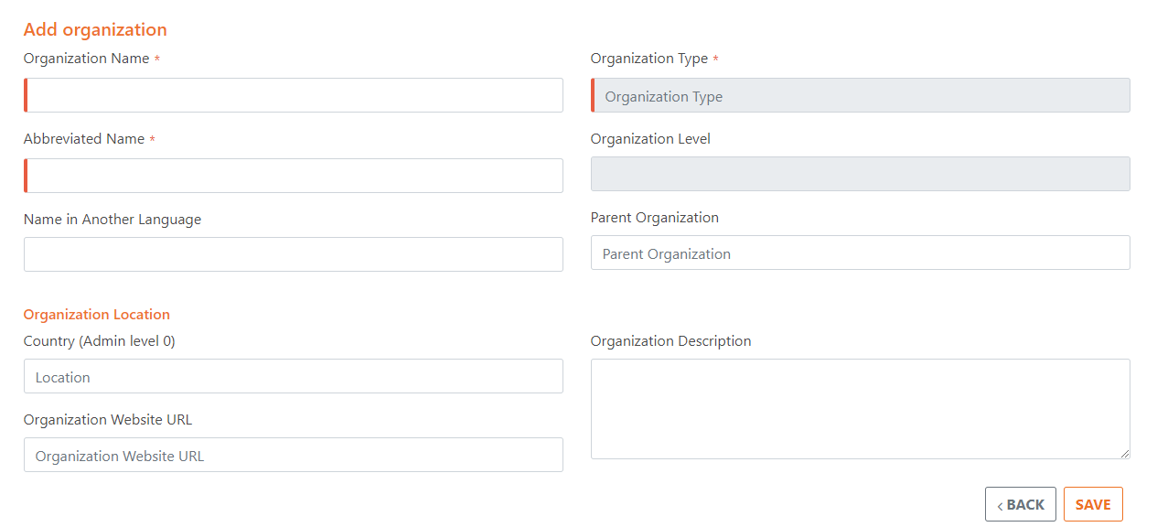
Register New Organization – Verify and Register (For Plan Leads)
if you didn’t find the organization, click on Add Organization.* Fill in ALL available Organization details (yellow columns in Kobo excel). Please pay attention to the required fields. Follow the guide for the “Organization Type and Sub-Type” based on the instructions on the next page.
In case Plan Leads need to update already registered organization, they communicate with MATS in HPC HQ to do so through normal channels i.e. Support HPC Teams channel.
Please note that registering organization should comply with the set standards accessible in Projects Module User Guide pages 12-28. A dedicated session for organizations registration or refresher training can be offered by OCHA HQ.

Slide 8
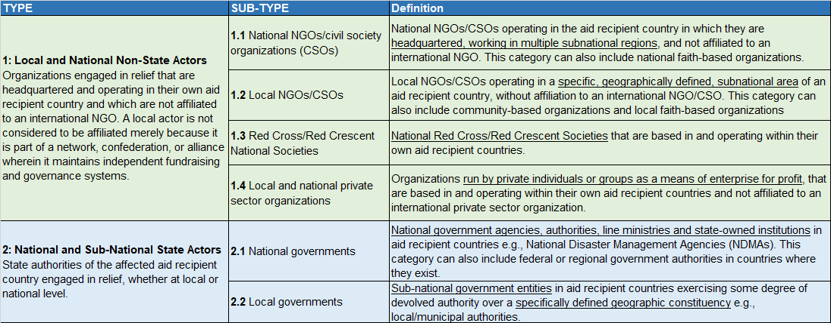
Register New Organization – Select Correct Organization Type, Sub-type
When filling out the "Add Organization" form on PM, pay particular attention to the “Organization Type and Sub-Type” as this information will have important implications.
In general, there are 4 types with their respective sub-types. See the table below and in the next page for a summary.

Slide 9
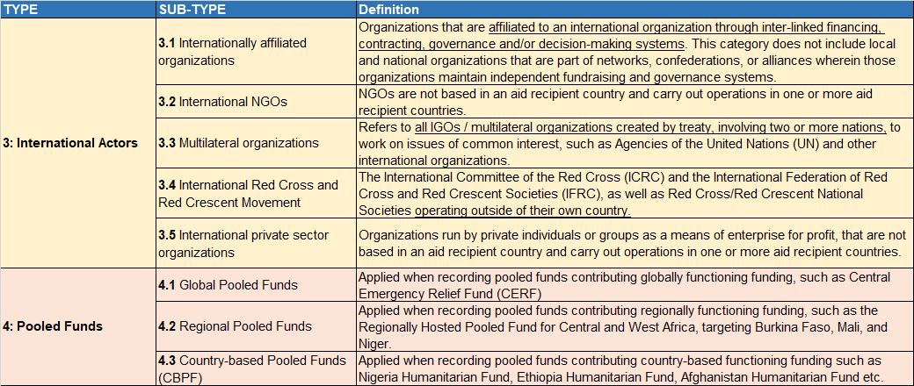
Register New Organization – Select Correct Organization Type, Sub-type
When a particular organization type and sub-type is selected, the system will automatically generate a grouping under which the selected category falls, in accordance with the Grand Bargain standards.
Do thorough check and consult with the HPC HQ team for guidance and to consult on the tricky cases, such as cross-border organizations

Slide 10
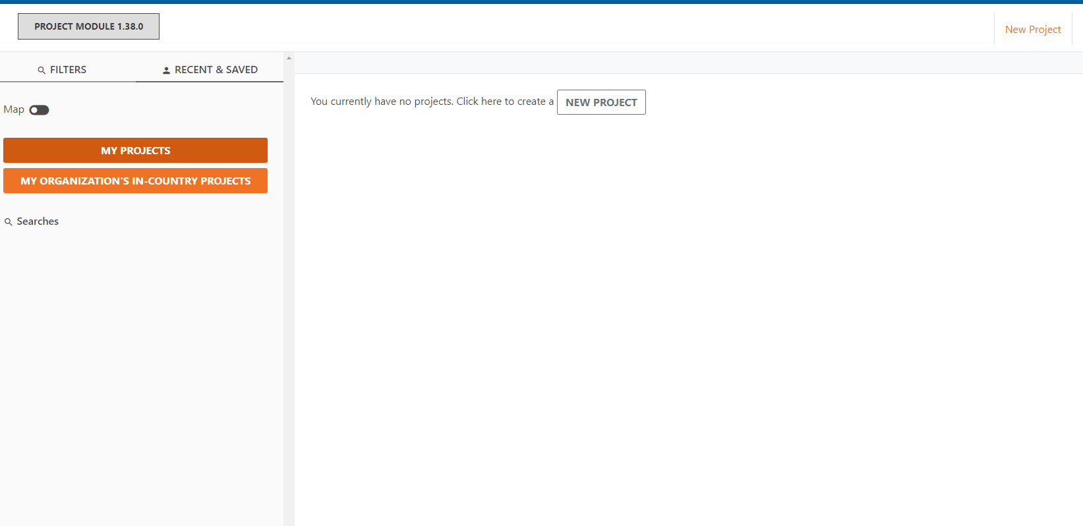
Create a new project
On the landing page for the HPC project module, click on ‘New Project’ to start.

Slide 11
Basic Info Tab
Once on the project creation page, type (or copy & paste) the information into the corresponding fields.
All mandatory fields on the online platform are marked with an orange asterisk (*) and highlighted with red bar
On the left of the screen, you will see a navigation pane which indicates the tabs and track progress.

Slide 12
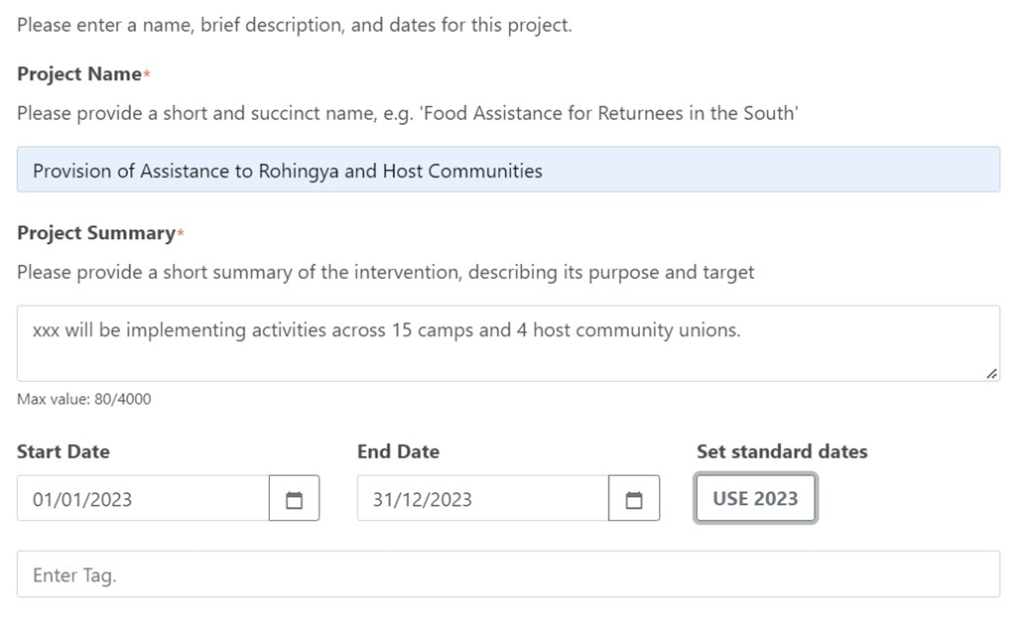
Basic Info Tab: Add projects details
Add the Project Name and Project Summary.
Add Start Date and End Date: you can click on USE 2024. This field has financial implications. Start and End dates should reflect ONLY the part that is covered under specific year. E.g. if the project is a multi-year project starting at some time in 2023 and ending in 2025, include for 2024 plans, a start date of 01/01/2024 and end date as of 31/12/2024.
Skip the Project Tags option.
1. General Description (Name, Summary, Contacts)

Slide 13
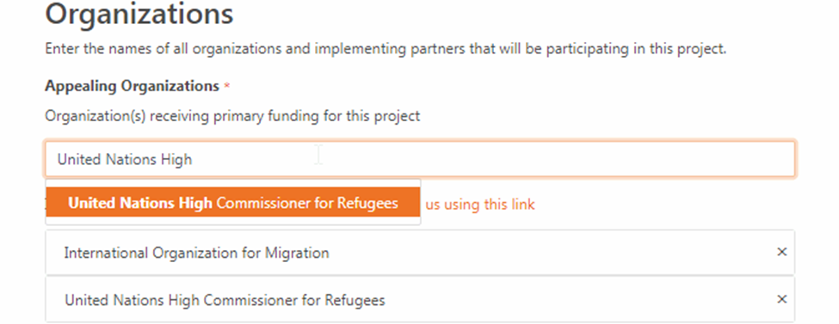
Basic Info Tab: Add the Organization
Search for the Appealing Organization(s) by typing in the name of the organization and clicking on the name that appears in the pop-up box as illustrated below.
If you are unable to find the organization in the list, please submit a request for your organization to be registered by clicking on the link (please inform us using this link)
Add Implementing Partner(s). For multiple partners add and separate them by a commas.
2. Appealing Organization(s)
Note: For multi-organizations projects, search and add them all

Slide 14
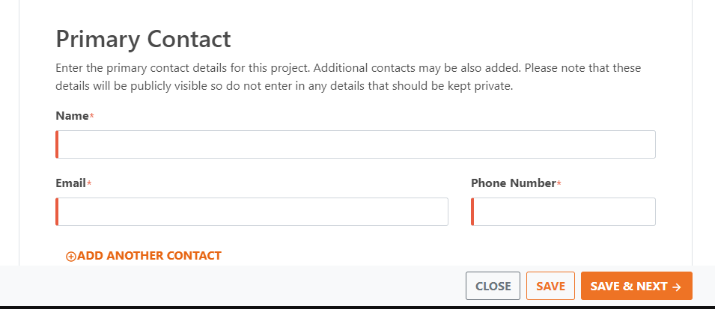
Basic Info Tab: Add Contacts
Copy & paste or type the Primary Contact details. You can add multiple contacts by clicking on
“+ ADD ANOTHER CONTACT".
Click SAVE & NEXT → to move onto the next page.
IMPORTANT: A good practice to move from one part of a project to another is by clicking on SAVE & NEXT to allow for implementing logic from one stage to another.

Slide 15
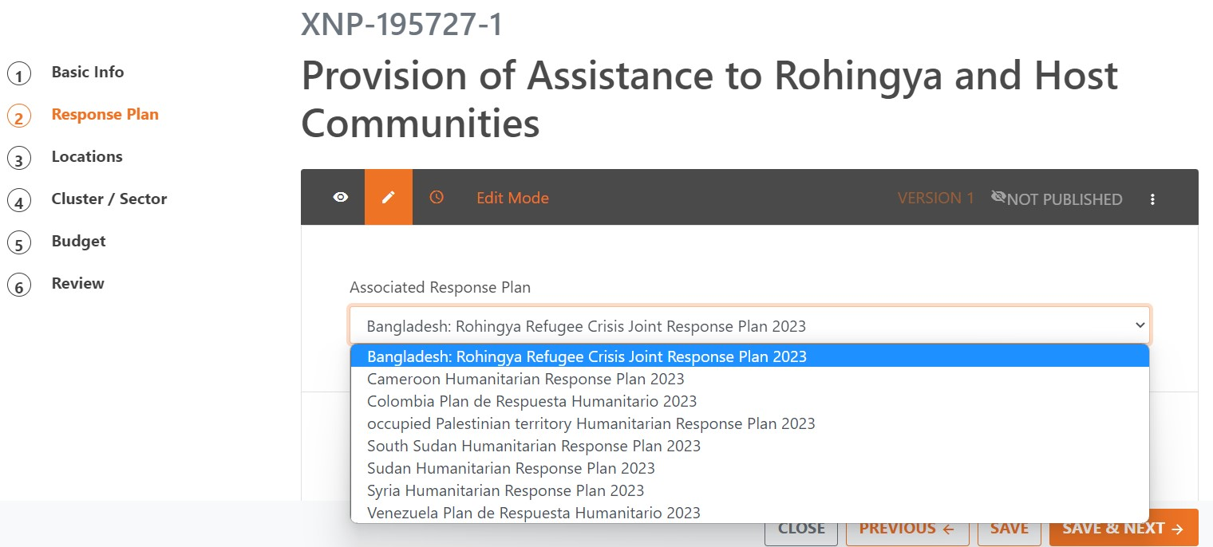
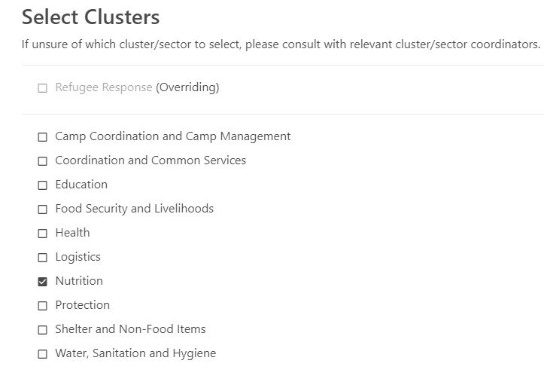
Response Plan Tab: Link to the clusters
Select the response plan to connect the project to. Once selected, a list of the plan Sectors/Clusters will be listed to select, in addition to multiple questions to be answered.
3. Selecting the Response Plan
4. Selecting the Cluster(s)
IMPORTANT: Ensure to select the plan in the right year. If a plan has been selected from previous years, it means the project is linked incorrectly resulting on the need to rework the project to relink it to the correct plan + year

Slide 16
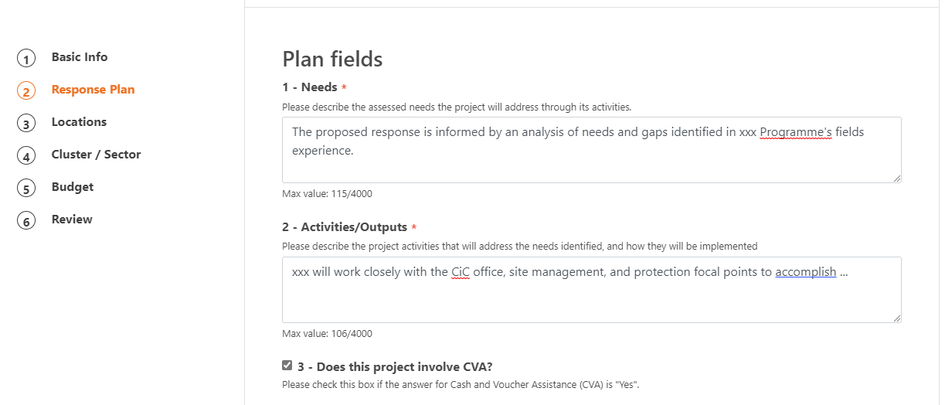
Response Plan Tab: Answer projects questions (Plan fields)
Projects questions under the Plan Fields needs to be answered. The responses to these questions can be of free test , checkbox, a selection from drop down list, or numbers. See below screenshot of an example:
Click SAVE & NEXT → to move onto the Locations page.

Slide 17
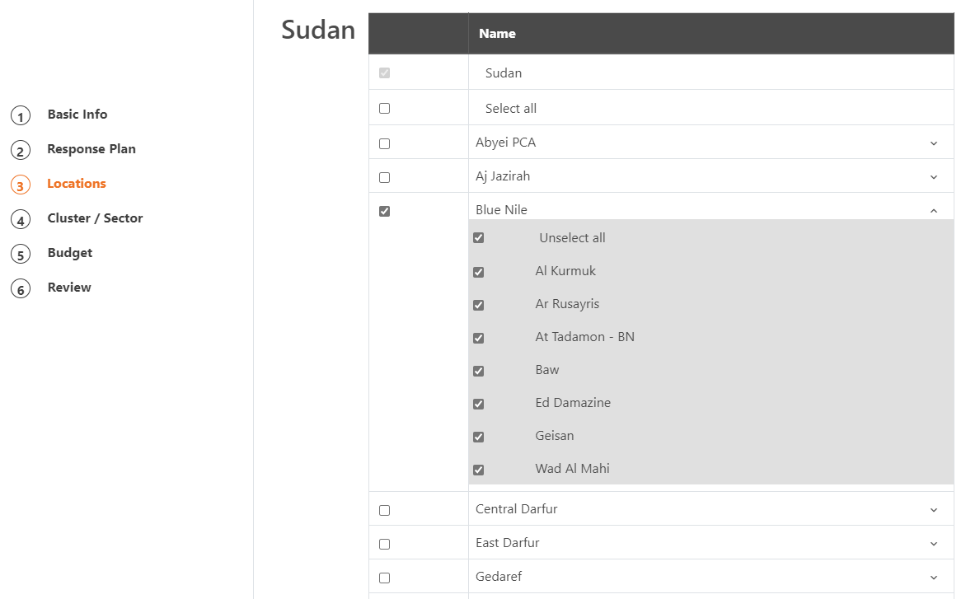
Locations Tab: Add the projects locations
Check the locations where the project will be implemented, at lower admin level available
Click SAVE & NEXT → to move onto the next page.
Admin 0
Admin 1
Admin 2
5. Location i.e., where the projects will be implemented

Slide 18
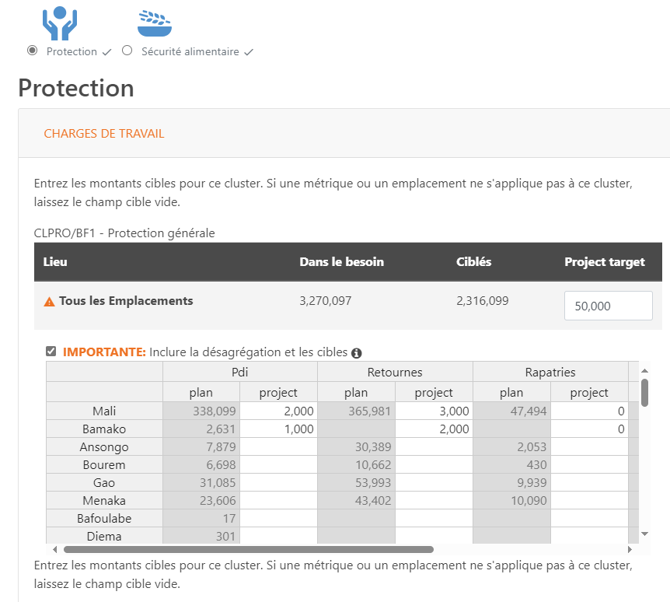
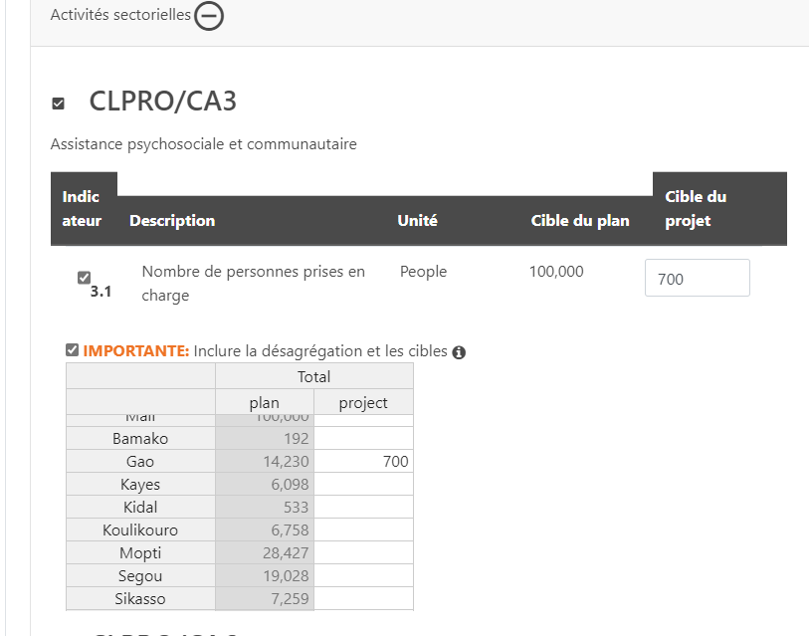
Cluster/Sector Tab: Add Projects targets against Cluster targets
Add project targets, including at indicators level.
Add the disaggregated targets to indicate
the quantities of your project per location.
6. Plan framework e.g., Project target vs plan/cluster(s) target
Caseloads
(people targeted)
Activities targets

Slide 19
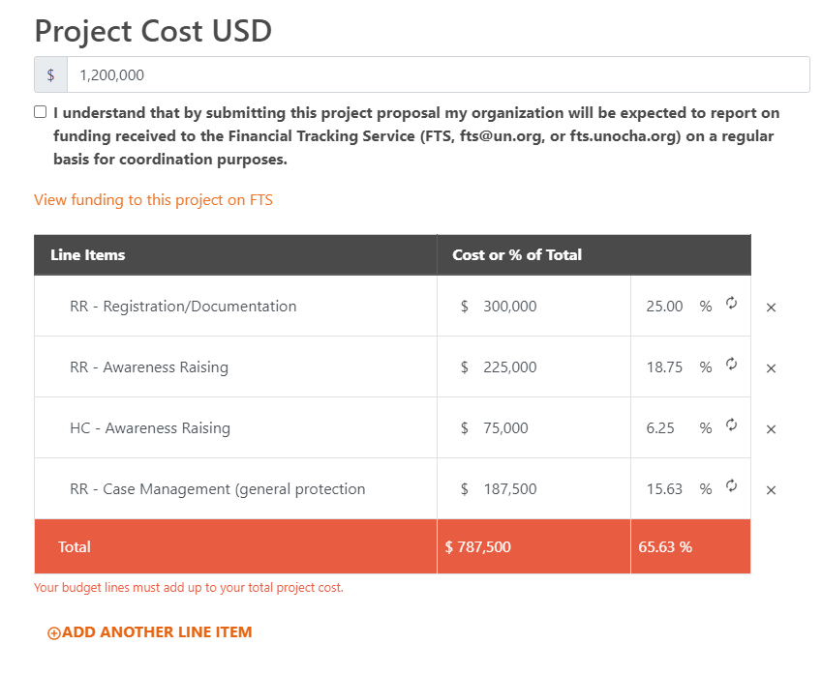
Budget Tab: Add the overall cost and budget line items
Add overall Project budget in the field Project Cost USD, and, and then list the budget line items, with the cost for each. You also can add percentages for each item instead of the full amount, and the system will calculate the cost automatically without having to add it manually.
Add more line items by clicking on ‘ADD ANOTHER LINE ITEM’.
7. Budget
e.g., broken down by clusters and appealing agencies
Note: If the overall project cost entered at the top of the page does not match the budget line items breakdown, the colour of Total bar will be displayed in RED (see screenshot). Once all numbers matches again, the Total bar will turn GREEN.​

Slide 20
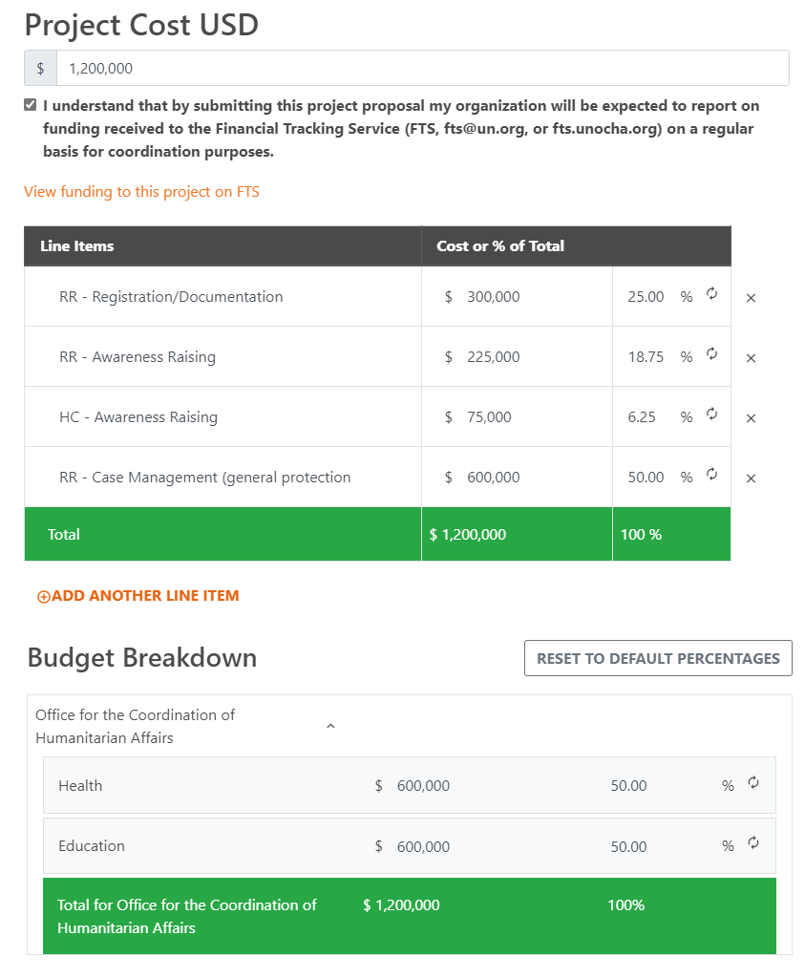
Budget Tab: Add the budget breakdown by cluster/organization
You can delete a row by clicking on the ‘x’ next to the row.
Tick the disclaimer checkbox that you will inform FTS
When the project received funding.
IMPORTANT: It is critical you send funds reports to FTS on
regular basis using the standard template
Note: If the project has two or more cluster or appealing organizations, budget split will be required for each cluster/organization, as illustrated here.
Click SAVE & NEXT → to move onto the next page.

Slide 21
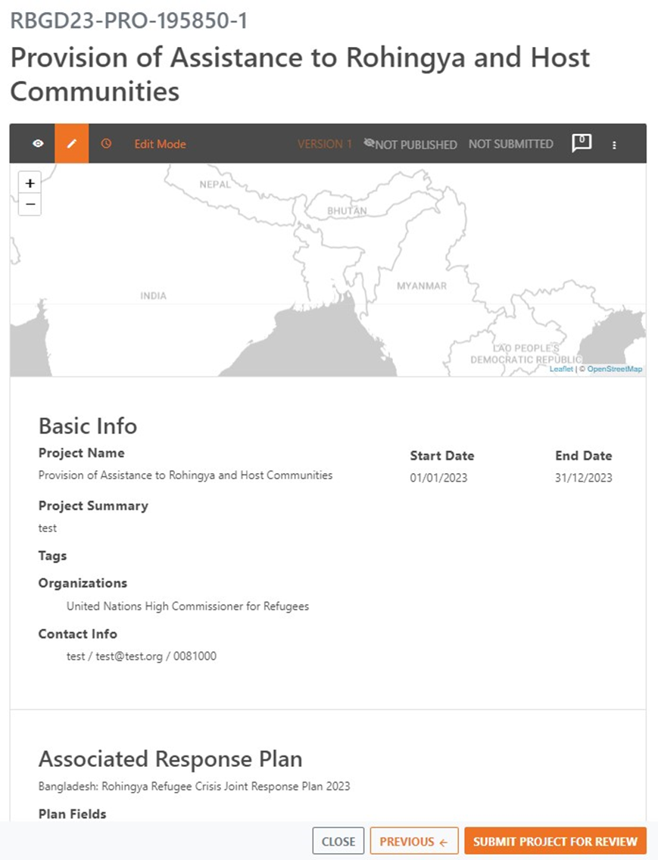
Submit the Project
You have now all the details added for review.
If you need to modify some information, you can do so by clicking on ← PREVIOUS at the bottom. When finish from making changes, ensure to move to next step by clicking on Click SAVE & NEXT → until last page.
If you are done and completed the changes, click on SUBMIT PROJECT FOR REVIEW.
IMPORTANT: Once the project is submitted it will have restricted access to edit it. Therefore, make sure you revise it thoroughly before submitting it.

Slide 22
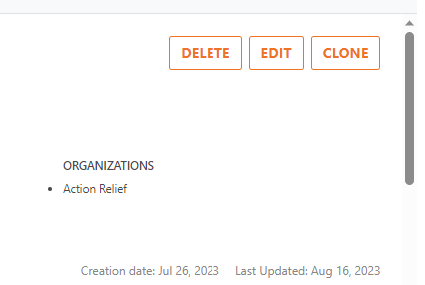
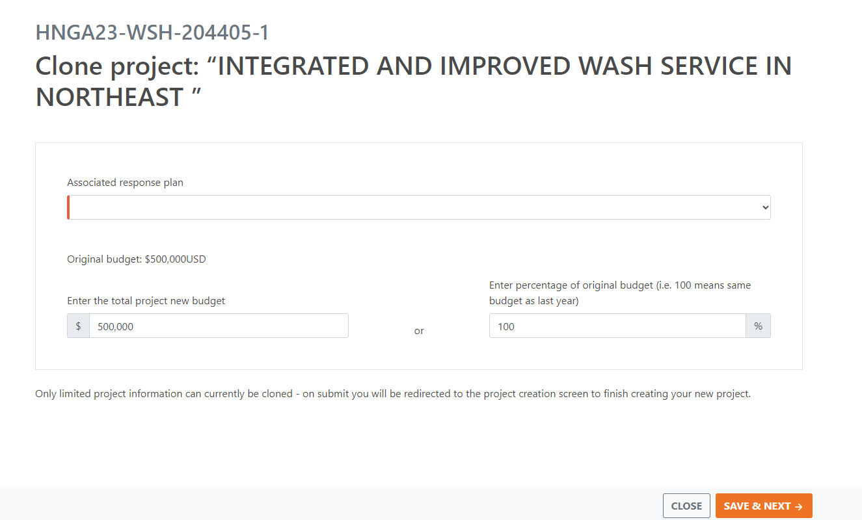
Clone/Copy Existing Project
This feature allows for creating a new copy of existing project instead of creating is from scratch. The cloned project will be similar to the source project but will have a new id. New project will be unsubmitted until it is revised and the number are updated then it can be submitted for review. Below are the steps to clone projects:
From Project Module home page, click on the [Clone] button of the source project.
Update the start date and end dates to reflect the new year
Select the Response Plan and enter the Budget (either as overall project cost, or as percentage of the source project cost).
1
3
Select target plan for the new project
Indicate total budget of the new project by numbers or percentage
2

Slide 23
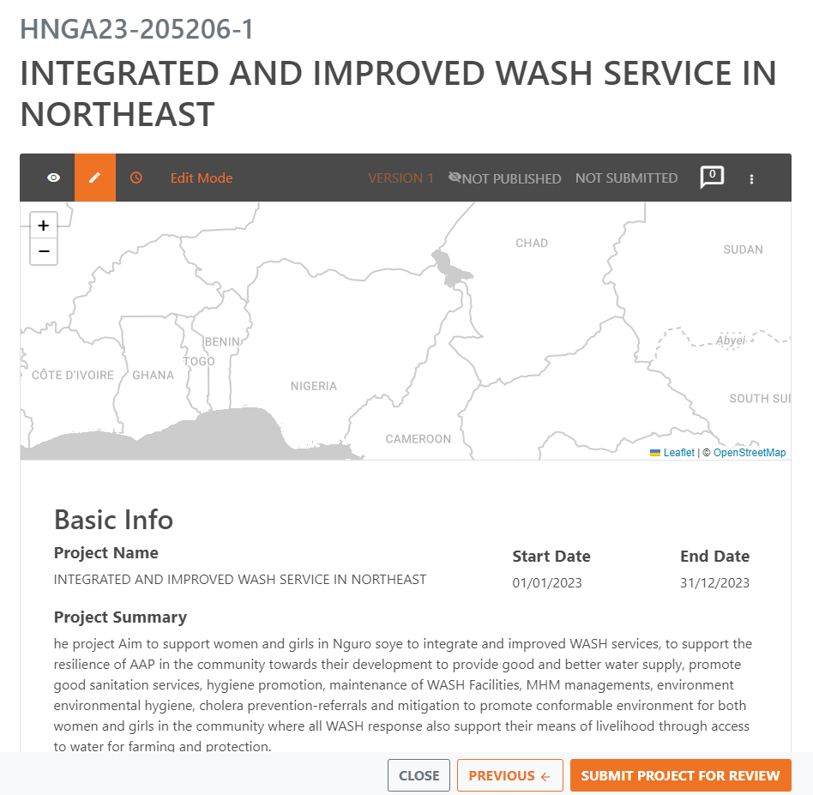
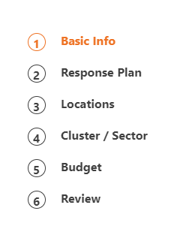
Clone/Copy Existing Project
A new project will be created with indication of the source project Id, and direct you to the Basic Info page to start reviewing and updating the new project information.
After updating the Basic Info, Click SAVE & NEXT. Follow this same procedure for all Tabs including entering the targets in the cluster/sector Tab. The budget breakdown in the Budget Tab will be populated automatically so no need to update it if not necessary.
Once done click on [Submit Project for Review].
Enter Cluster / Sector targets first. These are not cloned from the previous project and need to be created before saving
IMPORTANT: At this stage, the projects will be reviewed and decided to ‘Approve’/’Reject’/’Return for Edit’ by the cluster leads. No action is needed from partners UNLESS the projects status is Returned for Edit. In this case partners need to revise the cluster comments and resubmit the project
Click on Submit to add the project to the plan

Slide 24
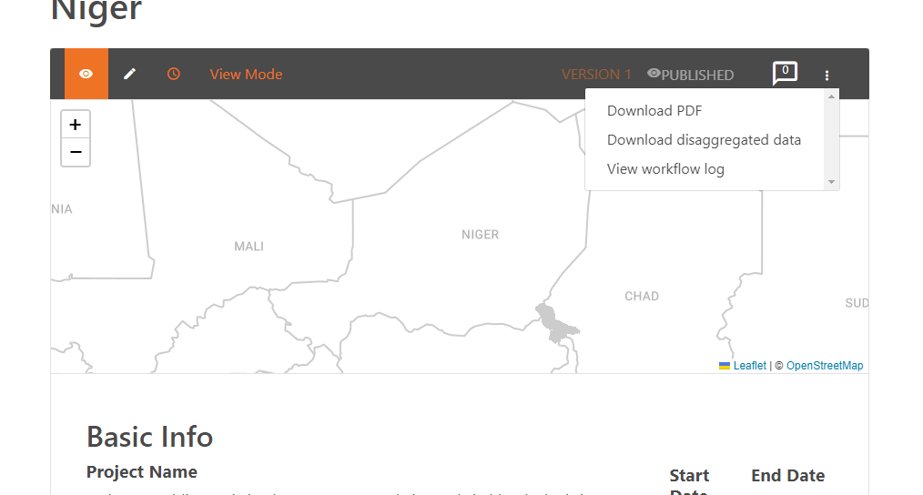
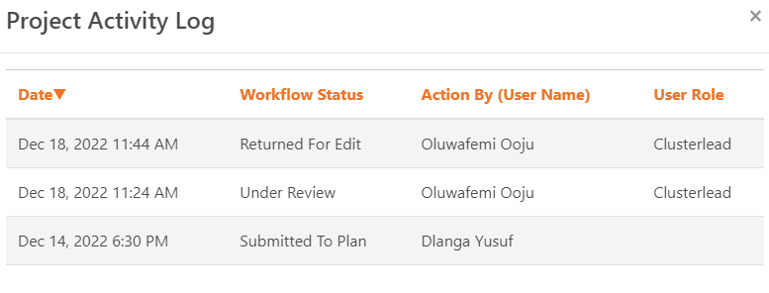
View Project Activity Log
The log helps Plan Leads, clusters, and Partners know what processes happened on the project. This can be done from within the project of interest window by clicking on the three floating dots - → [View workflow log]. This will load a popup window with list a of changes to the project statuses.

Slide 25
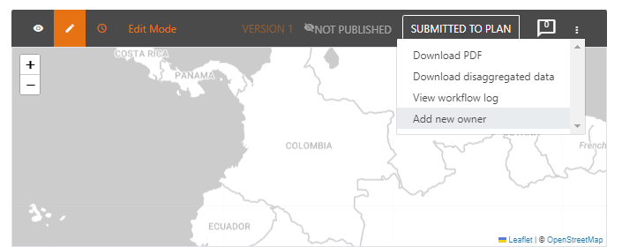
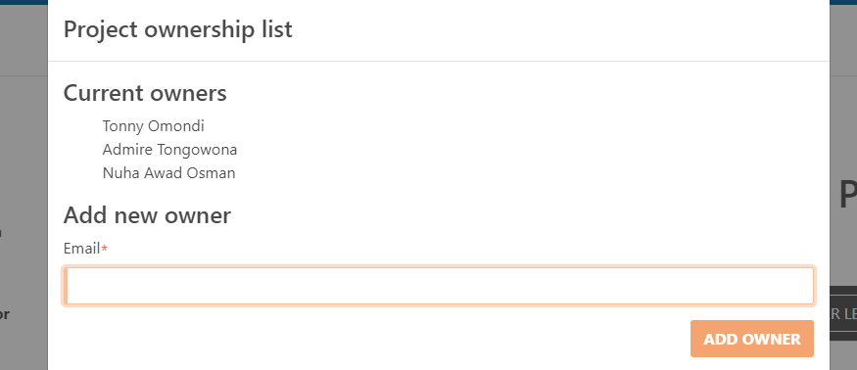
Add New Project Editors/Owners
Add one or more Project Owner is possible to allow for multiple editors to edit the projects. Click Add New Owner option from the menu -→ enter the Humanitarian ID email address.
In the same menu, all Projects Owners are listed under Current owners.

Slide 26
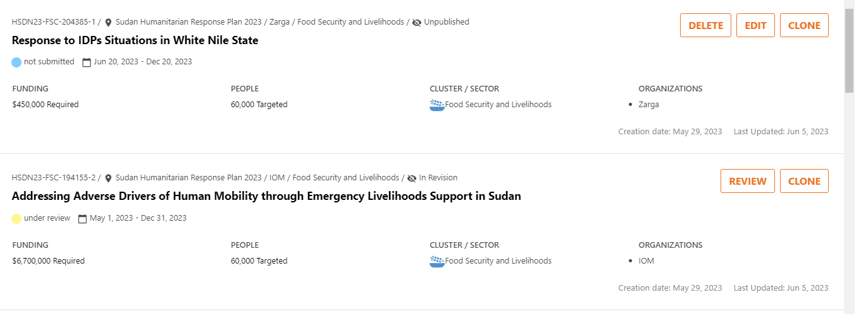
Delete Projects
Plan Leads and Project Owners also have the ability to delete a project. However, this can be done ONLY if the project status is Unsubmitted.

Slide 27
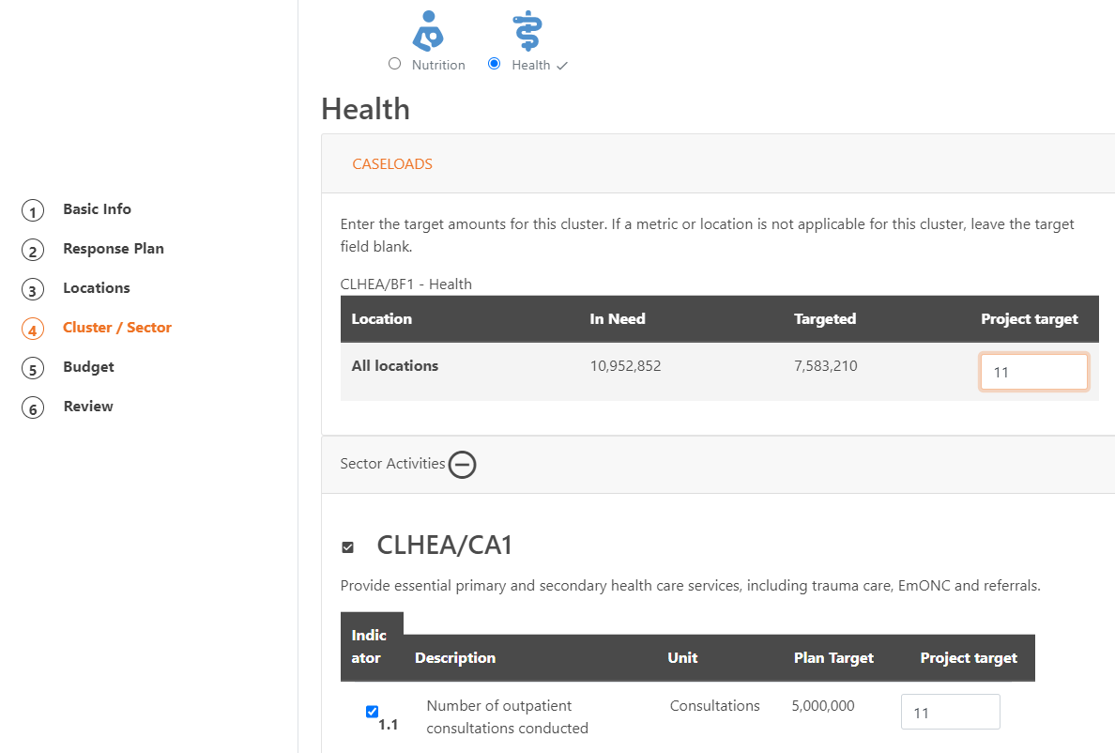
Review Projects: Navigation
After a project is submitted by the organizations/partner(s), the clusters to be able to review the project, they need to change its status to “Under Review” by clicking the "Add to Review" button. When Under Review, clusters can use the pages on the left to navigate through the project details.

Slide 28
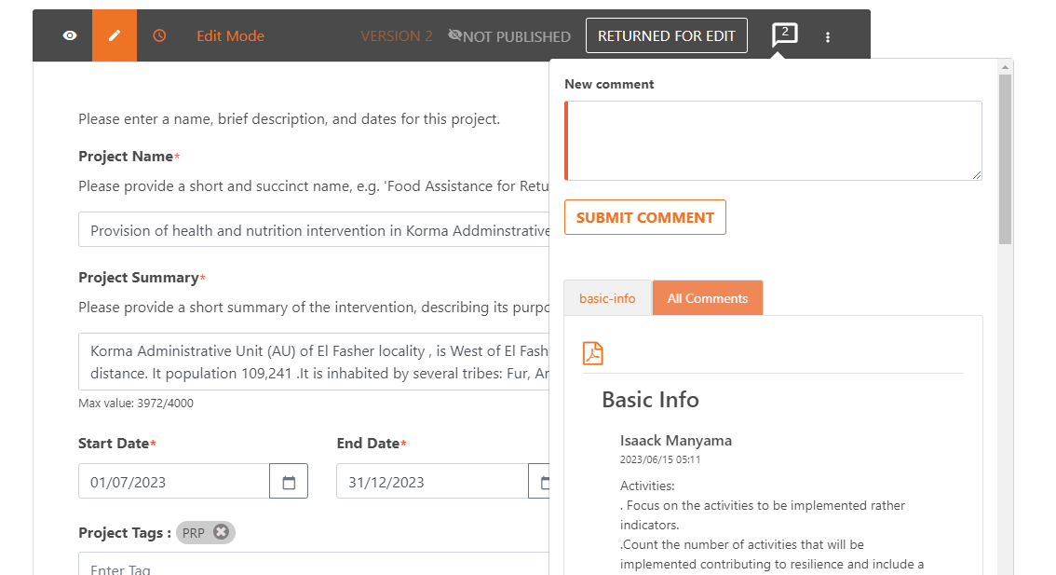
Review Projects: Adding/previewing Comments
During the review process, cluster leads can highlight or raise certain points to the partners through the comments feature. Which can be added/viewed as explained in the below screen.
In the case on major changes need to be communicated to partners then, cluster leads will need to change the projects status to “Returned for Edit” for partners action to review and resubmit the project.

Slide 29
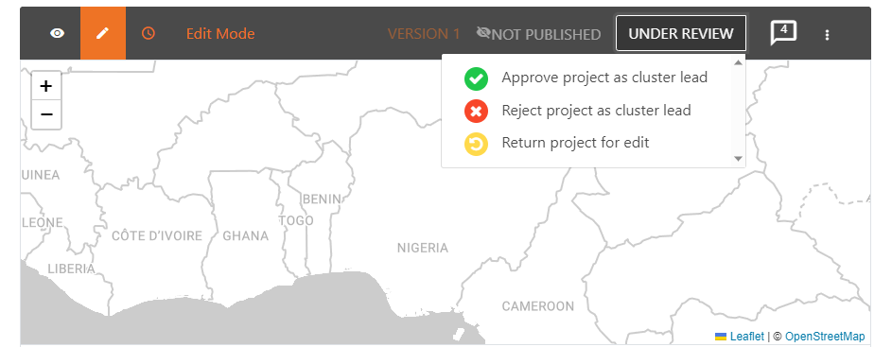
Approve Projects: Single Cluster Approval
After Cluster Leads’ review process is concluded, they decide to either “Approve”, “Reject” or “Returned for Edit” the project.
If the project is Approved or Rejected, then no changes can be made by the partners neither by the cluster leads.
If the project is Returned for Edit, then the partner require to make changes to their projects based on the clusters comments then resubmit the project for the cluster to reconsider reviewing it.

Slide 30
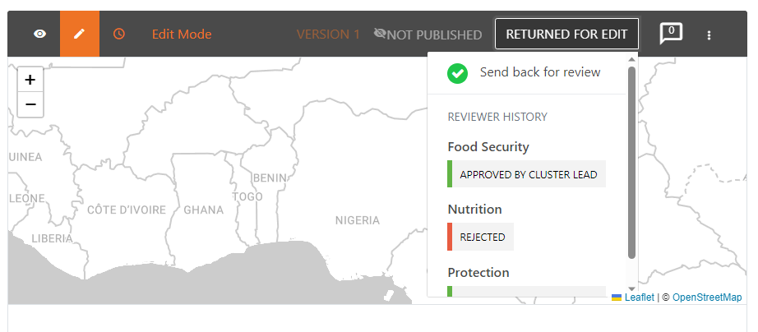
Approve Projects: Multi-cluster Approval
This follow same procedure for the approval like the single cluster approval process. i.e. a project needs to be added to review by ANY cluster lead, and then decide to either Approve, Reject or Returned for Edit the project.
The project will be approved, ONLY when all clusters approve it.
The project will be rejected, ONLY when all clusters reject it.
When there is disagreements amongst cluster leads, the project status will be changed automatically to “Returned for Edit” so partners need to act i.e. remove the rejected clusters(s) and resubmit again.
This box displays the Overall Project Status
This field displays the Individual Cluster Status(es)

Slide 31
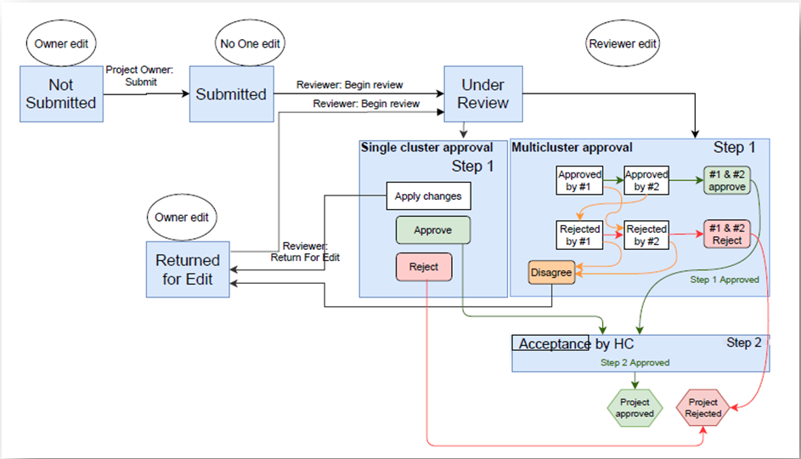
Approval Process Diagram

Slide 32
Edit Projects
The table below summarizes who can edit projects under which status(es):
(1)* This scenario occurs in multisector projects that is “Returned for Edit” by any of the other participating clusters. In this case, the other clusters whose individual corresponding status is “Under Review” CAN edit their part.

Slide 33
Change Project’s Status
Who can change Project Status? | Status Change
PROJECT OWNER(PARTNER) | Unsubmitted Submitted
 | Submitted Unsubmitted
 | Returned for Edit Under Review (1)*
CLUSTER LEAD | Submitted Under Review
 | Approved Under Review Returned for Edit Rejected
 | Approved Under Review (2)* Returned for Edit Rejected
The tables below summarize who can change projects status (from – to):
(1)* This scenario occurs in multisector projects that is “Returned for Edit” by any of the participating clusters. In this case, the other clusters whose individual corresponding status is “Under Review” CAN approve/reject their part.

Slide 34
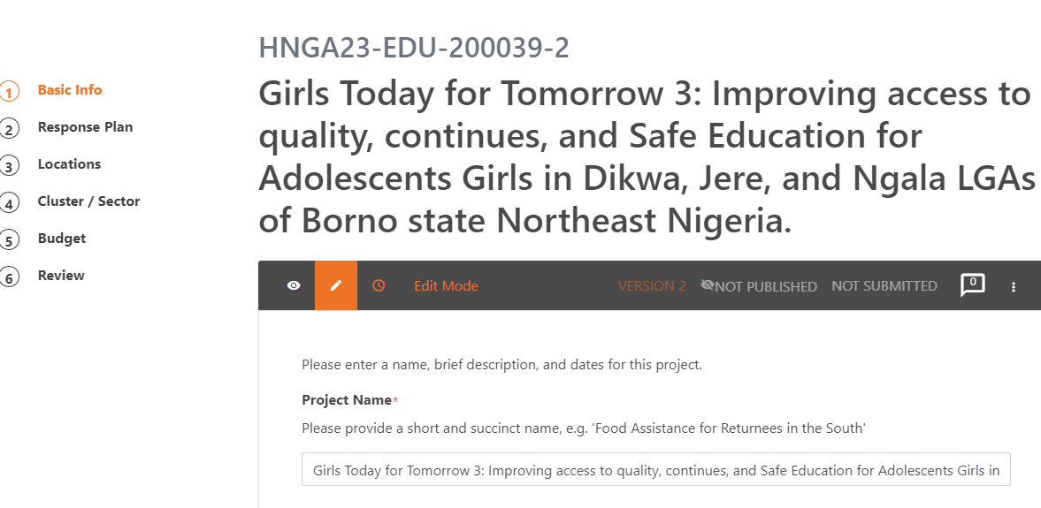
Revise Published Projects
When a decision is made to revise projects i.e., due to a change in the context, and needs or planning, published projects will need to be revised to include updated figures. Project Owners can do so by creating a new version. The steps are:
Click on the pen symbol to create a new project version. E.g., if the project code is HNG23-EDU-200039-1, then the newly created version will have the same code except the “version number” shown with a suffix after the hyphen sign, as HNG23-EDU-200039-2.

Slide 35
Download All projects data
Projects datasets can be extracted from the Project Module interface as follows:
Select the plan from the left panel, then click on the icon with bars to see the different reports available in Excel format. These are:
Download the current summary view of projects: Summary table of only the projects shown on the screen.
Download all data: List of all projects details, budgets, projects overall caseloads and indicators targets, but disaggregated data is not available in this report.
Download all locations: List of all locations and their details.
Download all caseload disaggregated data: List of all projects overall and disaggregated caseloads projects targets.
Download all indicators disaggregated data: List of all projects overall and disaggregated indicators projects targets.

Slide 36
Download individual project data
Individual project data can also be extracted from within the project sheet itself. To do so, open the project of interest, then click the three floating dots to see the available reports. These are:
Download PDF: Report on current project in preview format as a .pdf.
Download disaggregated data: Report on the project’s disaggregated targets for both indicators and caseloads.

Slide 37
Additional Sources
Project Module (PM) User Guide
Planning Bridge Tools Guide
HPC Tools API Wiki

