Slide 1
Sudan HPC 2024: Proposal on boundary-setting and prioritization
Sudan ICCG meeting
19 September 2023

Slide 2
CONTENT
01
02
03
Background, Purpose & Objectives
Boundary-setting
Prioritization

Slide 3
1
BACKGROUND, PURPOSE & OBJECTIVES

Slide 4
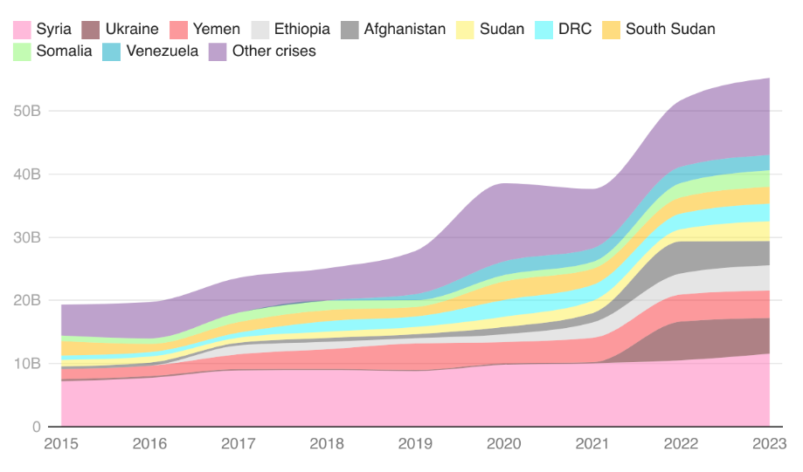
THE GROWING HUMANITARIAN APPEALS
Evolution of the funding requirements since 2015
364%
# People in Need
From 2015 to 2023 from 78 M to 362 M
184%
Growth of global humanitarian requirements
Since 2015 – From $19.5B to $55B
Notes:
Note: RRP and HRP figures are combined for major crises with both documents e.g. Syria)

Slide 5
GROWING HUMANITARIAN NEEDS IN SUDAN
Evolution of the PIN and target since 2015
357%
# People in Need
From 2015 to 2023 from 5.4 M to 24.7 M
235%
# People targeted
Since 2015 – From from 5.4 M to 18.1 M
*
* Revised 2023 HRP (May 2023)

Slide 6
GROWING HUMANITARIAN NEEDS IN SUDAN
Evolution of the Sudan funding requirements since 2015
Growth of Sudan humanitarian requirements
Since 2015 - From $1.03 BN to $2.56 BN
148%
*
* As of 16 September 2023

Slide 7
EVIDENCE-BASED, REALISTIC AND EFFECTIVE SUDAN HUMANITARIAN APPEAL IN 2024
Maximize the effectiveness of the limited resources and avoid the existing capacity being stretched too thin.
Through rational boundary-setting and clear prioritization
Make the humanitarian appeal as credible, realistic, clearly defined and well-prioritized as possible.

Slide 8
FROM PiN TO TARGET – BOUNDARY SETTING & PRIORITIZATION
What are the *humanitarian* needs?
(Humanitarian Needs Overview)
Consider where the EMERGENCY is (using JIAF framing questions & analysis of shocks)
Consider:
Humanitarian Access; Response Capacity
Complementarity with a) Govt action; b) devt action/plans
Boundary setting
Who are we planning to assist?
(Humanitarian Response Plan)
Response outside the HRP (incl. other humanitarian actors (ICRC/MSF) + devt action)
No response
What is prioritized within the HRP
(e.g. specific geographic areas, certain activities etc)?
Prioritization
Notes:
JIAF framing questions Q1.Where is the highest concentration of the population in need in the country?
Q2. Which areas have many sectors with a large population in need?
Q3. What sectors have the highest PiN? (i.e., what sectors are driving the needs in a given area?)
Q4. Where are the areas with the highest severity?
Q5. Which areas have a large number of sectors with high severity of needs?
Q6. What sectors have the highest severity? (i.e., what sectors are driving the needs in a given area?)
Q7. What areas have the coexistence of the highest PiN and highest severity?
Q8. What sectors have both the highest severity and highest PiN? (i.e., what sectors are driving the needs in a given area?)
Q9. What sectors often co-exist?
Q10. What is the PiN Trend as compared to the previous year?

Slide 9
2
BOUNDARY-SETTING

Slide 10
FIVE PROPOSED ELEMENTS TO CONSIDER (BUILDING UPON WHAT ALREADY EXISTS)
Strategic element (Strategic Objectives)
Programmatic element
Geographical element
Operational element
Operational capacity
Access & national capacity
Funding trends
Nexus
element

Slide 11
1. STRATEGIC ELEMENT
Current status | The revised HRP focuses on the scale-up of life-saving multisectoral assistance and protection services (SO1 and 2). The HCT decided to pause programming related to SO 3 and 4 of the initial HRP (access to livelihood, basic services, and resilience solutions, respectively).
Proposal | The 2024 response planning be grounded on the analysis of the current situation as planning assumption as opposed to a hypothetical projection of situation and needs to ensure realistic boundaries.* The volatility of the situation has rapidly evolved over the past five months due to the elements not under the control of the humanitarian community.
Ask | Agreement in keeping SOs 1 and 2 for 2024 HRP. This will determine what programming will go into the HRP (or not).
* Projection, including scenario-building, can guide the risk analysis to ensure a proactive vision of preparedness.

Slide 12
2. PROGRAMMATIC ELEMENT
Current status | Solid HPC experience among the Sudan humanitarian community. Mechanisms to minimize overlapping activities and ensure complementarity among different actors are already in place, thanks to the strong coordination structure and capacity that pre-exist. Following the April eruption of hostilities, duty of care commitment took precedence, while operational challenges such as frequent disruption of telecommunications affect how humanitarian actors interact or collaborate.
Proposal | Consideration of the extent to which the 2024 humanitarian programming to be included in the HRP complement and/or overlap with those to be implemented by partners not traditionally part of the HRP should be factored in to minimize potential duplication of efforts and financial ask.
Ask | Clusters are strongly encouraged to coordinate with non-traditional HRP partners to identify possible duplication during the response planning process.

Slide 13
3. GEOGRAPHICAL ELEMENT
Current status | The initial HRP classified 190 localities (including the Abyei PCA area) into four priorities, based on the multi-cluster convergence of needs, access constraints and conflict or non-conflicts driven needs of life-saving and life-sustaining response. Of the total of 190 localities, the planned response targeted a varying degree of PiN in 176 localities.
Proposal | 1) Revisit the ‘access’ classification, e.g. the likelihood of resolving ‘high’ access constraints, the possibility to delink ‘access constraints’ from these definitions and, assess it through different approaches, e.g. by analysis historical response monitoring data or through feasibility perspective. The HCT is committed to continuing to explore all possible means and utilize every opportunity to widen humanitarian access to reach people in need wherever they are. 2) Clusters targeting will be guided by their own sectoral analysis of needs and severity. 3) At the inter-cluster level, re-identify priority level by locality based on JIAF 2.0 analysis of inter-sectoral severity results where only high severity areas (4 and 5 scales - as per the JIAF 2.0 analysis) should be considered for HRP prioritization. 4) For areas where convergence of high severity (intersectoral severity), consider a multi-sectoral response approach to ensure effectiveness and efficiency.
Ask | Clusters to use interoperable scales and global operational guidance of the JIAF 2.0 to consistently present sectoral results, including PiN and severity, and coherent intersectoral analysis.

Slide 14
4. OPERATIONAL ELEMENT (1/4)
4.1 Operational capacity
Current status | Historically, around 80-100 humanitarian organizations participated in the Sudan HRPs each year (about 40 per cent were national NGOs). The planned activities covered a large number of localities across the country, albeit at varying degrees. After April, it is generally assessed that partners have a reduced operational capacity due to several reasons. This has hampered the provision of assistance in several areas, particularly hot spot locations. About 3.2 million people (18% of the overall target) received life-saving assistance provided by 109 humanitarian organizations (Apr-Jul). National NGOs and Red Crescent accounted for 45 per cent of the overall response capacity.

Slide 15
4. OPERATIONAL ELEMENT (2/4)
4.2 Access and national capacity
Current status | ERC: Sudan the ‘toughest place in the world’ for humanitarian access. Bureaucratic and administrative impediments continue to curtail humanitarian partners’ ability to deploy technical teams into Sudan and parts of the country where needs are highest. Staff, volunteers and activists working for Sudanese CSOs and national NGOs continue to live and work in many of those ‘hard to access’ parts of the country. They have been critical frontline responders for the last four months, despite direct attacks on CSOs. There is a renewed global call to support civil society in Sudan in all its diversity – from national NGOs to Emergency Response Rooms. The revised HRP includes $123.5 million of ask for the response by national NGOs, or less than 5% of the total ask. As of mid-September, only $9.5 million (less than 0.4% of the total amount received) has been allocated directly to them.*
* The amount represents the sum of all projects directly submitted by national NGOs as appealing organization. It does not include the projects in which national NGOs are identified as “implementing partners”.

Slide 16
4. OPERATIONAL ELEMENT (3/4)
4.3 Funding trends
Current status | During 2020-2022, Sudan received an annual average of $1 billion of humanitarian funding, most channeled through the HRPs. As of 16 September, Sudan has received $770 million in humanitarian funding - $685 million of which has been channeled through the HRP (27% of the total ask). Around $532 million has gone to the UN (71% of the total received). So far, around 50 donor countries are humanitarian funders to Sudan. The top five donors are the United States, ECHO, CERF, UAE and Germany.

Slide 17
4. OPERATIONAL ELEMENT (4/4)
Proposal (overall for this element) | The response planning is to be grounded on a realistic consideration of funding prospects in 2024 and access (or a lack thereof), particularly as a result of active hostilities and unpredictable conflict dynamics. Consider expanding – in a conflict-sensitive manner – support to locally-led aid efforts across Sudan, including grassroots organizations, CSOs, national NGOs.
Ask (overall for this element) | To the extent possible, use the existing access data and analysis to inform response planning, while acknowledging its limitations. Proactively engage the Sudan NNGOs Forum, grassroots organizations, and CSOs to assess capacity and their needs for additional resources for possible expansion of support to national NGOs. Analyse funding trends pre- and post-April 2023 and use the result to inform response planning. Clusters to deconflict financial asks, particularly of UN agencies, to remove or avoid overlaps of financial asks (between appealing and implementing organizations).

Slide 18
5. NEXUS ELEMENT
Current status | The UNDAF covering 2018-2021 underwent two extensions – the first in July 2021 to cover until the end of 2022 and the second extension (in July 2022) to cover until the end of 2023 as an interim framework. Development programmes have been suspended, while the fighting has forcibly displaced over 3.6 million people (as of August), over half of them to urban areas.
Proposal | While the relevance of a development cooperation framework may be questioned under the current circumstances, the humanitarian-development collaboration element cannot be completely ignored when planning the 2024 humanitarian response. This include the challenge of urban displacement, which cannot be addressed through humanitarian interventions alone. It should equally be addressed as a development and economic challenge that requires collaboration beyond the humanitarian domain.
Ask | The HCT in collaboration with the UNCT, under the leadership of the HC/RC to take a proactive approach in identifying opportunities to (re)initiate dialogues with key Development partners and/or other non-humanitarian actors on humanitarian-development collaboration to guide urban displacement response. Wherever appropriate and applicable, pre-existing work, systems and networks/partnerships were in place before the conflict could be capitalized upon. For the 2024 response planning, interventions that seek to respond to the life-saving and protection needs of IDPs, including those sheltering in urban areas, will be of humanitarian nature.

Slide 19
3
PRIORITIZATION

Slide 20
PURPOSES & RATIONALE
The HRP will remain the entirety of the financial ask for the humanitarian response in Sudan for the whole year of 2024.
In most cases, it will be impossible to implement all activities planned in the HRP simultaneously due to various reasons, e.g. limited funding, lack of actors or access challenges.
Within the agreed boundaries and scope of the HRP, to define a subset of those activities that should be prioritized.
The prioritization exercise does not suggest that some activities are more important than others.
On the contrary, it seeks to guide humanitarian actors who need to know on which issues they should concentrate their efforts, and donors who want to know the most time-critical activities (and associated financial requirements) and when to mobilise resources to enable implementation.

Slide 21
PROPOSAL
1. The HCT should agree on clear prioritization criteria to guide the prioritization decision. This may include:
Life-saving component: the definition of the CERF life-saving criteria can be adopted.
Time-criticality/sensitivity (e.g. winterization, distribution of seeds before planting season, repair of damaged schools before the beginning of school year, or in case of foreseen access opportunities, etc).
Critically-enabling consideration (e.g. repairing a road that provides access to a population in need, re-establishing telecommunication services for humanitarian actors, etc.)
Other leverageable considerations (e.g. delivering aid to a location where more people can be reached for a limited cost; leveraging national actors’ access to people in need, etc.)
2. Clusters apply the agreed prioritization criteria during their planning, based on their operational perspective and in consultation with their partners. Prioritization decisions should also be guided by a multisectoral/integrated approach, as opposed to a siloed one, e.g. for areas where convergence of high severity is observed.
3. If applicable, the response could be categorized into first-line, second-line and full-cluster responses. Minimum packages are designed to be flexible and can be scaled up if additional funding is secured. Examples: South Sudan 2017, Iraq 2015, Iraq 2016.
4. The prioritization outcome will support the triangulation of the response monitoring analysis that will inform course corrections and guide the (re)channeling of resources throughout 2024.

